Slide 1
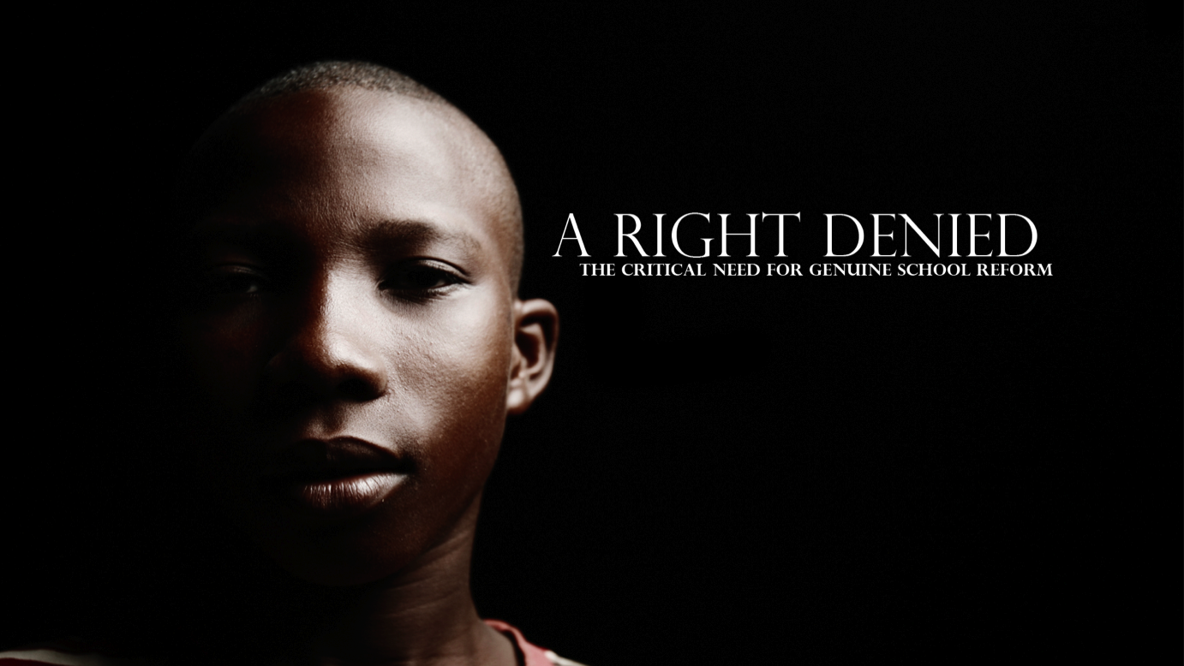
By Whitney Tilson
The full version of this presentation, a documentary of me presenting it, and other resources are posted at www.ARightDenied.org
To be added to my school reform email list, simply email me at wtilson@kasecapital.com
A documentary of Whitney Tilson presenting these slides can be seen at
www.ARightDenied.org
8/2/13

Slide 2



Slide 3
The more you learn, the more you earn.
Over the course of a lifetime, a college grad will earn
more than $1 million more than a high school grad.
Source: U.S. Census Current Population Reports, Series P-60, from Digest of Education Statistics, 2005.

Slide 4
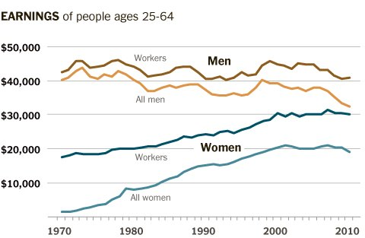
Wages for men have stagnated for 40 years, and for women they’ve stagnated over the past decade.
Median male earnings in 2010 were the same as in 1964 — nearly a half century ago
Note: Adjusted for inflation, in 2010 dollars.
Source: U.S. Census via The Hamilton Project, The Brookings Institution, in NY Times, 10/22/12, http://economix.blogs.nytimes.com/2012/10/22/the-uncomfortable-truth-about-american-wages.

Slide 5
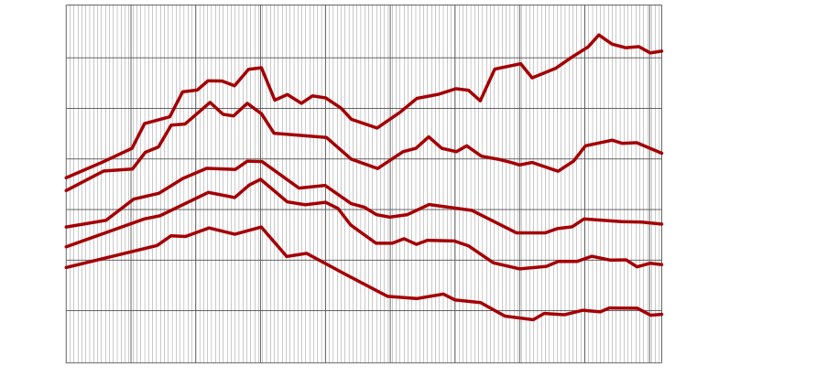
Wage trends are ominous for men without a college degree.
A high school diploma used to be sufficient to have a fair shot at the American dream, but no longer. A college degree is required.
Inflation-adjusted income
Median inflation-adjusted earnings for a man with a high school diploma fell by 41% from 1970-2010
Source: Inherited Opportunity for Higher Education, Association for Institutional Research, 5/16/06.

Slide 6
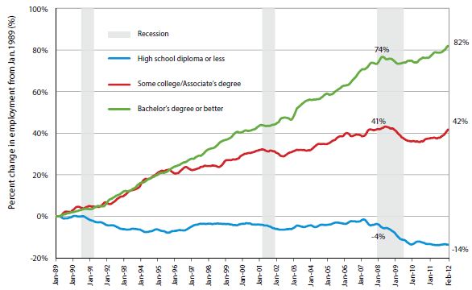
New job trends are ominous for
those without a college degree.
Source: The College Advantage, Georgetown Center on Education and the Workforce, 8/15/12.

Slide 7
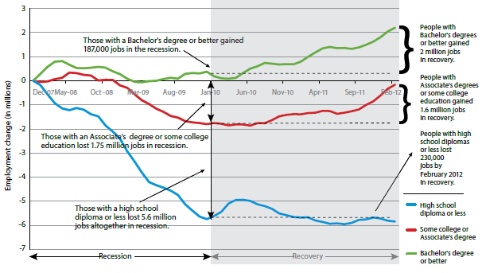
A closer look at job losses during The Great Recession.
Source: The College Advantage, Georgetown Center on Education and the Workforce, 8/15/12.

Slide 8
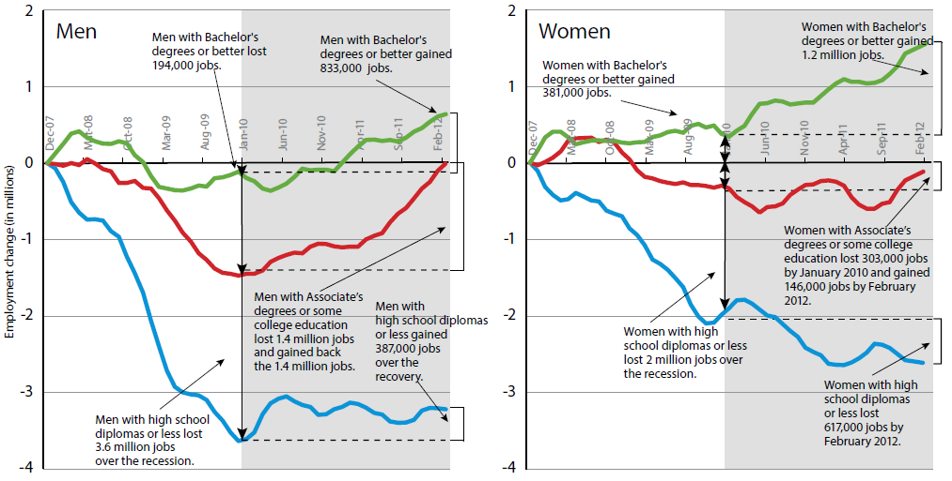
The returns on education (and penalty for lack of education) have been greater for women in recent years.
Source: The College Advantage, Georgetown Center on Education and the Workforce, 8/15/12.

Slide 9
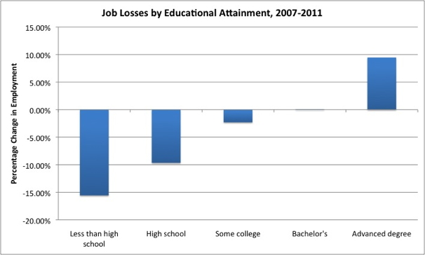
Even a bachelor’s degree isn’t enough.
98.3% of job gains among those with at least a bachelor’s were realized by those with advanced degrees
Source: The State of Working America, Economic Policy Institute, 12th edition, advance release, 8/22/12;
cited: www.washingtonpost.com/blogs/ezra-klein/wp/2012/08/17/education-and-the-recession-continued/

Slide 10
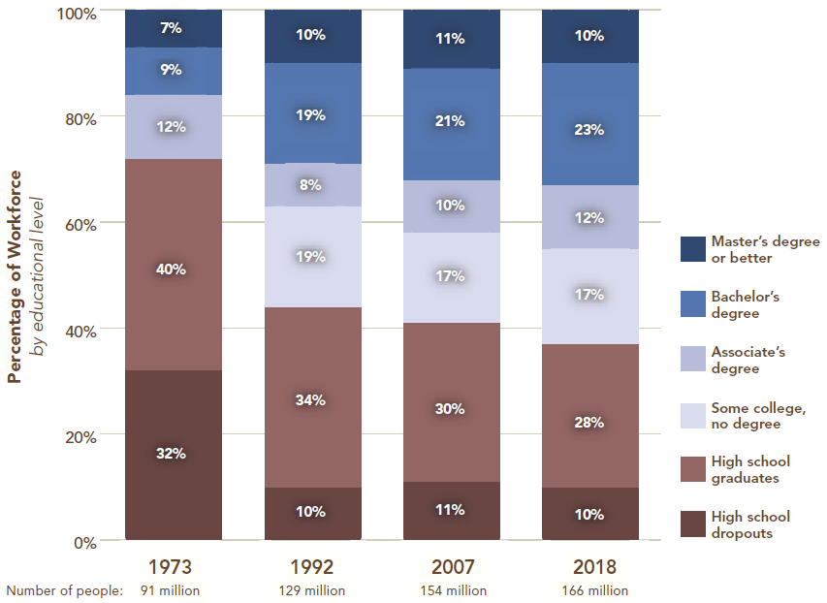
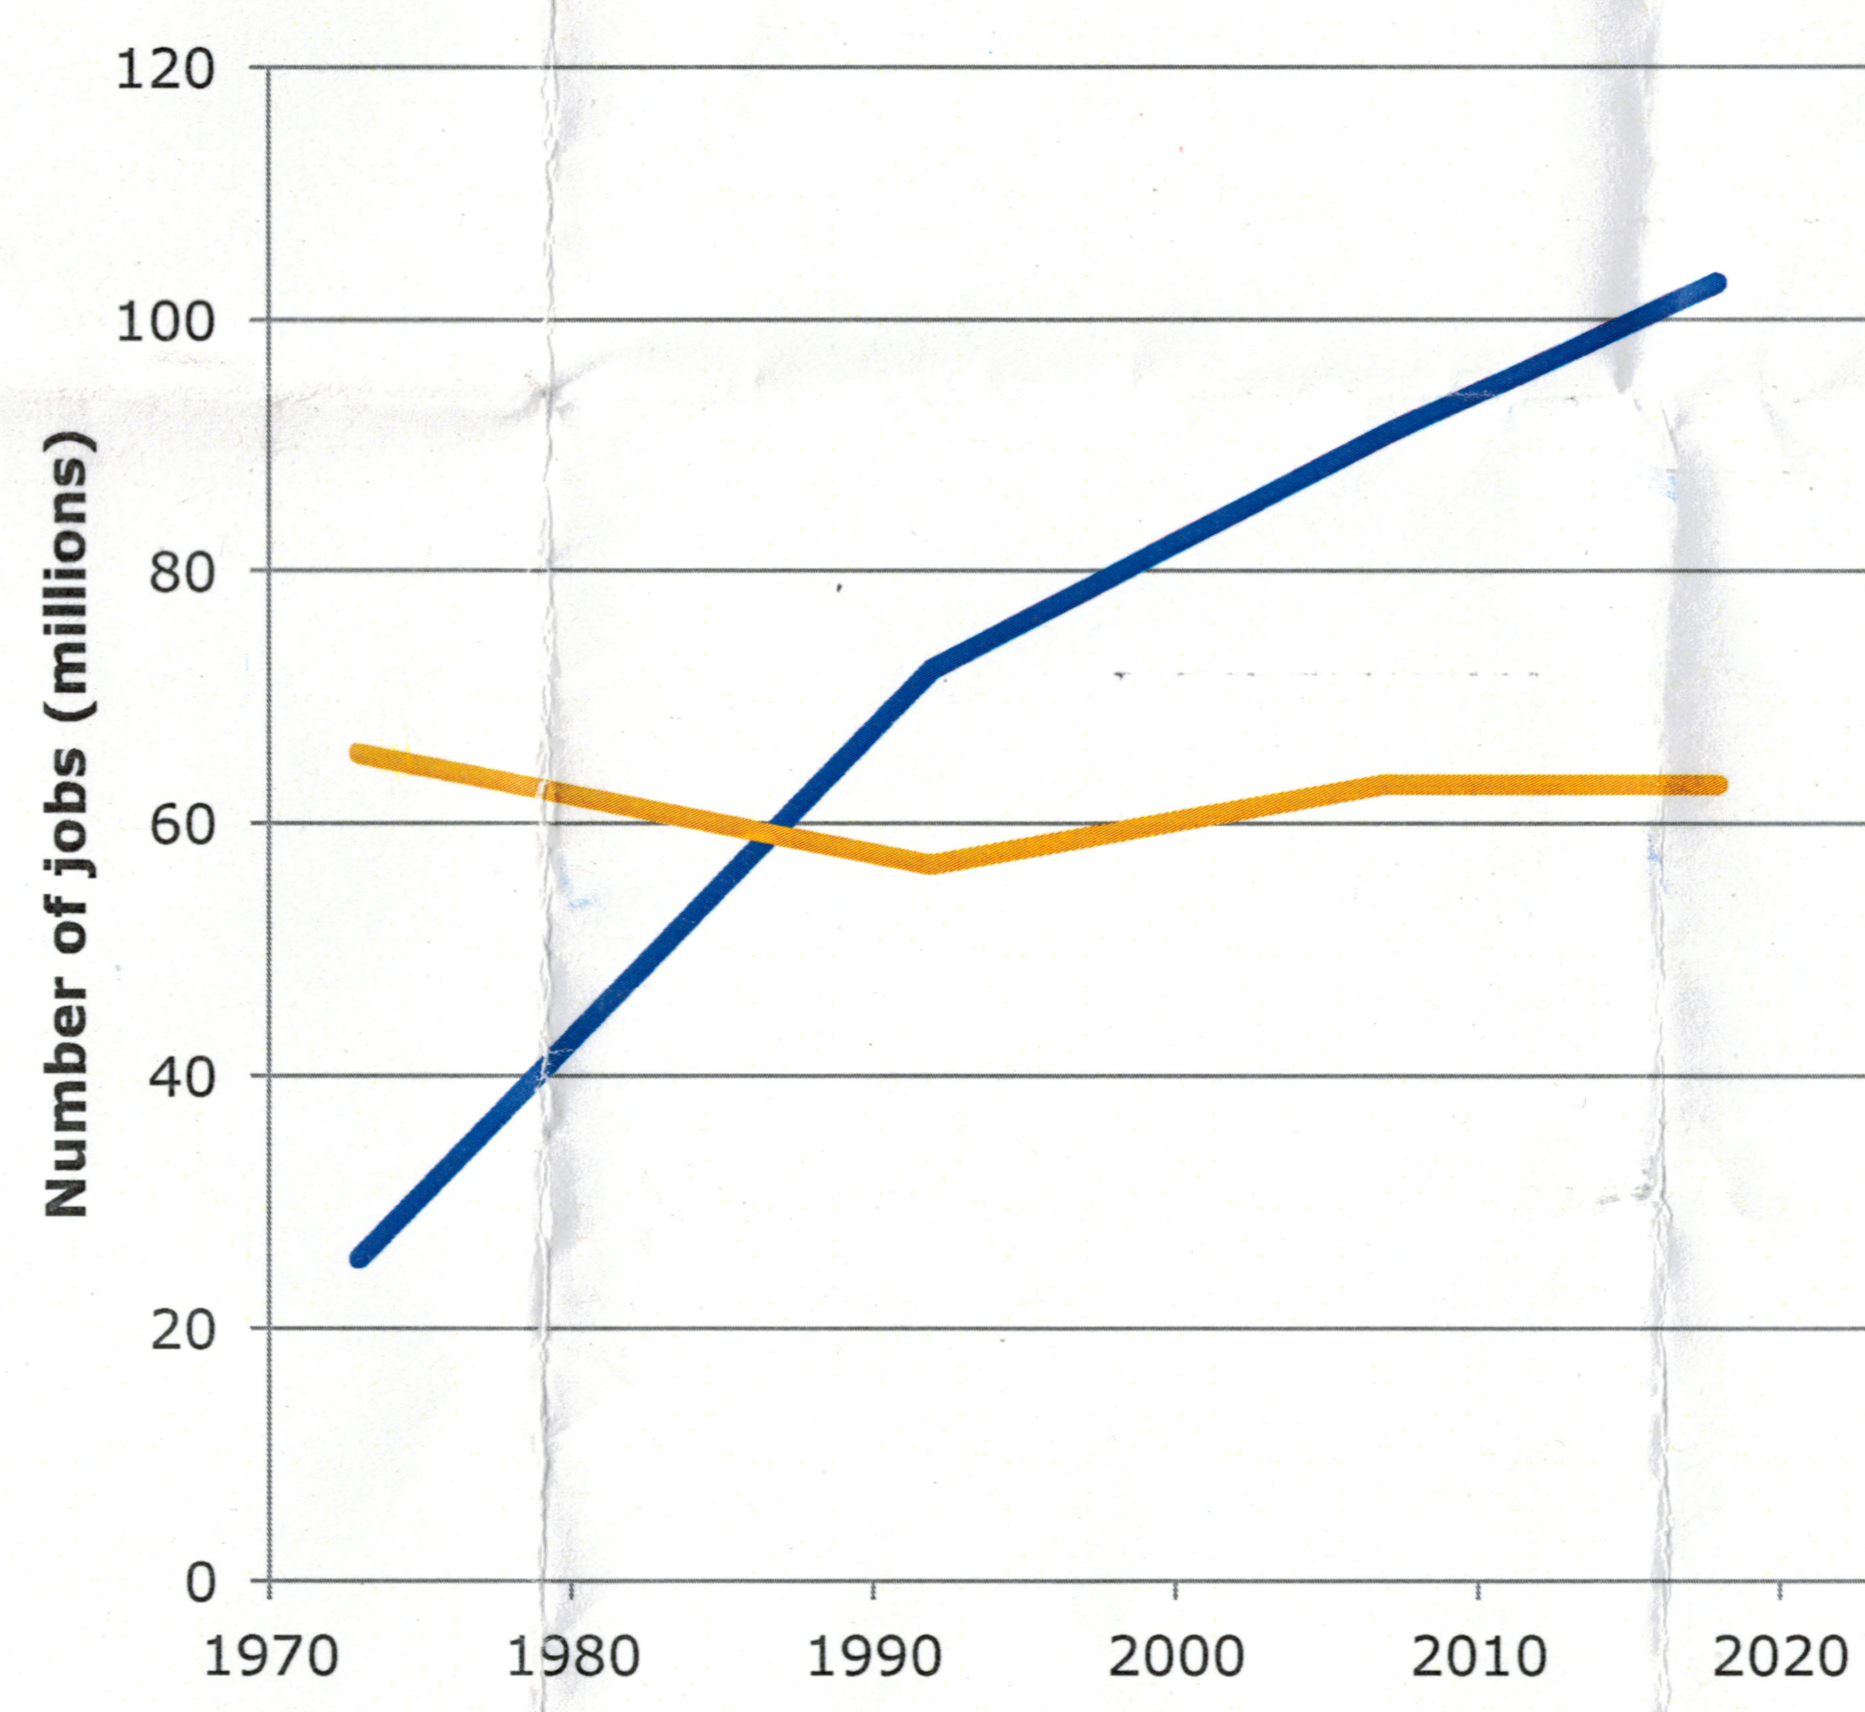
By 2018, 62% of all jobs will require post-secondary credentials vs. only 28% in 1972
.
Require at least some
college training
Require high school
diploma or less
Source: Projections of Jobs and Education Requirements through 2018, Center on Education and the Workforce, 6/10.

Slide 11
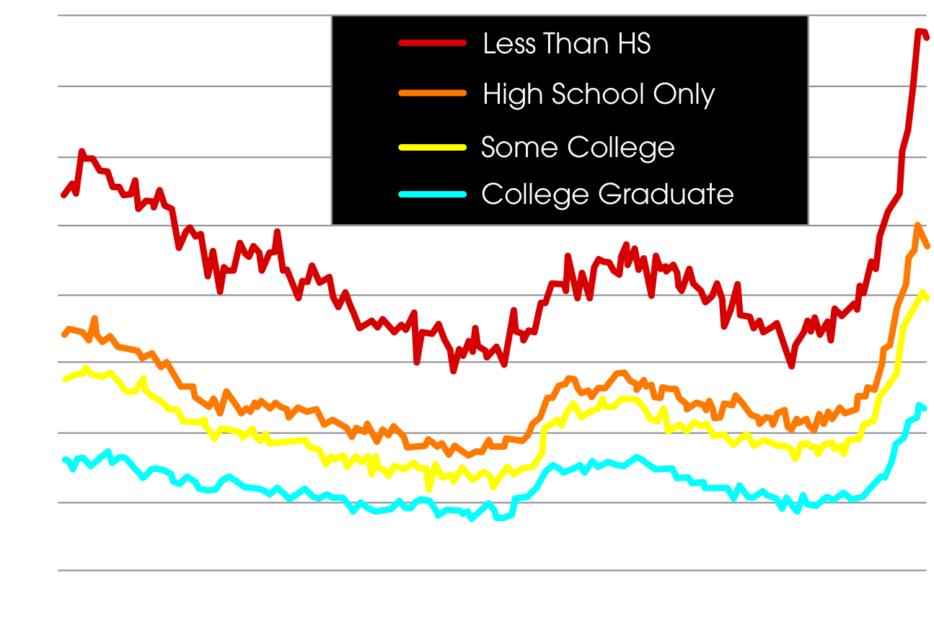
Education is also highly correlated with employment and workforce participation.
High school dropouts today have 3x the unemployment rate of college graduates.
52% of high school dropouts are not in the labor force and an additional 19% are looking for work.
Employed
(29%)
Employed
(56%)
Looking for Work (19%)
Not in
Labor
Force
(52%)
Looking for Work (20%)
Not in
Labor
Force
(24%)
HS Dropouts
HS Completed,
Not Enrolled in College
Source: Bureau of Labor Statistics, November 2010 unemployment data; Current Population Survey (left); Digest of Education Statistics, 2009 (2008 data) (right).

Slide 12
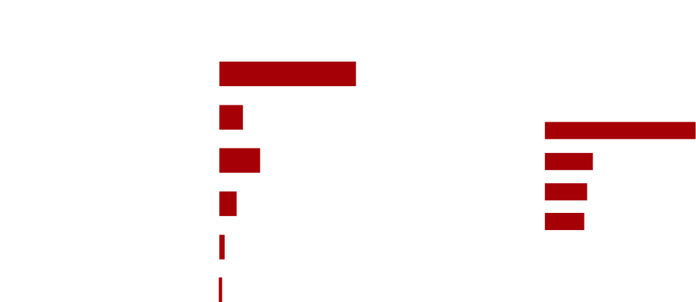
Male high school dropouts were 47 times more likely than a college graduate to be incarcerated.
Black males had the highest incarceration rate.
Source: NY Times, 10/9/09.

Slide 13

A lack of education is literally deadly.
Mortality Rate by Education for Adults 25-64 years:
More Than High School
206.3/100,000
Only High School
477.6/100,000
Less Than High School
650.4/100,000
30% of people in poverty report that their health is poor or fair, almost five times the rate reported by the wealthiest 20% of the population.
Source: Social Policy as Health Policy, Steven H. Woolf, Journal of the American Medical Association, 3/17/09.

Slide 14



Slide 15
Overall K-12 education spending has grown rapidly over time.
Per-pupil spending, adjusted for inflation, has more than quadrupled over the past 50 years to $12,463 in 2006-07.
We spend more per pupil than any country other than Switzerland, Norway and Luxembourg.
Note: Total expenditure per pupil in average daily attendance in constant 2007-08 dollars (total expenditure is the sum of current expenditures allocable to pupil costs, capital outlay, and interest on school debt).
Source: Digest of Education Statistics, 2009.

Slide 16
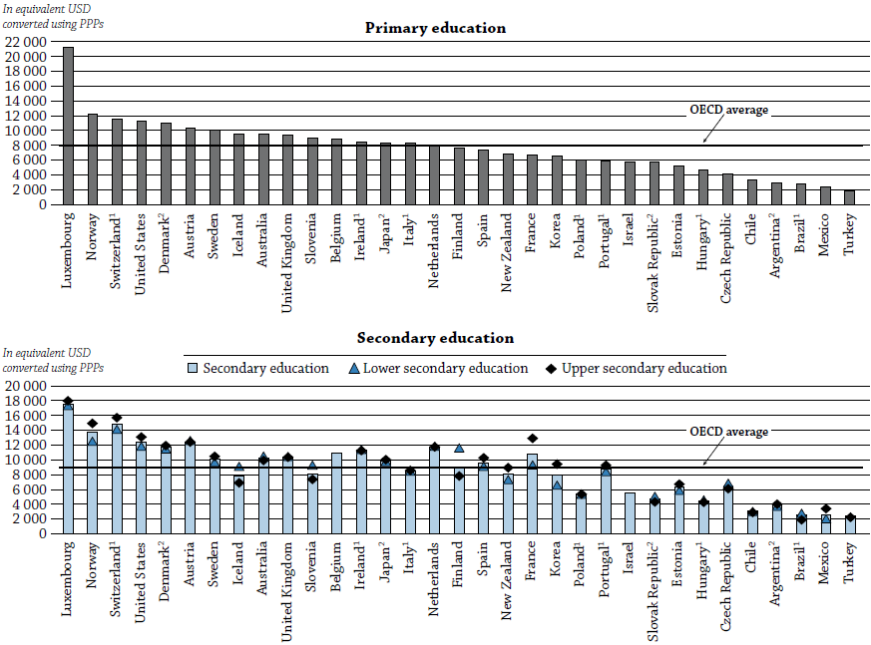
We spend more per pupil than any country other than Switzerland, Norway and Luxembourg
Source: OECD Education at a Glance, 2013, p. 165, www.oecd.org/edu/eag2013%20%28eng%29--FINAL%2020%20June%202013.pdf

Slide 17
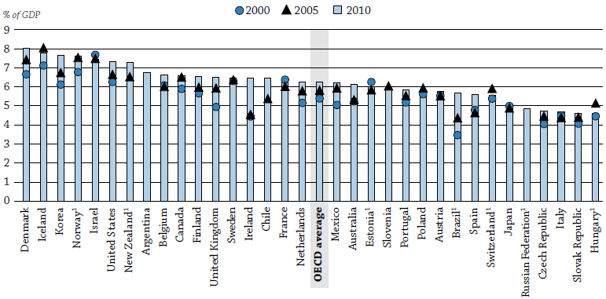
We are also spend more on education as a percentage of our GDP than all but five other countries
Source: OECD Education at a Glance, 2013, p. 182, www.oecd.org/edu/eag2013%20%28eng%29--FINAL%2020%20June%202013.pdf

Slide 18
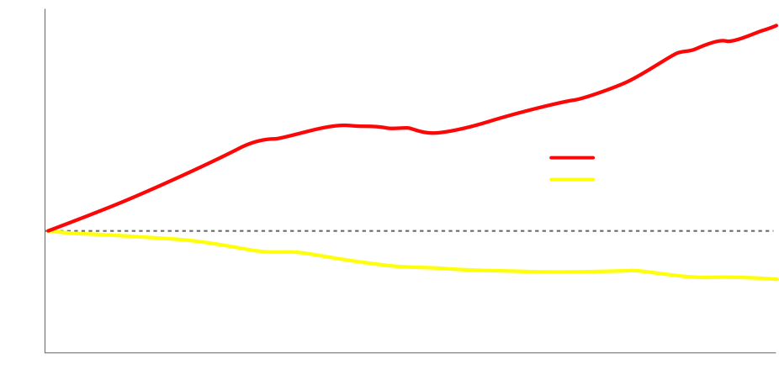
The rise in spending has been driven mainly by a tripling in the number of public school teachers over the past 50 years, which has led to a 43% reduction in the student-teacher ratio.
Note: In addition to 3.25 million public school teachers, there are 456,000 private school teachers in K-12.
Source: Digest of Education Statistics, 2009.

Slide 19
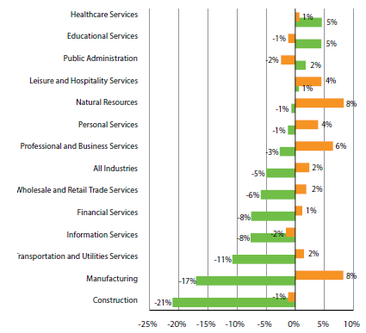

The long-term trend of more and more teachers may be reversing: educational services (teaching) was one of the few professions to gain jobs during The Great Recession – but is also one of the few to lose jobs in the recovery.
Source: The College Advantage, Georgetown Center on Education and the Workforce, 8/15/12.

Slide 20
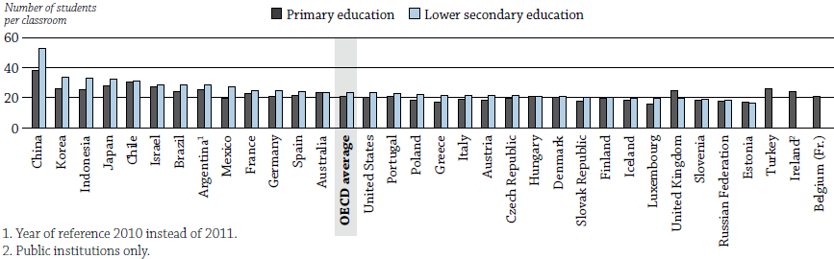
Average class size in the U.S. is slightly below
the OECD average.
Source: OECD Education at a Glance, 2011, p. 366, www.oecd.org/edu/eag2013%20%28eng%29--FINAL%2020%20June%202013.pdf

Slide 21
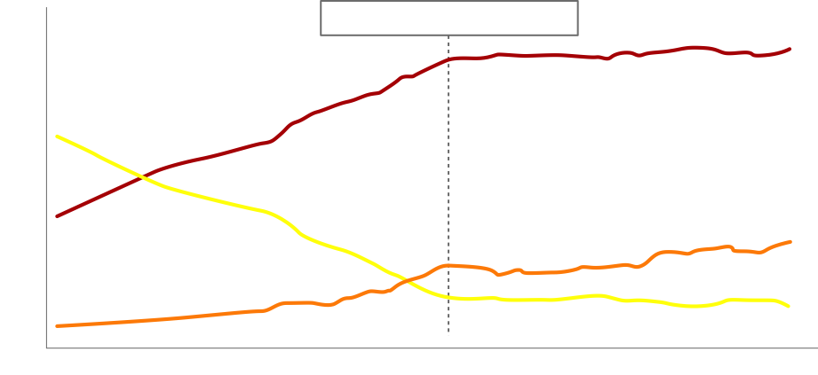
Despite a doubling of spending since the mid-1970s, average educational attainment has stagnated.
Percentage of persons 25-29 years old, by highest level of educational attainment.
Source: Digest of Education Statistics, 2008, pg. 13.

Slide 22
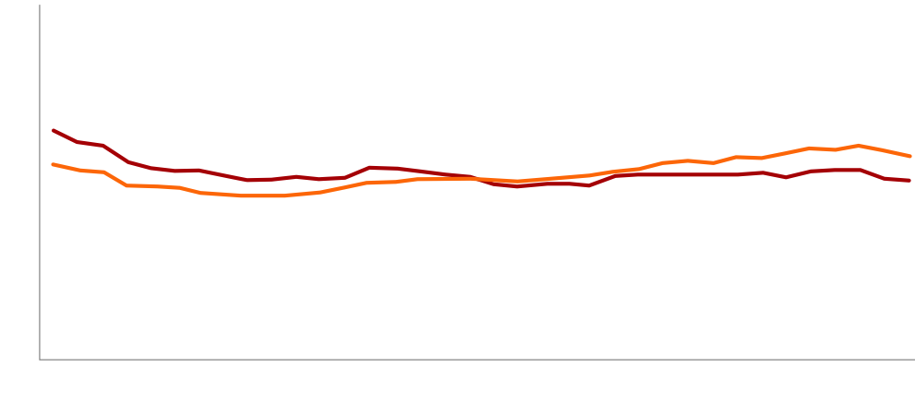
SAT scores haven't budged since the early 1970's.
Source: Wikipedia.

Slide 23
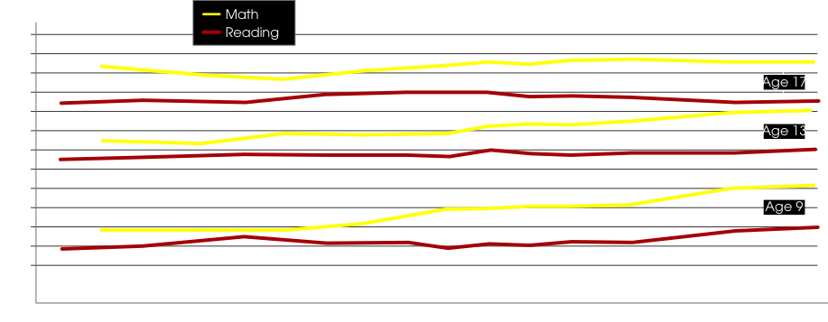
NAEP scores have stagnated as well.
Source: U.S. Department of Education, Institute of Education Sciences, National Center for Education Statistics, National Assessment of Educational Progress (NAEP), various years, 1971–2008 Long-Term Trend Reading Assessments.

Slide 24
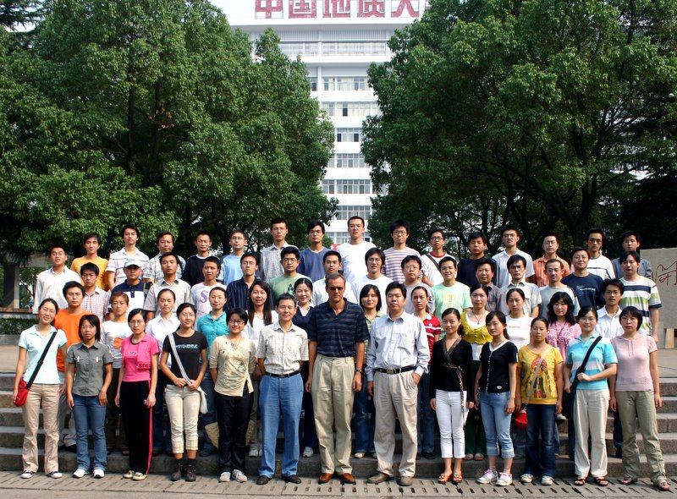

Why hasn't additional money
resulted in improved results?
Teacher quality has been falling rapidly over the past few decades
Our school systems have become more dysfunctional, bureaucratic and unaccountable
As a nation, we have been so rich for so long that we have become lazy and complacent. Our youth are spending more time watching TV, listening to iPods, playing video games (up 25% in recent years), going to sporting events, etc. rather than studying hard. These two pictures capture what's happening in China vs. the U.S.:
37% of American college students have, in the previous two weeks, engaged in binge drinking, defined as drinking five or more drinks in a row
-- University of Michigan study, 2009

Slide 25
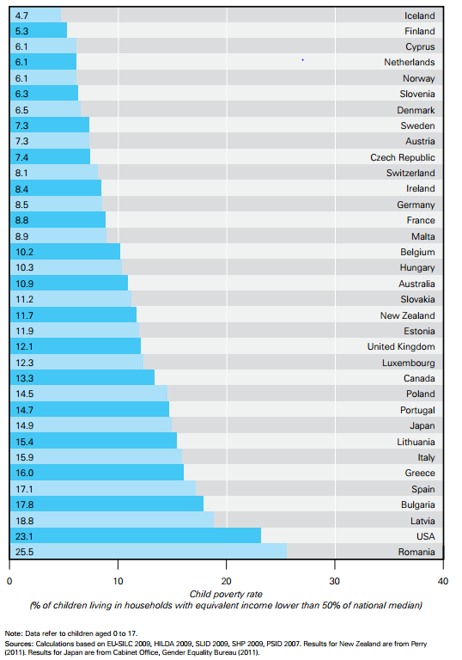
The childhood poverty rate is higher in the U.S. than any other developed country. And it’s particular pervasive among Black (39%) and Hispanic (34%) children.
Note: Poverty here is defined as relative to the national median, not on an absolute basis, so it makes the US rate appear higher.

Slide 26
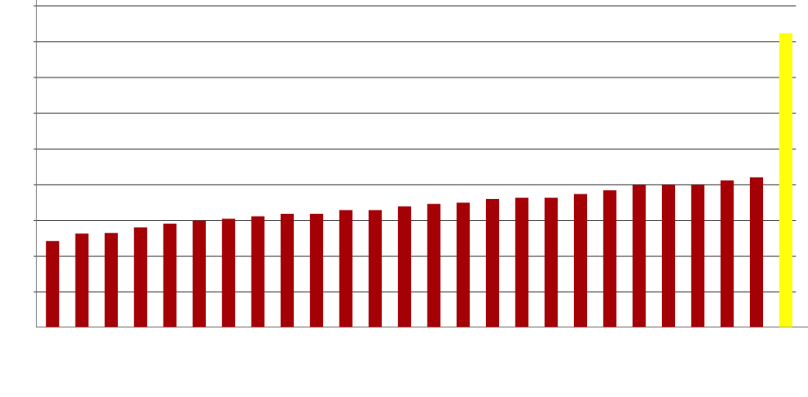
Americans watch more than twice as much TV as any other country.
Hours of TV/Day
Source: OECD Communications Outlook 2009; http://browse.oecdbookshop.org/oecd/pdfs/browseit/9309031E.PDF#page=202.

Slide 27
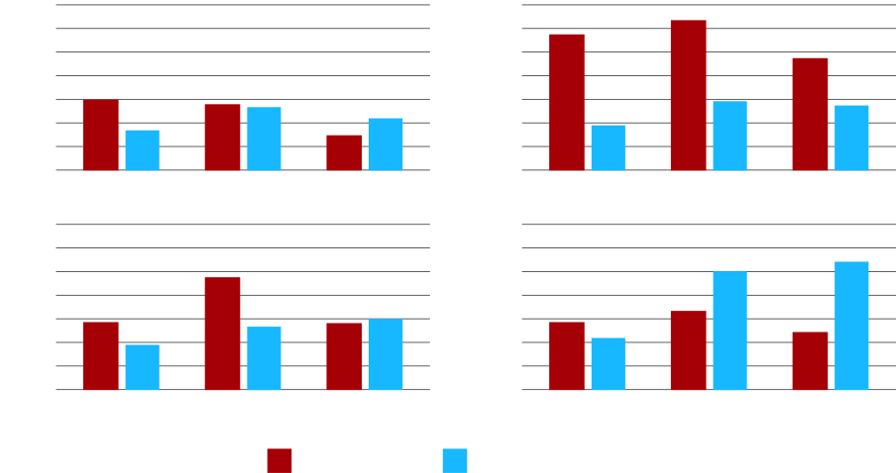
Overall, students at all grade levels are spending far more time watching TV than doing homework.
Source: No Excuses.

Slide 28
Over the past decade, American youth are spending much more time watching TV, listening to music, using a computer and playing video games – a total of 7½ hours every day in front of a screen.
The only thing they're spending less time doing is reading!
Average time spent with each medium in a typical day among 8-18-year-olds
Video games
Print (reading)
TV
Music
Computer
Movies
2009
10:45
2004
8:33
1999
7:29
Half of American teenagers (ages 12 through 17) send 50 or more text messages a day, and one third send more than 100 a day.
In 1960, students at four-year colleges in the U.S. studied 24 hours per week. Today, the average is 14 hours per week, 42% less.
Source: Kaiser Family Foundation, as reported in the NY Times, 1/20/10 (www.nytimes.com/2010/01/20/education/20wired.html); Pew Research Center.

Slide 29
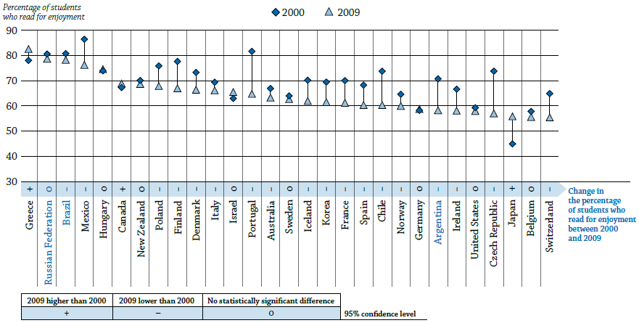
The percentage of U.S. students who read for enjoyment is 25th out of 29 OECD countries
Only 3 of 29 countries showed an increase from 2000 - 2009
Note: Countries are ranked in descending order of the percentage of students who read for enjoyment in 2009.
Source: OECD Education at a Glance, 2011, p. 107, www.oecd.org/dataoecd/61/2/48631582.pdf.

Slide 30



Slide 31
Our 15-year-olds trail most other OECD countries in reading, math and science.
Reading
Math
Science
The U.S. ranks 27th out of 29 wealthy countries in the proportion of college students with degrees in science or engineering
The U.S. 48th out of 133 developed and developing nations in quality of math and science instruction
In American graduate schools, nearly half of students studying the sciences are foreigners
#16
#23
#31
Avg: 493
Avg: 496
Avg: 501
Source: PISA 2009.

Slide 32
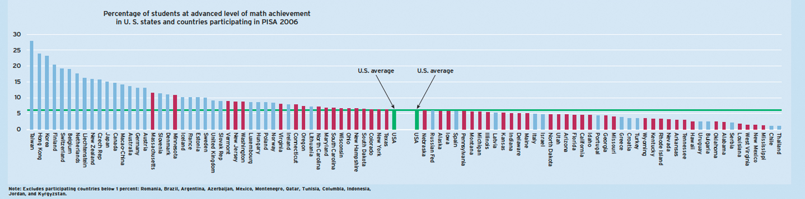
The U.S. ranks 29th in the world in the percentage of students at the advanced level in math.
Even our #1 state, Massachusetts, is ranked 15th
Source: NAEP and OECD data, in Teaching Math to the Talented, Eric A. Hanushek, Paul E. Peterson and Ludger Woessmann, Education Next, Winter 2010

Slide 33
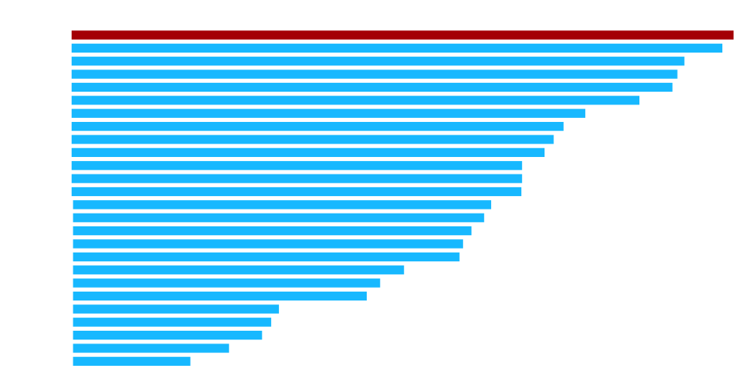
We get very little bang for our education buck.
Source: National Center for Education Statistics; US Census Bureau; OECD; GovernmentSpending.com; McKinsey analysis;
Appeared in The Economic Impact of the Achievement Gap in America's Schools, McKinsey & Co., 4/09.

Slide 34
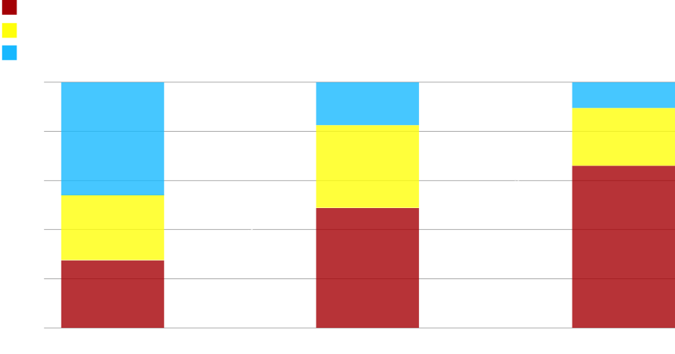
Our relative performance is weak and declines dramatically the longer our students are in school.
Math Performance
Source: NCES 1999-081R, Highlights From TIMSS. Slide courtesy of Education Trust.

Slide 35
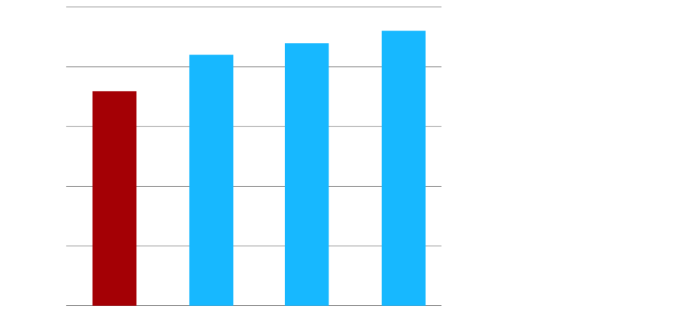
U.S. students go to school fewer hours per day and fewer days per year than students in Asia.
Source: Business Week, James P. Lenfestey.

Slide 36
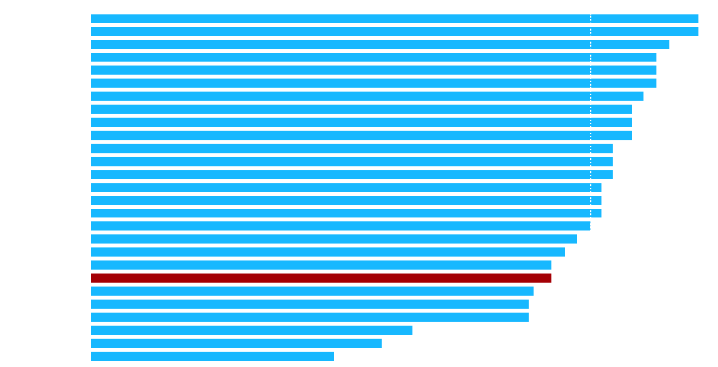
Our high school graduation rate
lags nearly all other OECD countries.
Source: OECD, Education at a Glance, 2007; 2005 data; Appeared in The Economic Impact of the Achievement Gap in America's Schools, McKinsey & Co., 4/09.

Slide 37
The U.S. is among the leaders in college participation but ranks 16th – in the bottom half – in college completion.
We only earn ½ a degree per college student, whereas in Portugal, for example, it's 1:1.
Source: National Report Card on Higher Education, http://measuringup.highereducation.org.

Slide 38
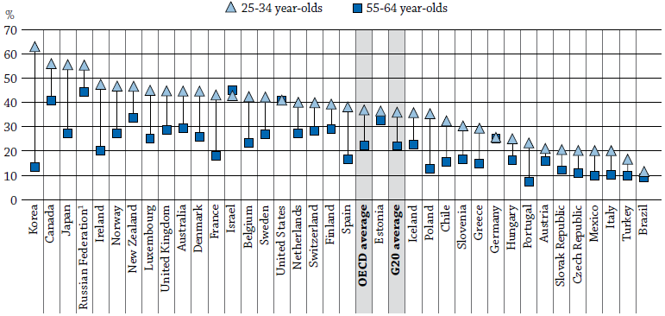
Our college completion rate has stagnated,
allowing our economic competitors to pass us.
Of 36 OECD countries, the U.S. has dropped from 4th in the world to tied for 12th
Note: Countries are ranked in descending order of the percentage of 25-34 year-olds who have attained tertiary education (i.e., earned at least a two-year college degree).
Source: This chart is from the 2011 OECD Education at a Glance (p. 30, www.oecd.org/dataoecd/61/2/48631582.pdf), but in the 2013 OECD Education at a Glance (which didn’t have a chart), the U.S. rose to 43% among 25-34-year-olds, up from 41% among 55-64-year-olds, making the U.S. tied with Sweden and France for 12th among 34 OECD countries (plus Brazil and Russia) for 25-34-year olds.

Slide 39
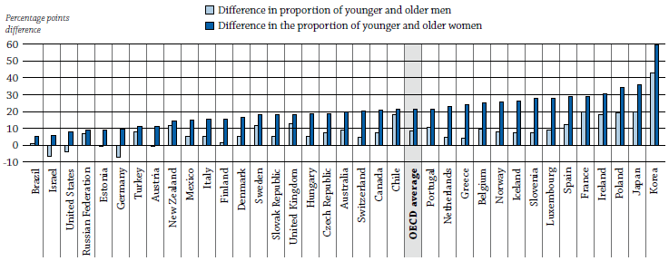
Nearly every other country has made greater gains than we have over the past 30 years.
The college completion rate among American men has actually declined!
Notes: Countries are ranked in ascending order of the difference in the proportion of 25-34 year-old women and 55-64 year-old women with tertiary education.
Israel and Germany are special cases. The data for the former is skewed by nearly 1 million Russian Jews, most of whom have college degrees, who immigrated to Israel. Excluding these immigrants, Israel would have shown gains. As for Germany, most students, rather than earning college degrees, enter career training schools where they learn specialized skills that help make Germany a manufacturing and export powerhouse.
Source: OECD Education at a Glance, 2013, p. 33, www.oecd.org/edu/eag2013%20%28eng%29--FINAL%2020%20June%202013.pdf

Slide 40
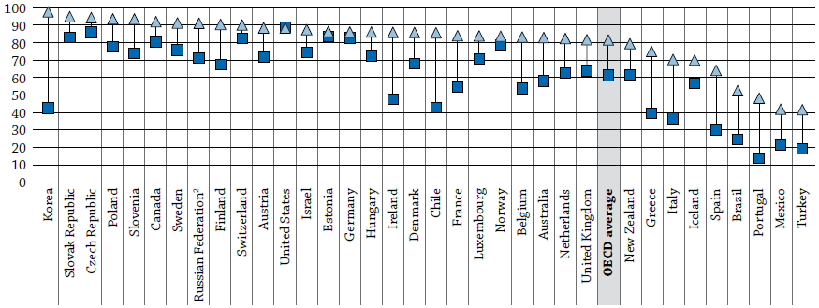
The story is similar for high school graduates.
Of 35 OECD countries, the U.S. has dropped from 1st in the world to 12th and is the only country to show no gain in the past 30 years
Note: Countries are ranked in descending order of the percentage of 25-34 year-olds who have completed “upper secondary” education (i.e., high school, presumably including GED in the U.S.).
Source: OECD Education at a Glance, 2011, p. 32, www.oecd.org/dataoecd/61/2/48631582.pdf.

Slide 41
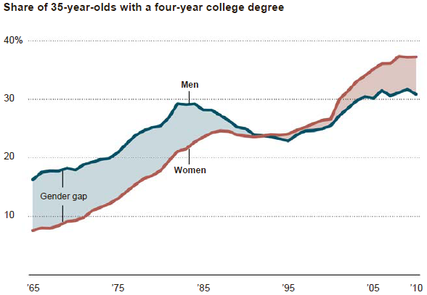
American women are the only reason we’re not falling much further behind
The percentage of men earning a college degree has stagnated for the last 30+ years, while women continue to make steady gains
Note: Adjusted for inflation, in 2010 dollars.
Sources: Left chart: http://nces.ed.gov/programs/digest/d12/tables/dt12_009.asp in NY Times, 6/12/13, www.nytimes.com/2013/06/13/education/a-sharp-rise-in-americans-with-college-degrees.html; right chart: "Wayward Sons: The Emerging Gender Gap in Labor Markets and Education," David Autor and Melanie Wasserman, in NY Times, 3/20/13, www.nytimes.com/2013/03/21/business/economy/as-men-lose-economic-ground-clues-in-the-family.html.

Slide 42
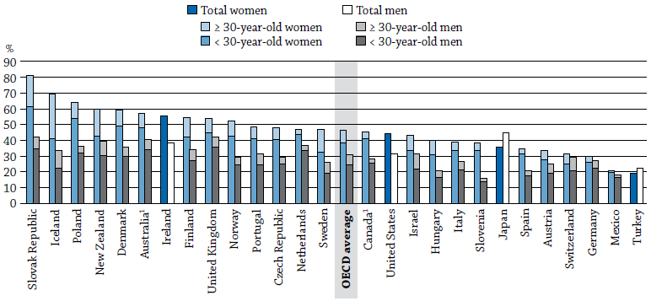
It’s not just the U.S. – women are earning college degrees at a higher rate than men in every OECD country except Japan and Turkey
Note: Countries are ranked in descending order of women’s graduation rates from tertiary-type A education in 2009.
Source: OECD Education at a Glance, 2011, p. 60, www.oecd.org/dataoecd/61/2/48631582.pdf.

Slide 43
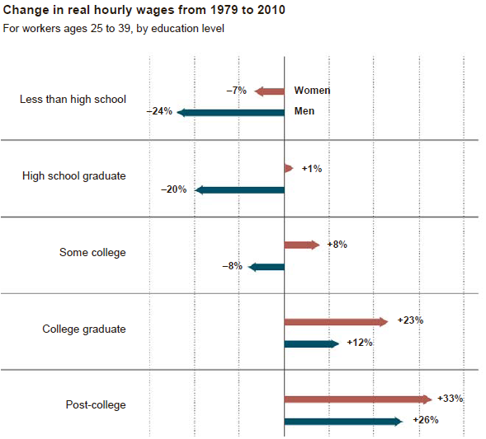
The higher educational attainment of women is translating into higher earnings
Young women’s earnings outpaced young men’s from 1979 to 2010 at every education level
Source: "Wayward Sons: The Emerging Gender Gap in Labor Markets and Education," David Autor and Melanie Wasserman, in NY Times, 3/20/13, www.nytimes.com/2013/03/21/business/economy/as-men-lose-economic-ground-clues-in-the-family.html.

Slide 44
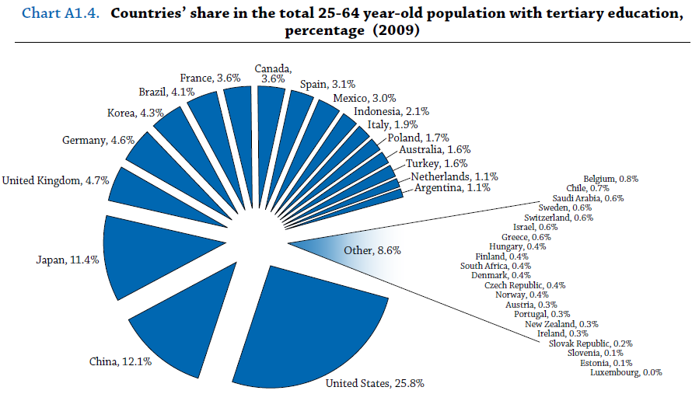
The U.S. still maintains an absolute advantage in the number of adults with college degrees
Note: Countries are ranked in descending order of the percentage of 25-34 year-olds who have completed “upper secondary” education (i.e., high school, presumably including GED in the U.S.).
Source: OECD Education at a Glance, 2011, p. 32, www.oecd.org/dataoecd/61/2/48631582.pdf; China data: “The Race That Really Matters: Comparing U.S., Chinese and Indian Investments in the Next Generation Workforce”, Center for American Progress and the Center for the Next Generation, 8/12.

Slide 45
But the U.S. advantage is fading:
By 2030, China will have 200 million college graduates — more than the entire U.S. work force
Source: UNESCO (degrees, enrollment); China finance ministry, via CEIC Data (spending); appeared in The New York Times, 1/16/13, www.nytimes.com/2013/01/17/business/chinas-ambitious-goal-for-boom-in-college-graduates.html.

Slide 46

American students score highly in only one area relative to their international peers: self-confidence.
Source: OECD.

Slide 47



Slide 48
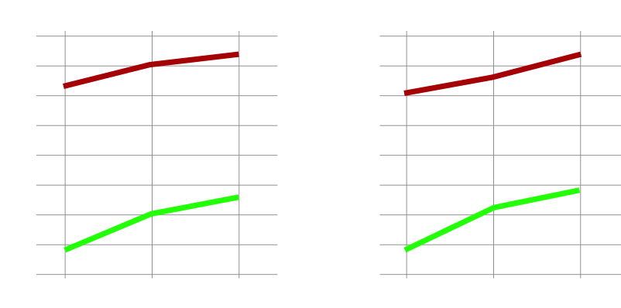
The Black-white achievement gap is one year in kindergarten, which can be explained entirely by demographic factors, and begins widening immediately.
Note: In the figures above, the Raw Gap represents the actual difference in test scores between Black students and white students. The Adjusted Gap represents the remaining inter-ethnic test-score gap after adjusting the data for the influence of students' background characteristics. Adjusted results control for socioeconomic status, number of books in the home, gender, age, birth weight, WIC participation, and mother's age at birth of first child. All adjusted gaps are statistically significant at the .05 level. Where the results indicate that the gap is negative, Black children with similar characteristics actually score higher than their white counterparts.
Source: Authors' calculations based on data from the Early Childhood Longitudinal Study Kindergarten Cohort (1998), U.S. Department of Education, appeared in Falling Behind, Fryer & Levitt, Education Next, Fall 2004.

Slide 49

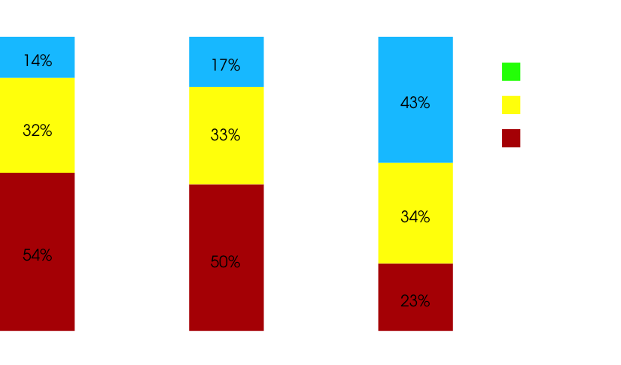
By 4th grade, the majority of Black and Latino students struggle to read a simple children's book. This has devastating consequences for their future.
16%
/Advanced
42%
32%
Up until the end of third grade, most children are learning to read. Beginning in 4th grade, they are reading to learn.
Up to half of the printed fourth-grade curriculum is incomprehensible to students who read below that grade level.
High school graduation, can be predicted with reasonable accuracy by knowing someone's reading skill at the end of third grade. A person who is not at least a modestly skilled reader by that time is unlikely to graduate from high school.
36%
52%
51%
22%
Source: 2009 data, National Center for Education Statistics, NAEP Data Explorer, http://nces.ed.gov/nationsreportcard/nde; Early Warning! Why Reading by the End of Third Grade Matters (Annie E. Casey Foundation).

Slide 50

The achievement gap widens every year.
Source: US DOE, NCES, National Assessment of Educational Progress (NAEP) Summary Data Tables, data for public schools;
Appeared in The Economic Impact of the Achievement Gap in America's Schools, McKinsey & Co., 4/09.

Slide 51
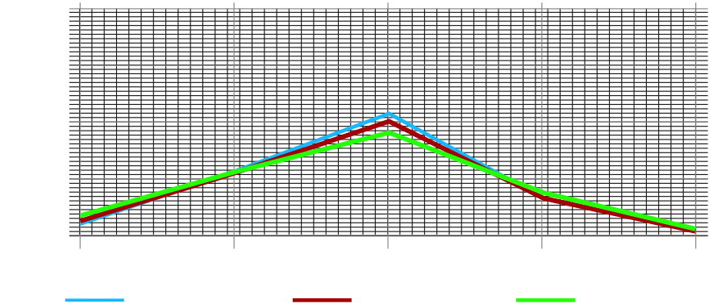
Black and Latino 12th graders read and do math at the same level as white 8th graders.
Source: NAEP 2005 data. Slide courtesy of Ed Trust.

Slide 52
The U.S. overall is 15th in the world on the PISA reading test for 15-year olds. U.S. Asian girls are #1 while Black boys are last, trailing Mexico.
U.S. Asian girls #1 in the world
U.S. girls #8 in the world
U.S. boys #23 in the world
U.S. Hispanic boys
#34 in the world
U.S. Black boys
#36 in the world
Source: 2009 PISA results.

Slide 53
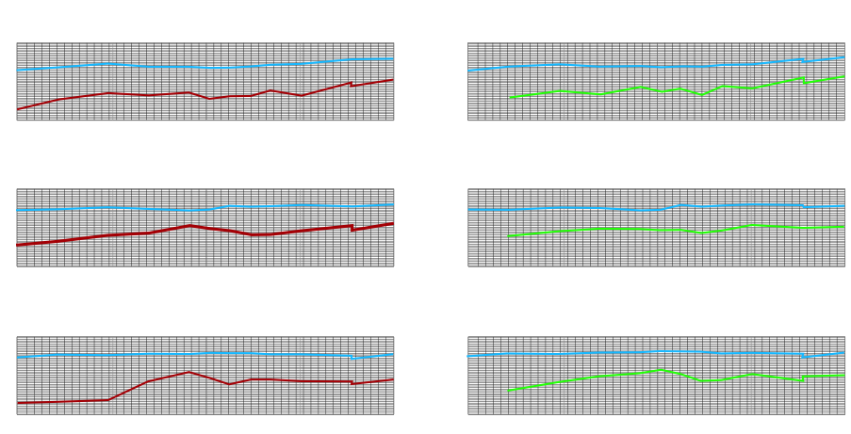
Over the past 20 years, the achievement gaps
in reading have remained persistently wide.
Source: NAEP 2008 Trends in Academic Progress.

Slide 54
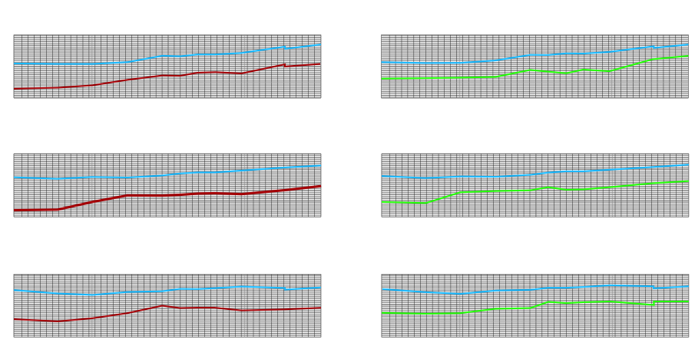
In the past 18 years, the achievement gaps in math have remained persistently wide as well.
Source: NAEP 2008 Trends in Academic Progress.

Slide 55
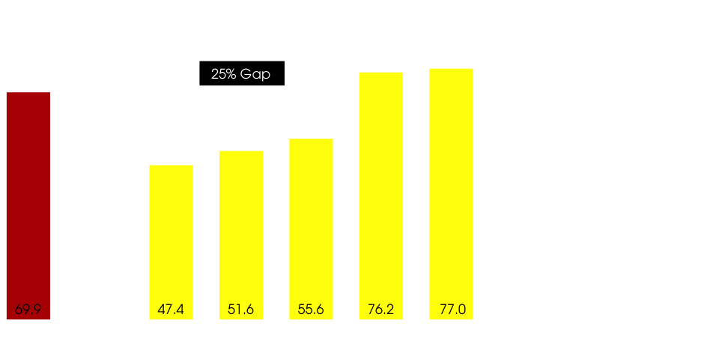
There are large racial gaps in high school graduation rates.
As bad as these numbers are, they're far worse in many cities. The Black male dropout rate is 80% in Indianapolis and Detroit, 69% in Baltimore and Buffalo, and 66% in Atlanta and Cleveland.
In addition, graduating from high school does not mean that a student is college ready. In New York state, for example, the reported graduation rate is 77%, but only 41% are college ready.
Note: College ready in NYS is defined as a score 80 or better on the math Regents exam and 75 or better on the English Regents exam.
Source: The Graduation Project, 2006.

Slide 56
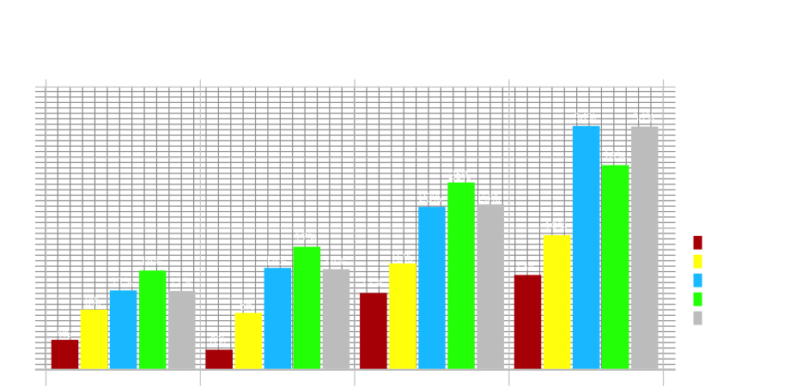
Some cities do a better (or less bad) job than others: Even after adjusting for parental education, the achievement gap varies widely among cities.
Source: USDOE, NCES, National Assessment of Educational Progress (NAEP) data, 2007.

Slide 57
In summary, Black and Latino children start school one year
behind and fall further behind every year.
But KIPP and other high-performing (mostly charter) schools reverse this trend.
KIPP students
Note: The entire gap achievement gap in kindergarten can be explained by the following background characteristics: socioeconomic status, number of books in the home, gender, age, birth weight, WIC participation, and mother's age at birth of first child. The widening of the gap cannot be explained by a change in background characteristics.
Sources: Previous slides, KIPP data, Whitney Tilson estimates.

Slide 58
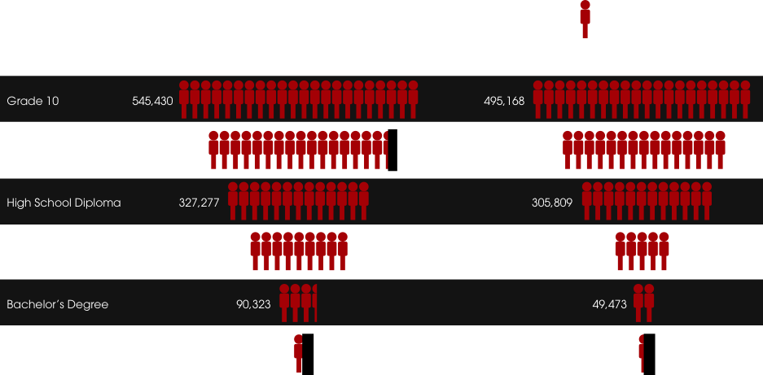
Few Black and Latino students make it to college and even fewer graduate.
Black
Latino
Sources: U.S. Dept. of Education, National Center for Education Statistics, Common Core of Data, State-level Enrollment and Degree Attainment Data. U.S. Census Bureau, 2003 Current Population Survey, Educational Attainment in the United States, June 2004. Slide courtesy of Education Trust.

Slide 59
Only 56% of students who begin a four-year college ever earn a degree – and there are vast differences among ethnicities
National average: 56.1%
Source: U.S. Census Bureau, Current Population Survey, 2010.

Slide 60
Only 42% of students who begin a two-year college ever earn a degree – and, again, there are vast differences among ethnicities
National average: 41.6%
Source: U.S. Census Bureau, Current Population Survey, 2010.

Slide 61
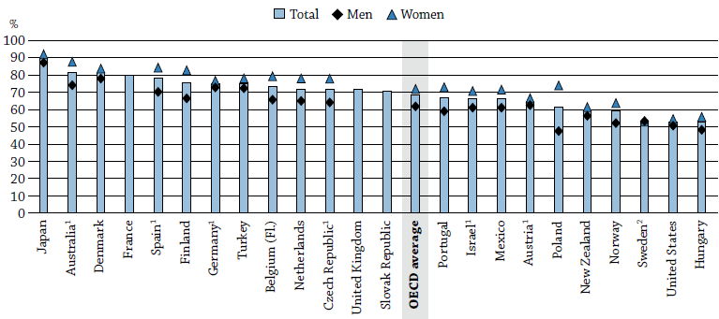
Our overall college success rate – barely above 50% – is among the worst in the developed world
Note: Countries are ranked in descending order of the proportion of students who graduate from tertiary education with at least a first degree.
Source: OECD Education at a Glance, 2013, p. 64, www.oecd.org/edu/eag2013%20%28eng%29--FINAL%2020%20June%202013.pdf

Slide 62
In New York State, of those in 9th grade in 2002, only 13% of Black and Hispanic males and 7% of English Language Learners were in their second year of college six years later.
Other (excl. other 3 categories)
All students
Students with disabilities
Black and Hispanic males
English Language Learners
Source: NYS data, 2010.

Slide 63
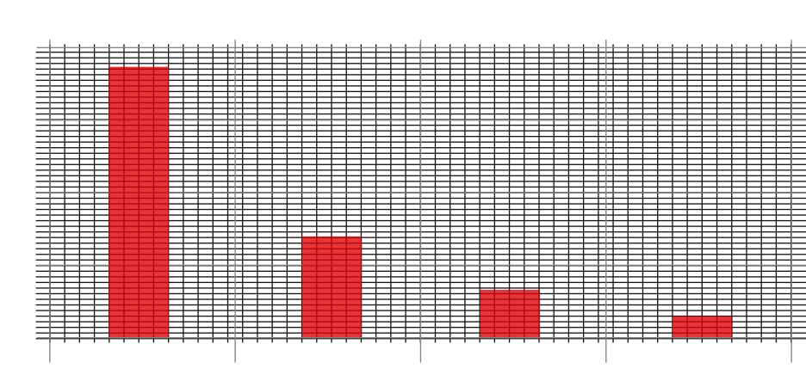
Very few children from low-income households are graduating from any four-year colleges.
Notes: 2003 data. Household income limits: Top quartile: $95,040+; 2nd quartile: $62,628-$95,040; 3rd quartile: $35,901-$62,628; Bottom quartile: <$35,901.
Source: www.postsecondary.org/archives/Reports/Spreadsheets/DegreeBy24.htm.

Slide 64
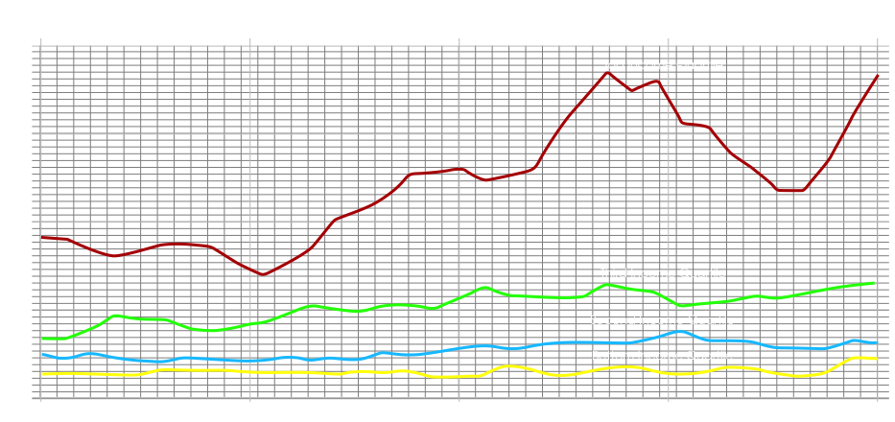
Very few children from low-income households are graduating from any four-year colleges… and there has been little improvement over the past 40 years.
Top Income Quartile
Second Income Quartile
Third Income Quartile
Bottom Income Quartile
Source: Inherited Opportunity for Higher Education, Association for Institutional Research, 5/16/06.

Slide 65
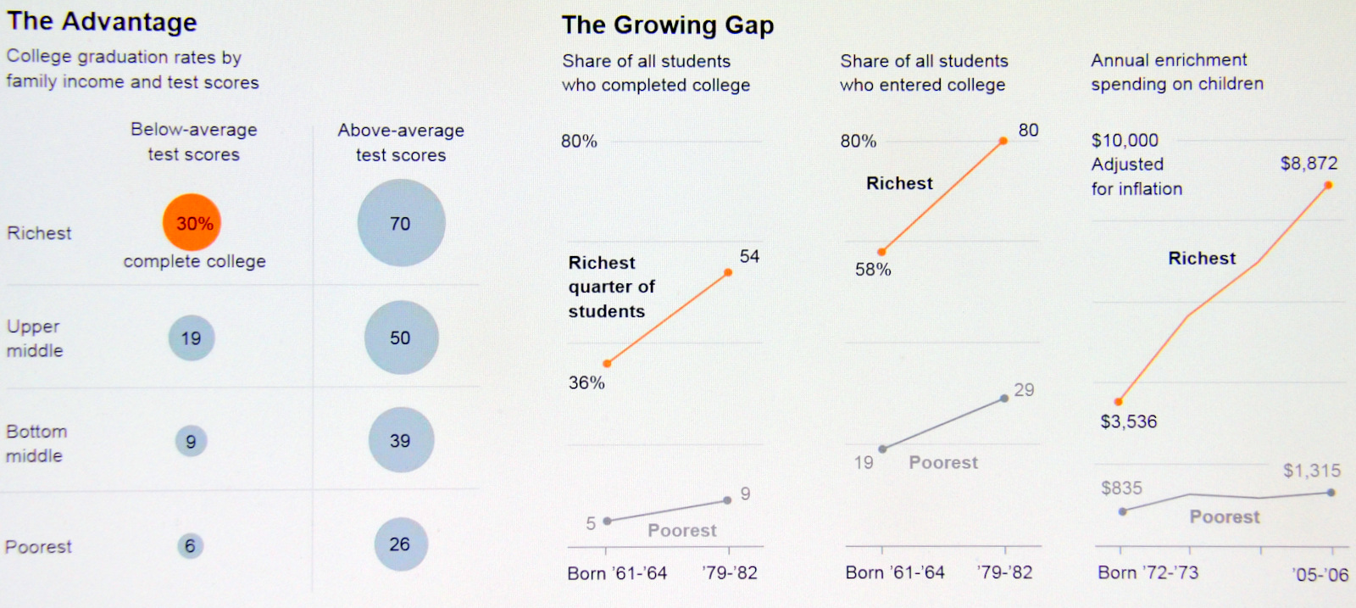
The wealthiest families are spending more and more on educational enrichment for their children, which is an important contributor to higher college completion rates
32%
drop out
69%
drop out
Sources: Sources: College graduation rates by family income and test scores: analysis of the National Education Longitudinal Study of 1988 by Matthew M. Chingos, Brookings Institution; share of students who enter and complete college: analysis of National Longitudinal Survey of Youth, 1979 and 1997 by Susan Dynarski and Martha Bailey, University of Michigan, in “Whither Opportunity: Rising Inequality, Schools, and Children’s Life Chances,” edited by Greg J. Duncan and Richard J. Murnane;” enrichment spending: Greg J. Duncan and Richard J. Murnane, “Whither Opportunity.”; chart appeared in: For Poor, Leap to College Often Ends in a Hard Fall, the NY Times, 12/22/12, www.nytimes.com/2012/12/23/education/poor-students-struggle-as-class-plays-a-greater-role-in-success.html.

Slide 66
Wealthy children with below-average test scores are more likely to earn a college degree than poor children with above-average test scores
Sources: Sources: College graduation rates by family income and test scores: analysis of the National Education Longitudinal Study of 1988 by Matthew M. Chingos, Brookings Institution; share of students who enter and complete college: analysis of National Longitudinal Survey of Youth, 1979 and 1997 by Susan Dynarski and Martha Bailey, University of Michigan, in “Whither Opportunity: Rising Inequality, Schools, and Children’s Life Chances,” edited by Greg J. Duncan and Richard J. Murnane;” enrichment spending: Greg J. Duncan and Richard J. Murnane, “Whither Opportunity.”; chart appeared in: For Poor, Leap to College Often Ends in a Hard Fall, the NY Times, 12/22/12, www.nytimes.com/2012/12/23/education/poor-students-struggle-as-class-plays-a-greater-role-in-success.html.

Slide 67
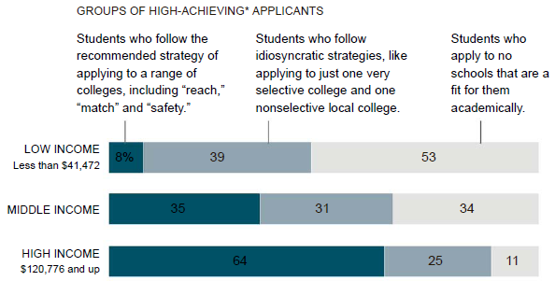
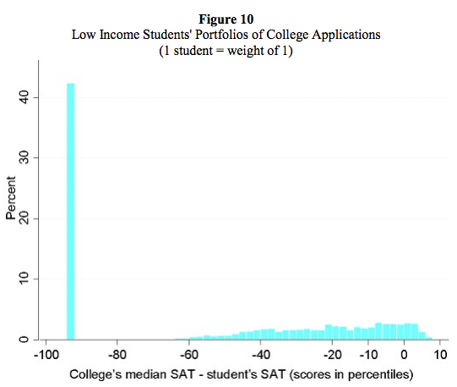

Poor kids are not attending the schools they should
Their college application patterns are illogical, demonstrating that they are getting bad advice – which leads to a terrible problem of “undermatching”
Where students would be
expected to go to college
Reach
schools
Safety
schools
This makes no sense
Source: The Missing “One-Offs”: The Hidden Supply of High-Achieving, Low Income Students, Hoxby and Avery, www.brookings.edu/~/media/Projects/BPEA/Spring%202013/2013a_hoxby.pdf, cited in How elite universities are killing the American dream, Matthew O'Brien, The Atlantic, 6/19/13, http://qz.com/95845/how-elite-universities-are-killing-the-american-dream; and How Top Students of Different Incomes Apply for
College, NY Times, 3/16/13, http://www.nytimes.com/interactive/2013/03/17/education/How-Top-Students-of-Different-Incomes-Apply-for-College.html.

Slide 68

There is very low social mobility in the U.S.
Rich kids without a college degree are 2.5 times more likely to end up rich than poor kids who do graduate from college.
Source: Pew Economic Mobility Project, www.pewstates.org/uploadedFiles/PCS_Assets/2012/Pursuing_American_Dream.pdf, cited in How elite universities are killing the American dream, Matthew O'Brien, The Atlantic, 6/19/13, http://qz.com/95845/how-elite-universities-are-killing-the-american-dream

Slide 69
Children from low-income households are falling by the wayside at every step of the educational ladder.
Source: Bill & Melinda Gates Foundation, J.P. Morgan Summit on U.S. Education, 2010.

Slide 70

74% of students at elite colleges are from top quartile households and only 9% are from bottom half households.
Notes: Elite colleges are the 146 most selective, as determined by Barron's: Profiles of American Colleges, 24th ed.
Source: Socioeconomic Status, Race/Ethnicity, and Selective College Admissions, Carnevale & Rose, Century Foundation.

Slide 71

The dearth of low-income students in college is in part due to the rising cost.
Source: National Report Card on Higher Education, http://measuringup.highereducation.org.

Slide 72

The cost of higher education in the U.S. is far higher than in any other country, more than double the OECD average.
Note: Countries are ranked in descending order of expenditure per student by educational institutions in primary education.
Source: OECD Education at a Glance, 2013, p. 165, www.oecd.org/edu/eag2013%20%28eng%29--FINAL%2020%20June%202013.pdf

Slide 73

In spite of rapidly rising costs, however, nearly all college-ready high school students are going to college.
The problem is that our K-12 schools are preparing far too few
students – especially Black and Hispanic ones – for college.
Source: Education Myths, year 2000.

Slide 74
Even the better students – the ones who go to college – are alarmingly unprepared.
• Close to half of the students who enter college need remedial courses:
  At Cal State, the system admits only students with at least a B average in high school, yet 37% of the incoming class last year needed remedial math, and 45% needed remedial English
• According to scores on the 2006 ACT college entrance exam, only 21% of students
applying to four-year institutions are ready for college-level work in all four areas tested:
reading, writing, math and biology
• Lack of preparedness leads to nearly half of all students beginning higher education by
attending a community college, which has negative consequences:
  One study showed that 73% of students entering community college hoped to earn four-year degrees, but only 22% had done so after six years (and only 35% had earned a college degree of any sort)
  41% of students at public two-year colleges drop out after their first year and only 28% have earned a two-year degree after three years
  A study by the Pew Charitable Trusts found that three-quarters of community college graduates were not literate enough to handle everyday tasks like comparing viewpoints in newspaper editorials or calculating the cost of food items per ounce
Source: At 2-Year Colleges, Students Eager but Unready, New York Times, 9/1/06; National Center for Higher Education Management Systems, 2009.

Slide 75
The failure of so many of our schools costs our society enormously.
• If U.S. students had met the educational achievement levels of higher-performing nations between 1983-1998, America's GDP in 2008 could have been $1.3 trillion to $2.3 trillion higher.
We are paying higher and higher taxes to pay for the increasing cost of our public schools, yet they are failing to deliver improved performance
• To compensate for underprepared workers, U.S. industry spends about $25 billion on dropouts yearly on remediation, and illiteracy costs American businesses more than $60 billion each year in lost productivity and health and safety issues
• High school dropouts:
  Are more likely to be unemployed, earn lower wages, and have higher rates of public assistance
  Cost our society $260,000 each in lost earnings, taxes, and productivity
  Are more likely to be single parents and have children at a young age
    52% of males who fail to finish high school father a child out of wedlock
  - Are more likely to become criminals and end up in jail…or dead
    75% of America's state prison inmates and 59% of federal inmates are high school dropouts
    63% of prison inmates are functionally illiterate
    52% of African-American men who fail to finish high school end up in prison by their early 30s
Sources: Harlow, C.W. (2003). Education and correctional populations, bureau of justice statistics special report. Washington, DC: US Department of Justice; ProLiteracy; Western, B., Schiraldi, V., & Zienberg, J. (2004). Education and incarceration. Washington, DC: Justice Policy Institute, p. 1; Early Warning! Why Reading by the End of Third Grade Matters (Annie E. Casey Foundation).

Slide 76
Why are low-income, minority students performing so poorly?
There are many reasons why low-income, minority children are performing so poorly academically – and many of these reasons are beyond the control of schools
    There is no doubt that children from troubled communities and families, in which few people have completed high school, much less college, are a challenge to educate
    Of course parents matter – a lot! So much so, in fact, that today, sadly, demography is destiny for most children
    If I could fix either all of the parents or all of the schools in America, I'd choose the former in a heartbeat. But I'm not sure it's possible to fix the parents – and I know it's possible to fix the schools
When asked to explain the achievement gap, surveys show that most Americans cite lazy, unmotivated students and parents who don't care about education
But there are many (mostly charter) schools that are generating extraordinary academic success with the most disadvantaged children, usually selecting students by lottery, spending less money per pupil, and often sharing the same building as chronically failing schools. We now know that very high-quality schools can meaningfully change the life trajectories of the great majority of even the most disadvantaged students, proving that demography is not destiny!
Thus, we must reject a "blame the victim" mentality: children are not failing our schools; rather, our schools are failing far too many children
However, given that many low-income, minority children enter school with two strikes against them, they need the best schools and teachers to change their life trajectories – but instead our educational system gives them the worst. They overwhelmingly get the lowest quality teachers and schools

Slide 77
    In summary, the color of your skin and your zip code are almost entirely determinative of the quality of the public education this nation provides.

Slide 78
    This is deeply, profoundly wrong and is contrary to everything this nation stands for.

Slide 79



Slide 80

Overview of our K-12 public school system today.
49.3 million public school students in 98,706 schools in 13,809 independent school districts
Total spending in K-12 public schools of $602 billion dollars annually, exceeding all areas of government spending except healthcare
A high degree of state and local autonomy
    No scale/R&D
    No common metric of success
    Fiscal inequity
A "delivery system" that has changed little for generations
Entrenched bureaucratic system of top-down governance
Overall, there are a small percentage of excellent schools, usually serving the most privileged students, a wide swath of mediocrity, and a catastrophically failing system among the bottom 25% of schools, which victimize mostly low-income, minority children
$602 bn.
Source: Digest of Education Statistics, 2010 (2008-09 data); chart: The Economic Impact of the Achievement Gap in America's Schools, McKinsey & Co., 4/09.

Slide 81
Too many school systems today are dominated by the "Three Pillars of Mediocrity."
Lifetime tenure (i.e., cannot remove ineffective performers)
Lockstep pay
System driven by seniority (not merit)
"These three pillars need to be replaced with a culture that differentiates based on merit and organizational need."
– Joel Klein, Chancellor, NYC public schools

Slide 82
There are two general approaches to fixing our schools: improve the current system and create alternatives to it.

Slide 83
Improve the current system
4 steps for fixing any broken system (1):
Adopt the right strategy and tactics
  Set high expectations and standards, benchmarked against international standards
    For political reasons, most states have engaged in a race to the bottom
    No state set its own reading proficiency standard for fourth-graders at a level that met or exceeded NAEP's "proficient" standard
    34 states set their proficiency standard so low that it falls below the NAEP's "basic" reading level
    From 2005-07, 15 states lowered their proficiency standards in fourth- and eighth-grade reading or math, while only 8 states increased rigor of standards in one or both subjects and grades
  Create more choice among public schools and empower parents via a “Parent Trigger”
  Focus on recruiting high-potential teachers
  Develop effective training and mentoring programs for all teachers, especially new ones, to ensure that they reach their potential
  Develop robust evaluations systems, including value-added data, to better measure teacher effectiveness and identify the most effective and ineffective teachers
  Distribute teacher talent more equitably
  Introduce differential pay based on three factors: subject areas (e.g., pay math and science teachers more), "hardship pay" (for those willing to teach in the toughest schools); and merit (pay top performers more)
  Renegotiate onerous provisions in union contracts (e.g., make it easier to remove ineffective teachers, make it harder to get tenure, eliminate seniority "bumping" rights and layoffs driven entirely by seniority)
  Use proven curricula
  Extend the school day and year
  Eliminate social promotion

Slide 84
Improve the current system
4 steps for fixing any broken system (2-4):
Hire and train great leaders and then empower them
  Give principals the power to manage their schools by giving them more control over their budgets and staff; in particular, they need the ability to hire great teachers and have a reasonable process for removing ineffective ones
Measure results
  Better measure student achievement and teacher and principal effectiveness by improving the collection and use of data and establishing rigorous, comprehensive evaluation systems that include, but are not limited to, test scores
  We must eliminate "happy schools" – schools in which the students are happy, the parents are happy, the teachers are happy and the principal is happy – the only problem is that the children can't read!
Hold people accountable
  Identify and reward the best people in various ways, including differential pay
  Put ineffective principals and teachers on probation, give them training and support and, if they do not improve, remove them
  Grade all schools, make the results public, and take strong actions to address chronically underperforming schools, including the possibility of requiring all adults to reapply for their jobs and/or shutting the school down and turning the building over to proven operators
Execution and implementation are critical
The system is so large and so broken that it will take decades to truly fix it – it's like turning a supertanker
  - But the journey of 1,000 miles begins with the first step…

Slide 85
Why isn't spending more money on my list of necessary reforms?
Facts:
Overall spending, even adjusted for inflation, has risen steadily…and large city schools are spending the most per pupil
More spending is not correlated with better outcomes among cities:
In not even one of the 11 cities are more than 35% of 4th graders reading proficiently
Charlotte
Percent of 4th grade students proficient or advanced in reading
Austin
Chicago
NYC
Boston
San Diego
Houston
Atlanta
LA
DC
Cleveland
Sources: NAEP Data Explorer (http://nces.ed.gov/nationsreportcard/naepdata/dataset.aspx); U.S. Census Bureau Public Education Finances 2007, pp. 95-110 (www2.census.gov/govs/school/07f33pub.pdf).
Per Pupil Spending
In the absence of genuine reform, simply increasing spending has proven to be a waste of money (e.g., Kansas City); in fact, it can do harm by further entrenching the status quo (e.g., New Jersey)
However, more money is a critical element to grease the wheels of reform
The key is to marry reform with additional resources (e.g., NYC, Washington DC, Austin)

Slide 86
Florida: a statewide case study of success.
Under Gov. Jeb Bush, who was elected in 1998 and served for eight years, Florida adopted a broad, ambitious reform agenda that included:
Giving all schools grades
Money to schools and directly to principals and teachers to reward success
Allowing parents to opt out of chronically failing schools
Ending social promotion after 3rd grade
Raising high school graduation requirements
Setting up alternative routes to teacher certification
Reforming teacher evaluations and tenure
Tying evaluations to teacher pay
Eliminating layoffs via LIFO
Requiring mutual content (i.e., principals must approve any teacher transfers into their school)
The full gamut of choice: various tax credit scholarships, charter schools, vouchers for pre-kindergarten, and virtual education

Slide 87
Florida has shown dramatic improvements.
Both NAEP and state FCAT scores skyrocketed
Graduation rates jumped and remediation rates fell
AP exams taken and passed soared
The number of schools rated A or B went up 4x while the number rated D or F fell 73%
Best of all, the largest gains were among low-income, Black, and Hispanic students.

Slide 88


Examples of Florida’s dramatic gains:

Slide 89
There is a limit, however, to how much improvement can be made, even by the greatest reformers, within the constraints of the existing system
  We can move from an F to a C, but not to an A
To move to an A, a new “relinquisher” model is needed, which is being pioneered in New Orleans
  Replace a school system with a system of schools
  “Let government set standards and hold schools accountable. Let educators operate schools and measure teacher performance however they choose. And, most importantly, let parents choose schools for their children.”
  – Neerav Kingsland, CEO, New Schools for New Orleans

Slide 90


Creating alternatives: the New Orleans case study.
Hurricane Katrina wiped out the existing school system, one of the worst in America, which was replaced with a system of choice, primarily via charter schools, which educate nearly 80% of all students now (soon 100%)
Many of the top school reform organizations in the country made large investments in New Orleans: KIPP, Teach for America, New Leaders for New Schools, etc.
The percentage of poor and African American students hasn’t changed:

Slide 91

The percentage of students performing on grade level has risen sharply.

Slide 92

The gap between New Orleans and the state has narrowed dramatically.
Since 2005, the DPS for New Orleans has grown 36.8 points, more than any other district, and closed the gap between our schools and the state average by 70 percent.
State District
Performance
Score
State
New Orleans
Source: Educate Now!
Note: The DPS is the most comprehensive measurement of school and student performance. It includes all students, all tests, and all grade levels, as well as dropout and attendance data. The DPS for New Orleans includes all RSD and OPSB schools, both charter and direct-run.

Slide 93

New Orleans charter schools significantly outperform national averages.

Slide 94

The number of failing schools has been cut in half in five years – and there will be almost none by 2016.

Slide 95

2/3 of parents in New Orleans say schools are better after Katrina, including 79% of charter parents.
Source: "Spotlight on Choice" project by the Scott S. Cowen Institute for Public Education Initiatives at Tulane University, 2011.

Slide 96
Alternatives to the current system.
Even where it’s not possible to implement a “relinquisher” (most places), it’s important to create choices outside of the traditional public system via charter schools and tuition vouchers/tax credits
  The goal is both to create better options for many students and also to spur the regular public schools to improve, thereby benefiting even the students "left behind"

Slide 97
Overview of charter schools:
Charter schools are tuition-free, non-selective public schools that operate with greater autonomy – and accountability – than regular public schools
There are 4,936 charter schools in 39 states and the District of Columbia, serving nearly 1.5 million students (roughly 3% market share)
Charter schools serve a higher percentage of low-income, minority, and urban students, and a lower percentage of special ed students and English Language Learners
As with regular public schools, the quality of charter schools varies widely
  Any school, whether charter or not, that is consistently failing to properly educate children should be shut down
In states with strong charter laws, charter schools are showing greater student gains than nearby regular public schools
Of the few hundred best schools in America that are truly changing life trajectories of low-income, minority children, a wildly disproportionate number are charter schools such as KIPP, Achievement First, and Uncommon Schools

Slide 98


Charter schools have achieved high market share and number of students in certain cities.

Slide 99

How do KIPP and a handful of other (mostly charter) schools succeed with the same students who are failing in regular public schools?
They identify and train top-notch school leaders who are empowered and held accountable for building outstanding schools
The school leaders focus on recruiting, training, motivating and retaining top teachers
Extended school day and school year
  KIPP students get 60% more class time than they would in regular public schools
Character and culture
  Work hard, be nice, there are no shortcuts, we're climbing the mountain to college, etc.
  One study showed that grit and determination were twice as powerful as IQ in predicting life success:
Source: "Self-Discipline Outdoes IQ in Predicting Academic Performance of Adolescents" by Angela L. Duckworth and Martin E.P. Seligman,
www.sas.upenn.edu/~duckwort/images/PsychologicalScienceDec2005.pdf

Slide 100
KIPP schools share a core set of operating principles known as the Five Pillars, and every teacher, parent/guardian and student signs a Commitment to Excellence.
The Five Pillars
The Commitment to Excellence
High Expectations. KIPP schools have clearly defined and measurable high expectations for academic achievement and conduct that make no excuses based on the students' backgrounds. Students, parents, teachers, and staff create and reinforce a culture of achievement and support through a range of formal and informal rewards and consequences for academic performance and behavior.
Choice & Commitment. Students, their parents, and the faculty of each KIPP school choose to participate in the program. No one is assigned or forced to attend these schools. Everyone must make and uphold a commitment to the school and to each other to put in the time and effort required to achieve success.
More Time. KIPP schools know that there are no shortcuts when it comes to success in academics and life. With an extended school day, week, and year, students have more time in the classroom to acquire the academic knowledge and skills that will prepare them for competitive high schools and colleges, as well as more opportunities to engage in diverse extracurricular experiences.
Power to Lead. The principals of KIPP schools are effective academic and organizational leaders who understand that great schools require great School Leaders. They have control over their school budget and personnel. They are free to swiftly move dollars or make staffing changes, allowing them maximum effectiveness in helping students learn.
Focus on Results. KIPP schools relentlessly focus on high student performance on standardized tests and other objective measures. Just as there are no shortcuts, there are no excuses. Students are expected to achieve a level of academic performance that will enable them to succeed at the nation's best high schools and colleges.
Teacher's Commitment
  We will always teach in the best way we know how and we will do whatever it takes for our students to learn.
  We will always make ourselves available to students and parents, and address any concerns they might have.
  We will always protect the safety, interests, and rights of all individuals in the classroom.
Parents'/Guardians' Commitment
  We will make sure our child arrives at KIPP every day by 7:25 a.m. (Monday-Friday) or boards a KIPP bus at the scheduled time.
  We will always help our child in the best way we know how and we will do whatever it takes for him/her to learn. This also means that we will check our child's homework every night, let him/her call the teacher if there is a problem with the homework, and try to read with him/her every night.
  We will always make ourselves available to our children and the school, and address any concerns they might have. This also means that if our child is going to miss school, we will notify the teacher as soon as possible, and we will carefully read any and all papers that the school sends home to us.
Student's Commitment
  I will always work, think, and behave in the best way I know how, and I will do whatever it takes for me and my fellow students to learn. This also means that I will complete all my homework every night, I will call my teachers if I have a problem with the homework or a problem with coming to school, and I will raise my hand and ask questions in class if I do not understand something.
  I will always behave so as to protect the safety, interests, and rights of all individuals in the classroom. This also means that I will always listen to all my KIPP teammates and give everyone my respect.
  I am responsible for my own behavior, and I will follow the teachers' directions.
Source: www.kipp.org/about-kipp/five-pillars.

Slide 101

Given that fewer than 1% of low-income, minority students nationwide attend high-performing schools like KIPP, why are such schools so important?
• KIPP and a handful of other similar schools are both laboratories of innovation – developing, testing and implementing new educational practices that can then be adopted more widely – and are also "black swans."
• Just as the existence of even one black swan proves that all swans aren't white, even a small number of high-performing schools proves that, without spending any additional money, schools have the capability to change the life trajectories of children and send nearly all low-income, minority students to college. They prove that demography is not destiny!
• KIPP schools have been a major catalyst in transforming the debate about the achievement gap, from one focused on excuses ("we just need to spend more money") and blaming the victims ("it's impossible to educate those kids") to one that centers on how to make every school as successful as KIPP schools.

Slide 102

Voucher and tax credit programs are in effect in only a few areas.
School choice, in the form of tuition vouchers and tax credit scholarships, redirects the flow of education funding, channeling it directly to individual families rather than to school districts, which allows families to select the public or private schools of their choice and have all or part of the tuition paid
Most voucher programs are carefully targeted at disadvantaged students (disabled, low income, and/or attend chronically failing schools)
Voucher programs have a long and successful history in this country: G.I. Bill, Pell Grants, Town Tuitioning in Maine and Vermont
Vouchers are enormously popular with students and parents
Studies are mixed, but many show that vouchers benefit students who take advantage of them and that public schools respond to the competition, so even the students "left behind" benefit from them
Food stamps are vouchers that don't require the recipients to shop at only certain supermarkets; ditto for HUD's Housing Choice (Section 8) Vouchers

Slide 103
We need to adopt both strategies.
Charter schools provide critical lifelines for needy children, and are also laboratories of innovation and models for change
While the “relinquisher” model isn’t politically feasible in most districts, there’s no reason why every school in America couldn’t be charterized, in the sense that the adults in the building have to set five-year goals, are given the power, autonomy and resources to achieve those goals, and then are held accountable for results
  If they fail to deliver them, then they can lose the right to occupy the building and teach the children and other adults can be brought in
Once they reach a critical mass, choice programs/schools do indeed create pressure for change – New Orleans, DC and Harlem, for example
For the foreseeable future, however, the vast majority of children will continue to be educated at their local public school
First and foremost, parents don't want choice – they want a good neighborhood school!

Slide 104
What might a successful system look like?
We don't have to look very far.
The United States has two educational systems:
One is performing poorly, while the other is
the envy of the world.

Slide 105
Characteristics of our K-12 public school system:
Characteristics of our post-secondary system:
Only people with means can afford to opt out of the public schools
Public schools have dominant market share
Students and their parents typically have little or no choice of school; they are assigned to one school based on where they live
Money doesn't follow students; if they don't attend their local public school, they get nothing
  If students or their parents are dissatisfied with a school, they have few options
Failing schools typically face few consequences
Teachers, even the most ineffective teachers, almost always get tenure within a few years
Very little innovation and specialization among schools
Public, private and religious schools all compete fiercely for students
No one type of school has dominant market share
Students and their parents choose among a vast array of options when determining which school is best, depending on each student's interests and needs
Money in the form of scholarships and student loans – both public and private – largely follows students
  If students or their parents are dissatisfied with a school, they can easily switch schools
Failing schools face severe consequences
It takes many years for teachers to earn tenure, and the process is generally rigorous and competitive
Tremendous innovation and specialization among schools

Slide 106
Other relevant examples
• U.S. military
  3 million active and reserve military personnel
  A broken, demoralized institution after Vietnam
  How did we fix it?
Wal-Mart
  Over 2 million employees worldwide, including 1.4 million in the U.S.
  How does Wal-Mart manage its workforce?
The NYC police department
  The number of murders declined by 81% from 1990-2012
  How was it turned around?
Doctors
  How do we select, train, evaluate and reward doctors?

Slide 107
The Importance of Teacher Quality
Parents are most important, but among school-based factors, numerous studies have shown that the most important determinant of student achievement is teacher quality.

Slide 108

The importance of teachers.
School-Based Factors Affecting Student Achievement
Human capital accounts for nearly 60% of a school's impact on student achievement
Chart courtesy of New Leaders for New Schools.
Source: Marzano, R.J., Waters, T., & McNulty, B. (2005). School leadership that works: From research to results. Alexandria, VA: Association for Supervision and Curriculum Development..
"Teacher effects are much stronger than class-size effects. You'd have to cut the average class almost in half to get the same boost that you'd get if you switched from an average teacher to a teacher in the 85th percentile."
– Malcolm Gladwell, Most Likely to Succeed (www.gladwell.com/2008/2008_12_15_a_teacher.html)

Slide 109
A new study underscores the importance of teacher quality.
Three Ivy League professors studied 2.5 million children (mostly likely NYC) over 20 years, from fourth grade through adulthood.
There were huge differences among teachers, who were ranked based solely on student test scores, using a value-added methodology, which proved to be quite reliable “even after observing teachers’ impacts on test scores for one year.”
“Students assigned to higher value-added teachers…are more likely to attend college, earn higher salaries, live in better neighborhoods, and save more for retirement. They are also less likely to have children as teenagers.”
“Teachers’ impacts on students are substantial. Replacing a teacher whose true VA is in the bottom 5% with a teacher of average quality would generate lifetime earnings gains worth more than $250,000 for the average classroom.”
“If you leave a low value-added teacher in your school for 10 years, rather than replacing him with an average teacher, you are hypothetically talking about $2.5 million in lost income.”
“As a rough guideline, parents should be willing to pay about 25% of their child’s income at age 28 to switch their child from a below-average (25th percentile) to an above-average (75th percentile) teacher.”
“Overall, our study shows that great teachers create great value – perhaps several times their annual salaries – and that test score impacts are helpful in identifying such teachers.”
Source: The Long-Term Impacts of Teachers: Teacher Value-Added and Student Outcomes in Adulthoood, Chetty, Friedman, Rockoff, National Bureau of Economic Research, 12/11.

Slide 110

A study in Dallas compared two groups of students, both of which started 3rd grade at about the same level of math achievement.
Source: Heather Jordan, Robert Mendro, and Dash Weerasinghe, The Effects of Teachers on Longitudinal Student Achievement, 1997. Slide courtesy of Ed Trust.

Slide 111

Three years later, one group vastly outperformed the other. The only difference: Group 1 had three effective teachers, while Group 2 had three ineffective teachers (results were similar in reading).
Source: Heather Jordan, Robert Mendro, and Dash Weerasinghe, The Effects of Teachers on Longitudinal Student Achievement, 1997. Slide courtesy of Ed Trust.

Slide 112

Effective teachers turned low-performing Dallas 4th graders into high-performing 7th graders.
Source: Heather Jordan, Robert Mendro, and Dash Weerasinghe, The Effects of Teachers on Longitudinal Student Achievement, 1997. Slide courtesy of Ed Trust.

Slide 113

There is enormous variation in teacher effectiveness.
Teacher impacts on math performance in third year by ranking after first two years:
Source: Identifying Effective Teachers Using Performance on the Job, Hamilton Project, April 2006.

Slide 114

One study in Boston concluded that "one-third of the teachers had no measurable effect on the reading and math skills of their students."
One frustrated principal said, "About one-third of my teachers should not be teaching"
Notes: 10th grade students at non-selective Boston public schools; average student scores prior to 10th grade were comparable (670-687 range); excluded bilingual and special education students.
Source: Boston Public Schools, Bain & Company, 3/31/98.

Slide 115
If we could replace the bottom 6-10% of teachers with merely average teachers, U.S. students would rise to the level of top-performing countries.
Source: Eric Hanushek, cited by Malcolm Gladwell, Most Likely to Succeed (www.gladwell.com/2008/2008_12_15_a_teacher.html).

Slide 116
We Face Two Big Problems When It Comes to Teacher Quality:
Overall teacher quality has been declining for decades
Teacher talent is unfairly distributed

Slide 117
Problem #1: Teacher quality has been declining for decades. By any measure, most new teachers are now drawn from the bottom third of college graduates.
Among high-school students who took the SAT in 1994-1995, those who intended to study education in college scored lower on both the verbal and math sections than students expressing an interest in any other field
In 1998 the mean SAT score for students who intended to major in education was 479 math and 485 verbal – 32 and 20 points lower than all college-bound seniors
Once in college, education majors were more likely to be in the bottom quartile and less likely to be in the top quartile than any other major
When Massachusetts made it harder to become a teacher, requiring newcomers to pass a basic literacy test before entering the classroom, more than a third of the new teachers failed the test in the first year
A 2010 study of teacher-prep programs in 16 countries found a striking correlation between how well students did on international exams and how their future teachers performed on a math test. In the U.S., researchers tested nearly 3,300 teachers-to-be in 39 states. The results? Our future middle-school math teachers knew about as much math as their peers in Thailand and Oman—and nowhere near what future teachers in Taiwan and Singapore knew
Source: Thomas D. Snyder, et al., Digest of Education Statistics 1997, U.S. Department of Education, p. 135; Tyce Palmaffy, "Measuring the Teacher Quality Problem," in Better Teachers, Better Schools, edited by Marci Kanstoroom and Chester E. Finn, Jr., Thomas B. Fordham Foundation, pp. 21-22; Robin R. Henke, et al., Out of the Lecture Hall and into the Classroom: 1992-1993 College Graduates and Elementary/Secondary School Teaching, U.S. Department of Education, p. 58; Your Child Left Behind, Amanda Ripley, The Atlantic, 12/10.

Slide 118

Top-performing high school students are far less likely to enter teaching.
Source: Teaching at Risk-Progress and Potholes, The Teaching Commission, March 2006.

Slide 119

College seniors who plan to go into education have very low test scores.
Source: General Test Percentage Distribution of Scores Within Intended Broad Graduate Major Field Based on Seniors and Nonenrolled College Graduates, Educational Testing Service, www.ets.org/Media/Tests/GRE/pdf/5_01738_table_4.pdf.

Slide 120
Why has teacher quality been declining?
• More career opportunities for women and minorities
- 40 years ago, 52% of college-educated working
women were teachers; today, only 15% are
• Ineffective recruiting and training practices
• Abysmal schools of education
Three-quarters of the country's 1,206 university-level schools of education don't have the capacity to produce excellent teachers
More than half of teachers are educated in programs with the lowest admission standards (often accepting 100% of applicants) and with "the least accomplished professors."
More than 60% of alumni say "schools of education do not prepare their graduates to cope with classroom reality" (and principals agree)
• Lack of accountability in the system
• Increasing difficulty of removing ineffective teachers
• Outstanding performance is not rewarded
- Differential pay has all but disappeared
• Teacher pay is determined almost entirely by two factors, seniority and
certifications, which have little to do with student achievement
Source: Educating School Teachers, Arthur Levine, 9/06.

Slide 121
What can be done to improve teacher quality?
Broadly speaking, there are four ways to improve teacher quality:
  Attract more talented people into the profession
  Upgrade the skills and teaching ability of current teachers
  Better retain effective teachers
  Remove ineffective teachers
The best schools and districts do all of these things; unfortunately, most don't

Slide 122
A comparison of how teachers and doctors are trained in the U.S.
Imagine that we trained doctors the same way we train teachers: that our least accomplished college grads went to medical schools, which were noncompetitive schools of quackery that taught students little. Upon graduating, new doctors had to pass nothing more than an eighth-grade level test (or none at all) and were immediately thrown into emergency rooms, treating the neediest patients. Of course, the mortality rates would be off the charts for these patients, almost all of whom are poor and minority.
(Incidentally, it's easy to imagine what defenders of this outrageous and immoral system would say: "It's not the doctors' fault. Look at how many of our patients are obese, have bad diets, drink and smoke too much, etc. What can we be expected to do when you ask us to treat such patients???" (This is, of course, exactly what the unions say.))
In an ideal world, the teachers in this country would go through a rigorous development program, as doctors do, that would look something like this:
Ed schools would be highly competitive (the nations with the highest achieving students like Finland and Singapore only take teachers from the top 10 percent of college graduates);
Ed schools would be rigorous and provide students with real preparation;
Graduates would have to pass a tough exam demonstrating that they'd mastered the content;
New teachers would enter a carefully controlled and monitored environment, with seasoned mentors by their side to make sure they learned (and did no harm);
Effective teachers would be rewarded and given more responsibility; and
Ineffective ones would be given additional support and, if that didn't work, counseled out.
In our dysfunctional, Alice-in-Wonderland education world, not one of these six things happens with any regularity.
If we had a system to select, train and evaluate teachers that was as good as the one for doctors, the resulting quality would be as good and the public would surely support paying teachers as well as doctors.

Slide 123
Specific steps to improve teacher quality:
Tap talent pipelines like Teach for America and KIPP that have a proven ability to recruit and retain highly effective teachers
  In 2010, 11% of all Ivy League seniors applied to Teach for America
  At Harvard 18% of all seniors, including 40% of African-American seniors, applied
If layoffs are necessary, do them based on merit, not seniority
  A 2010 study of California's 15 largest school districts revealed that "if seniority-based layoffs are applied for teachers with up to two years' experience, highest-poverty schools would lose some 30% more teachers than wealthier schools, and highest-minority schools would lose 60% more teachers than would schools with the fewest minority students"
Hire/train better principals and give them more control over their staff
Ensure that the placements of voluntary transfers and excessed teachers are based on the mutual consent of the teacher and receiving school
  End the "dance of the lemons" (aka, "pass the trash" and "the turkey trot")
Introduce differential pay (e.g., pay more to the most effective teachers, teachers willing to teach in the schools with the greatest concentration of the most disadvantaged students, and hard-to-find teachers, such as those in math, science and special ed)
Improve the recruiting process: make it more selective, hire teachers earlier in the year
Provide better training and mentoring for new teachers
Improve overall teacher training; substantially reform ed schools
Developed value-added systems to better measure teacher effectiveness and identify the most effective and ineffective teachers
  Studies show that teacher effectiveness can be identified relatively quickly
Don't grant tenure to ineffective teachers
  Today, virtually all teachers who stay on the job get tenure, regardless of effectiveness
Streamline the process of removing ineffective teachers, while maintaining appropriate protections against arbitrary firings
Source: Unintended Consequences, The New Teacher Project, 11/05; The Center for Reinventing Public Education, www.crpe.org/cs/crpe/view/csr_pubs/340.

Slide 124
Problem #2: By any measure, low-income, minority students are not getting their fair share of high-quality teachers.
On average, they are much more likely to be taught by teachers who:
  Didn't major or minor in the field they are teaching
  Are inexperienced
  Did poorly on SATs and other standardized tests
  Got poor grades in high school and college
  Attended noncompetitive colleges

Slide 125

Low-performing 4th graders in Dallas were far more likely to be assigned to ineffective teachers.
In fact, when the researchers found a low-income Black child with three consecutive effective teachers, they had to manually check the data because it was more likely to be a data error!
Source: The Real Value of Teachers, Education Trust, Winter 2004.

Slide 126

High-poverty schools have far more teachers who did poorly on SATs and attended non-competitive colleges.
Source: The Real Value of Teachers, Education Trust, Winter 2004.

Slide 127

Poor and minority high school students nationwide are more often taught by teachers who did not major or minor in the field they are teaching.
All Schools
High-poverty
Schools
(50% or more)
Low-poverty
Schools
(15% or fewer)
High-minority
Schools
(50% or more)
Low-minority
Schools
(15% or fewer)
Source: Teaching Inequality, Education Trust, June 2006.

Slide 128

High-minority schools in Illinois have by far the lowest-quality teachers.
Source: The Real Value of Teachers, Education Trust, Winter 2004.

Slide 129
Why is teacher talent distributed so unfairly?
I don't believe that there's someone in every school system in America that says, "Let's take the most disadvantaged kids, who most need the best teachers and schools, and instead stick them with the worst." Instead, it's the "banality of evil." It's just the way the system works:
  Experienced teachers use seniority to get placed at "good" schools
  Rookie teachers are disproportionately assigned to schools with teacher shortages (i.e., those serving low-income, minority students)
  The best principals (who tend to attract the best teachers) tend to end up at more affluent schools
  Affluent parents demand high-quality principals and teachers – and know how to raise a ruckus if they don't get them

Slide 130



Slide 131
Our school system is run by the government,
…Which means it's ultimately controlled by politicians,
…Which means that changing the political dynamic is the key to improving the system.
The primary struggle over the past two decades has been to create hundreds of "no excuses" schools, almost all of them public charter schools, that prove beyond a shadow of a doubt that even the most disadvantaged children can be educated to a high level, with the same parents and students (chosen by lottery), spending the same amount of money per student and, in some cases, even sharing the same buildings as failing regular public schools.
We now know what works and what needs to be done.
The primary battle over the coming decades will be to overcome the political and institutional barriers that stand in the way of reform.

Slide 132
Why hasn't more been done to improve the system?
Answer #1: Jobs, Money, Power and Politics.
• Over the past 15 years, it has been proven beyond all doubt that even the most disadvantaged children can achieve at high levels
The broad outline of what needs to be done has become clear (high standards, a focus on teacher and principal quality, greater accountability, more school-level autonomy, less onerous labor contracts, greater parental choice, etc.), so why has change been so slow?
Simple: the system, while failing millions of children, isn’t broken. Rather, it operates just the way it was designed to: to serve the interests of the adults in the system. On that measure, the system is working well:
  Over time, there have been five clear trends: more jobs, higher pay, better benefits, fewer hours worked, and greater job security
  It's not just teachers who are benefiting; it's principals, administrators, custodians, bus drivers, cafeteria workers, etc.
The school system is the largest employer in most cities, so it's a huge source of jobs, money, patronage and political power

Slide 133
Why hasn't more been done to improve the system?
Answer #2: An unfair fight.
The adults are well organized and extremely politically powerful, especially in large cities (where, not coincidentally, the schools are the worst)
These powerful entrenched interests benefit from the status quo – and fight fiercely to preserve it
In contrast, the victims of the failing system – primarily low-income, minority children and their parents – are the most marginalized, powerless people in our society
It's therefore not surprising that the system is highly resistant to change
• There is little doubt that if wealthy, white families had to send their children to failing schools, there would be a hue and cry and schools would be improved quickly

Slide 134
Why hasn't more been done to improve the system?
Answer #3: Kids don't vote and don't have a union.
The teachers' unions are the single most powerful interest group in the country, and are particularly influential in the Democratic Party
  4.6 million members, accounting for 2% of all U.S. adults
  Public employees are the only growing force in the labor movement
  "NEA/AFT revenues at all levels probably exceed $1.3 billion a year, not including their PAC funds, foundations, and a host of special funds under their control." – Dr. Myron Lieberman
    Not just money, but grassroots organization to get out the vote, etc.
        Turnkey campaign operation
        Filings, yard signs, mailings, telephone calls, volunteers, fundraising
        Crucial foot soldiers in elections
    Teacher union representatives account for approximately 10% of the delegates at the Democratic National Convention, more than any state except California
    Often very influential in electing school board members
        In such cases, they are, in effect, negotiating with themselves
    As one Southern governor said: "There's only one thing you have to know about politics in my state. Every teacher has every summer before every election off."

Slide 135
The union agenda.
The teachers' unions are the most powerful and organized opponents of genuine reform, and have a very consistent agenda:
  Increase spending and reduce class size (e.g., more money to more teachers)
  Maintain a seniority-driven system, especially in the case of layoffs
  Oppose differential pay for teachers, other than for certifications and seniority
  Weaken charter schools and reduce their number
  Vehemently oppose any type of voucher/tax-credit program
  Fight for rapid tenure and greater job security (e.g., make it difficult to remove any teachers, even the most ineffective ones)
  Oppose systems to measure teacher effectiveness
  Defeat politicians and school superintendents who are serious about reform
  Water down or, ideally, kill NCLB
It's important to understand the difference between teachers – who in many cases are doing heroic work – and their unions
  For example, when asked whether seniority should be the sole factor considered when determining who should be laid off (a union priority), 74% of teachers say no, including 64% of tenured teachers and 55% of teachers with 20+ years seniority
  Teachers are forming alternative organizations like Educators4Excellence to represent their views and challenge their unions
  Over the years, the teachers' unions' behavior has become less and less like a professional association such as the American Bar Association or American Medical Association, and more and more like the longshoreman's union

Slide 136
Thoughts on the unions.
Many school reformers are outraged that the teacher unions are often not fighting on behalf of schoolchildren
This is an unreasonable expectation. Just like any other union, they exist to fight for the interests of their members
Like most unions, among their major goals are more jobs, higher pay, better benefits, shorter work hours and greater job protection
They have been extraordinarily effective at achieving these aims
They have been very clever to embrace the children, such that any attack on them or their interests appears to be an attack on children and children's interests
In fact, the interests of teachers are often completely contradictory to the interests of children
  For example, it is obviously in the best interests of children if ineffective teachers can be removed quickly, yet the unions fight – generally very successfully – to make it extremely difficult to remove even the most ineffective teacher
  Among the unions favorite prescriptions to fix our schools is to reduce class size, which obviously benefits unions because it requires hiring many more teachers, yet the evidence shows that this is very costly yet does little to help students – and may even harm disadvantaged students
School reformers must make it clear that they, not the unions, are the ones who are putting the interests of children first

Slide 137
But it's not just the unions.
Even in states where the unions are weak, the same problems exist and the system is highly resistant to change
The unions aren't the primary cause, but rather mostly the result of the terrible system
  Organizations tend to get the union they deserve
Reform is often viewed as a threat to good jobs for local residents – there are huge racial dynamics at work
The real problem isn't the unions, but "The Blob": the whole system of millions of jobs, the politicians who feed off it, the bureaucratic inertia that's built up over decades, etc.
Even if we overcame the political obstacles, implementing reform and improving such a big, broken system is enormously difficult and will take a long time
  It's important to have realistic expectations – but also not to get discouraged
  The journey of 1,000 miles begins with the first step – and we're many steps into the journey and making real progress

Slide 138
• Mission: To move the Democratic Party to champion genuine school reform
• Rationale: Only Democrats can move the Democratic Party, so DFER is founded, run and funded by Democrats
• We must change the debate from Republicans vs. Democrats to those who defend the educational status quo vs. those who demand more for our children
• DFER seeks to influence the Democratic Party at all levels, with an emphasis today at the national level, plus 14 state affiliates (California, Colorado, Indiana, Illinois, Massachusetts, Michigan, Missouri, New Jersey, New York, Ohio, Rhode Island, Tennessee, Washington, and Wisconsin)
• DFER began supporting Barack Obama when he was a relative unknown, before he was elected to the Senate and even before his 2004 speech at the Democratic National Convention
Once elected, President Obama picked a reform-minded Secretary of Education, Arne Duncan, and they have moved aggressively to challenge the status quo
DFER played a critical role in conceiving of, getting the funding for, and implementing Race to the Top

Slide 139
Overview of Race to the Top:
• A historic opportunity for reform: President Obama has a chance to reinvent the relationship that exists between the federal government and the states
• $4.3 billion in new, one-time federal funding (part of the stimulus package)
• Awarded competitively to states that embrace reforms favored by Obama administration
• States all over the country moved rapidly to make reforms and pass legislation to improve their chances of winning RTTT funds
• 46 states and DC applied in one or both rounds of RTTT
Two states, Delaware and Tennessee, won in the first round and received $700 million. On August 24th, 10 more winners of $3.4 billion were announced: DC, Florida, Georgia, Hawaii, Maryland, Massachusetts, New York, North Carolina, Ohio, and Rhode Island

Slide 140

Race to the Top funds dwarf philanthropic money available for reform.
Arne Duncan has twice as much discretionary money as his eight predecessors over the past 29 years combined!

Slide 141
Race to the Top is focused on comprehensive reform.
  • Providing high-quality pathways for aspiring teachers and principals (21 points)
  • Improving teacher and principal effectiveness based on performance (58 points)
  • Ensuring equitable distribution of effective teachers and principals (25 points)
  • Improving effectiveness of teacher and principal preparation programs (14 points)
  • Providing effective support to teachers and principals (20 points)
  • Fully implementing a statewide longitudinal data system (24 points)
  • Accessing and using state data (5 points)
  • Using data to improve instruction (18 points)
  • Intervening in the lowest-achieving schools and LEAs (10 points)
  • Turning around the lowest-achieving schools (40 points)
  • Developing and adopting common standards (40 points)
  • Developing and implementing common, high-quality assessments (10 points)
  • Supporting the transition to enhanced standards and high-quality assessments (20 points)
  • Articulating state's education reform agenda and LEAs' participation in it (65 points)
  • Building strong statewide capacity to implement, scale up, and sustain proposed plans (30 points)
  • Demonstrating significant progress in raising achievement and closing gaps (30 points)
Source: U.S. Department of Education, www.ed.gov/programs/racetothetop/executive-summary.pdf.

Slide 142

What you can do: Do's
• Be informed
  You have to know what's going on at the local, state and national level
  Join my email list and I'll do the work for you – just email me at WTilson@tilsonfunds.com
• Support grassroots programs, but also become politically active on this issue
  - Showing up at political events and writing checks to politicians isn't sexy (and only political junkies like me think it's fun), but it is by far the most leveraged way to bring about large-scale change that benefits large numbers of children
• Let your voice be heard – at events and in the press
• Increase the percentage of your philanthropy that goes toward advocacy
School Choice Rally in Tallahassee, FL, March 2010
• Build in the costs of advocacy (particularly parent advocacy) into school budgets
  The education reform movement overall has done a terrible job of organizing our greatest political asset: our parents (there are a few notable exceptions: Eva Moskowitz with Harlem Parents United; Steve Barr and Green Dot in Los Angeles; John Kirtley in Florida)
• Meet regularly with politicians and decision-makers, attend political fundraisers and ask tough questions, and contribute to politicians who are helpful – and hold those who aren't accountable
• Host a showing of Waiting for "Superman"
• Bring people to visit local high-performing schools such as certain charter schools
  - People don't really understand charter schools and what is possible with even the most disadvantaged kids until they see it with their own eyes
• Join DFER (www.dfer.org), sign our statement of principles & become part of the team!
-142-

Slide 143
What you can do: Don'ts
• Don't assume that running a great school matters when it
comes to advocacy
  - Case study: KIPP Ujima Village Academy in Baltimore
• Don't assume that politicians understand the issues, or even
the politics behind them
    Tennessee legislators didn't know President Obama is a
  supporter of charter schools
• Don't think that effective advocacy is cheap
• Don't allow reform opponents to define the debate
  It's time to play offense!

Slide 144
What you can do right now
Get educated by downloading my slide presentation and signing up for my email list at www.arightdenied.org or email me at WTilson@tilsonfunds.com.
Sign up for email updates at www.dfer.org, www.edreformnow.org, www.studentsfirst.org, www.standforchildren.org and www.edtrust.org.
Go visit a high-performing school and get involved as a mentor, tutor, board member, etc.
Be an advocate: sent out emails, use Facebook and Twitter, etc., and bring your friends to visit a high-performing school. You can talk to people until you're blue in the face (and they're sick of hearing from you), but seeing is believing.
Host a showing of Waiting for "Superman", which is available on DVD and Netflix.
Get politically involved: show up at political events and ask tough questions of the politicians (who tend to be ignorant and/or gutless weasels on this issue) and, if you're able, write checks to support reform-friendly politicians.

Slide 145
Don't Get Discouraged!
…But do have realistic expectations
It's nice to fantasize about an 18-day, Egypt-style revolution that throws out the old order, that's not going to happen. The system is much too big, too entrenched, and too decentralized to fix quickly.
It's taken us 40 years to go from having the best system of public education in the world to having one that is, at best, middle of the pack among developed countries, and it will, sadly, likely take as long to get back to the top.
It will be a journey of 1,000 miles. We are many miles into the journey and are making progress, albeit in a three-steps-forward-two-steps-backward manner.
Don't be discouraged! There has been more progress in the past few years than in the previous 20, so it's an incredibly exciting time to be a school reformer!

