Slide 1
E-Rate Program:
2015 Changes
What the New E-Rate Rules Mean for Your Charter School
Presented by:
E-Rate Advantage, LLC
Ben Sniecinski
Contact Information:
ben@erateadvantage.com
908 892 0705

Slide 2
E-Rate Overview
Sponsored by the FCC
Managed by USAC
Application Review by Solix
1998 - $2.25B

Slide 3
Who is Eligible?
Schools and Libraries with an endowment under $50M
K-12
Head Start in some states – ages 3-5
Must have a building – Home based not eligible

Slide 4
3 New Goals
Ensuring affordable access to high speed broadband sufficient to support digital learning in schools and robust connectivity for all libraries
Maximize the cost effectiveness of spending for E-rate supported purchases
Making the E-Rate application process and other E-Rate processes fast, simple and efficient

Slide 5
2015 Benchmarks
Schools
  100 mbps per 1000 students
    With a goal of 1 Gbps per 1000
Libraries
  100 mbps for libraries with less than 50,000 users
  1 Gbps for libraries with more than 50,000 users

Slide 6
Why the change?
Wi-Fi in coffee shops’, why not schools?
Wi-Fi and broadband can have a dramatic impact on teaching
Reach more children
  With cap and elimination of services

Slide 7
Changes

Slide 8
Changes
These are Step 1 in the FCC’s changes for E-Rate
These changes are on a 2 year trial
  2015
  2016
Target of having all “workable” applications approved by September 1

Slide 9
Changes
Priority I becomes Category I

Slide 10
Changes (cont’d)
Priority I becomes Category 1
    There is no cap on funding for Category 1 services - $2.25 billion
  Some Services Eliminated Immediately
  Voice Service
    Phase down by 20% a year
  Broadband/Internet
    Still fully funded

Slide 11
Category 1 Services to be Eliminated
Eliminated as of 2015 – no phase down
  Paging
  Directory assistance
  E-mail
  Voice mail
  Web-hosting
  Texting
  DID’s

Slide 12
Voice Service Phase Down
USAC will phase out voice service by 20% a year
  This includes Cell Phone service
If you are a 90% school in 2015 you will get a 70% discount on voice service, 2016 = 50%, 2017 = 30 % and so on until you no longer get a discount on voice service

Slide 13
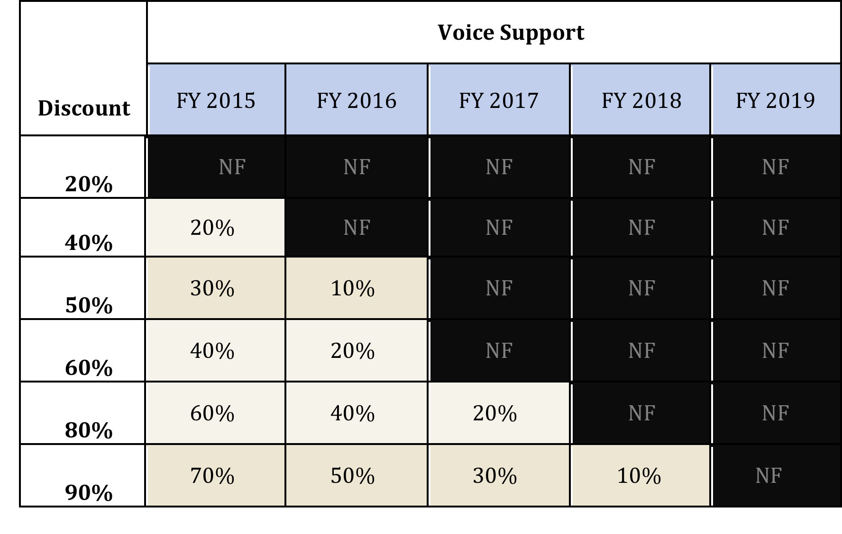
Voice Service Phase Down
*NF = No Funding

Slide 14
Broadband
  Broadband/Internet
    Still fully funded

Slide 15
Discount Matrix for Category I

Slide 16
Changes
Priority II becomes Category II

Slide 17
Priority II becomes Category II
Target of $1 billion a year
  Separate from the $2.25 billion of Category 1
Category II only supports Wi-Fi components
Max Discount is 85%
Category II funding is capped at $150 per student for schools and $2.30 per sq/ft for libraries
Minimum funding available $9,200

Slide 18
$1 billion Target
Category I still has priority over Category II
  If there is not enough Cat I money, they will take from Cat II
  Category II will have separate budget

Slide 19
Category II Wi-Fi Only
Category II is for Wi-Fi components only:
  Routers
  Switching
  WAP’s
  Cabling
  Racks
  Controllers
  Firewall service
  UPS’s
  Software
  Cloud based controllers
  Basic maintenance of Wi-Fi
  Managed Wi-Fi
    Obtained LAN/WLAN’s as a managed service for 3-5 years
  Caching Servers

Slide 20
Category II Discounts

Slide 21
Category II Funding Capped
$150 per student – PRE DISCOUNT – for schools
$2.30 per Square Foot – PRE DISCOUNT – for Libraries
5 year budget
  Examples:
    If you are a school with 1,000 students and you’re a 80% school you would get $120,000 in Category II funding for a 5 year period
      (1,000 * 150 = $150,000 * .8 = $120,000)
    If you are a 10,000 sq/ft library with an 80% discount you would get $18,400 in funding for a 5 year period
      (10,000 * 2.30 = 23,000 * .8 = $18,400)

Slide 22
Category II Minimum Discount
The minimum amount of funding you can receive is $9,200
  Pre Discount

Slide 23
Air Cards and Data Plans
Air Cards and Data Plans are still eligible
  However, you must demonstrate the cost effectiveness and explain why you chose data plans and not your own network.

Slide 24
Process Changes

Slide 25
Process Changes
No Tech plan required
No Income Survey Extrapolation
Hardware install beginning April 1, prior to the start of the funding year
Item 21 pricing will be made public
Community Eligibility Provision (CEP)
  Direct Certs X 1.6 multiplier
    Qualify for CEP is 40% or more of your students are direct Certified for NSLP

Slide 26
Process Changes (cont’d)
Preferred Master Contracts
  Master Contracts (Nationwide) for Cat II
  Exempt from Competitive bidding
  Mandatory for all bid evaluations, even if you don’t purchase off of one
Multi-year contracts
  No longer than 5 years

Slide 27
Process Changes (cont’d)
Invoicing
  Money goes directly to schools, no longer passes through service providers
  If you go with BEAR it must be through Electronic funds transfer
    USAC must have your banking info
Document Retention
    Goes from 5 years to 10 YEARS!
Inspectors
    Must allow inspectors, auditors, agents access to your premises

Slide 28
The Application Process
Determine Service Requirements
Establish Vendor Selection Criteria
  Price must be a factor
Open Competitive Bidding – File 470
Review Bids
Select Service Providers – File 471
USAC Application Review and Approval

Slide 29
School Requirements
CIPA Policy:
  Internet Safety Policy, Student training on appropriate internet usage, Technology Protection Measure, and Public Notice
Discount Validation:
  Every Student Counts
Document retention
  10 years

Slide 30
Questions?

Slide 31
Frequently Asked Questions
If I am a new Charter and I don’t know my population, how do I apply for Category II funding?
  You would estimate what you think your total number of students would be. If you over estimate you would simply not take the extra money, or if you have already taken it, you would give it back
With Funding year 2015 do we have to worry about the 2 in 5 rule?
  No. For funding year 2015 and 2016 USAC has reset the 2 in 5 rule and everyone can apply for Category II funding

Slide 32
Frequently Asked Questions (cont’d)
What happens if Category I demand exceeds their available funding?
  USAC will then take money from the $1 billion Category II bucket
As a new charter school my population is going to grow, especially in the first few years. If it does, how to I account for the new students when applying for Category II services?
  You would account for those new students in every year, just as you would in your first year applying for Category II funding. Example, in year one you have 500 students and you are a 85% school, you would get $63,750 (500*$150 = $75,000 * .85 = $63,750). Let’s assume you spend all of that money. Now in year two your population grows to 750 you can account for those additional 250 students. You would get $31,875 (250*$150 = $37,500 * .85 = $31,875).

Slide 33
E-Rate Advantage
Full service consulting company
  Take our clients from initial planning all the way to receiving a FCDL
E-Rate Forms Submittal
  470
  471
  486
Free and Reduced lunch evaluations
Eligible Services Evaluations
Act as the single point of contact during the review
Knowledge of E-Rate rules to maximize compliance
Knowledge of when and how to file all E-Rate paperwork
We secure over $30 million in funding a year
Over 98% application approval rating

Slide 34
E-Rate Advantage
Ben Sniecinski
  Contact Information:
  ben@erateadvantage.com
  908 892 0705
  www.erateadvantage.com

