Slide 1
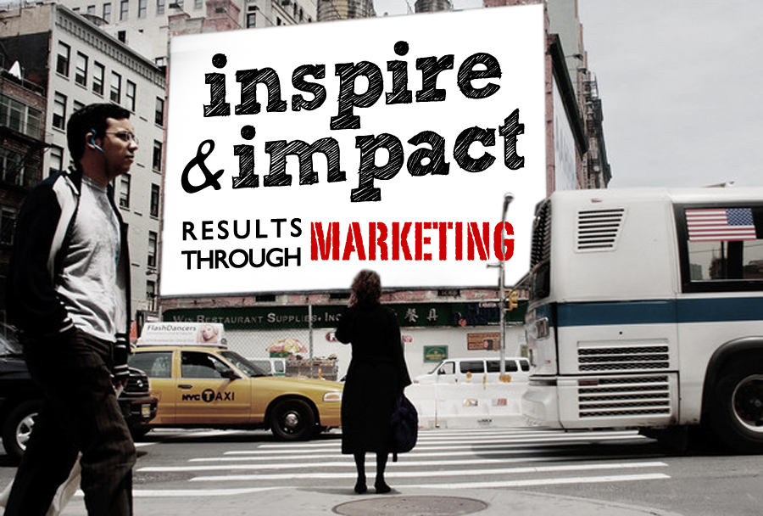

Slide 2
Notes:
Add logos around the picture

Slide 3
The numbers are staggering.
In 2006, there was an average of 32.4 billion searches on Google.
So far, 2012 has seen over 600 billion.
93% of adults in the United States own a cellphone.

Slide 4
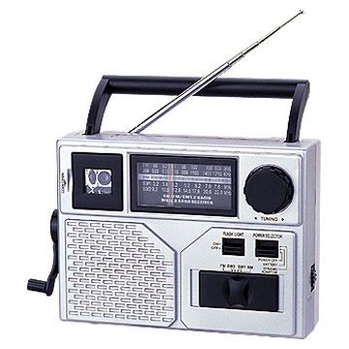
Print/
Out-of-home
Word of mouth
Radio
Internet
Television
Social Media

Slide 5
2012 & BEYOND

Slide 6
2012 & BEYOND
Word of Mouth
World of Mouth

Slide 7
SOCIAL MEDIA
MOBILE
COMMUNICATION
By 2020, the mobile device will be the world’s primary connection tool.

Slide 8
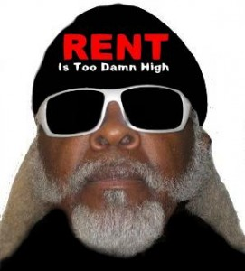
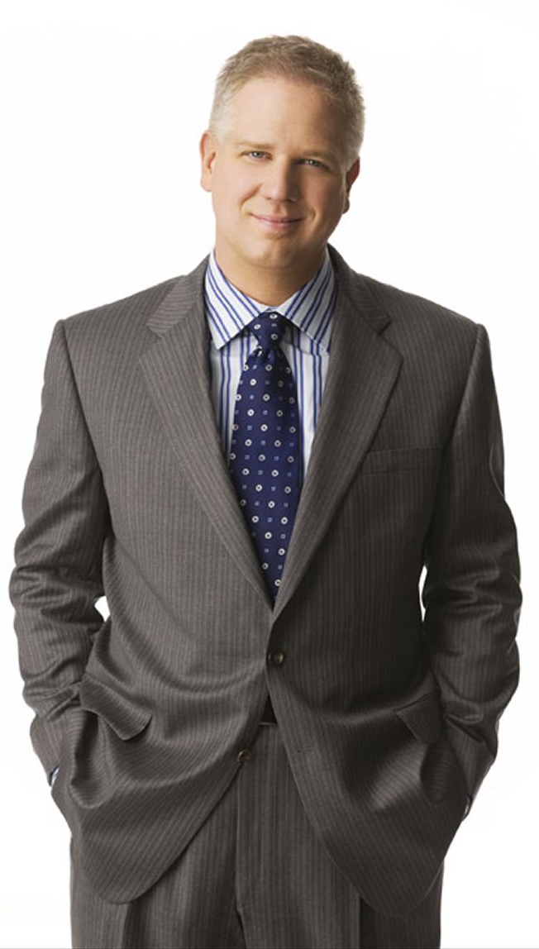
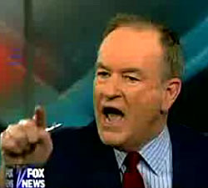
To cut through that clutter, people get ANGRY,
act as renegades, are controversial, or throw money at a MULTITUDE of communication channels until the message is heard

Slide 9
The best causes, organizations and companies – the best BRANDS – have connected through:
Give the
Multiplier Effect:
MESSAGES MATTER MORE THAN EVER!
Values

Slide 11
The Good News:
You don’t have to connect with 500 million people to succeed.
You need to start a ripple effect.

Slide 12
MESSAGE MATTERS
MOST!

Slide 13
“This is your brain on drugs.”
“Change you
can believe in.”
“I have
a dream.”
“Expect more,
pay less.”
“Think
different.”
“Got milk?”
“Just do it.”
Notes:
Georgina – can you put the logos of the various messages above to appear all at once on the next click.

Slide 14
Facts
Emotions drive 85% of decisions (any decision!)
Values sustain relationships
Rationale attributes are important, BUT they don’t trigger action.

Slide 15
Proof Every Day
10 proposals submitted
8 thought they followed directions
6 really followed directions & met the “criteria”
2 received funding
Why? “I really believed in what they were doing. I saw the WOW.” – National Charter School Foundation
WHAT TRIGGERED THE DECISION?

Slide 16
Foundation Example
“I BELIEVED in you….”
“I review 10 proposals a week; this one had the facts that proved they could succeed and the PASSION that MADE ME CONFIDENT the program would work”
“It was one thing to prove what happened because of the school, QUITE ANOTHER TO SEE what wouldn’t have happened without them”

Slide 17
Which of YOUR Messages Matter Most?

Slide 18
MESSAGE
Emotional Driver:
Succeed, Believe
Thrive, Expect More, Children-Students-Leaders-World
Attributes:
Public School,
Parent Choice, Accountability, History, No. of Students
Functional Driver:
Arts, Music, Literacy Program,
Test Scores
Emotional Drivers Trigger More than 85% of Decisions
X Charter School
Connect Your Messages!

Slide 19
The Original Message
X Charter School
Founded in 2005, X charter school is a public school that focuses on the whole child. We have some of the best test results in the state, an arts and music program, a unique literacy and reading program and high percentage of English language learners.

Slide 20
The Message
X Charter School
What’s Wrong With That Message?

Slide 21
A Better Message
X Charter School
The Only Thing We Don’t Respect? Status Quo.
Anna Lopez couldn’t read last year. This year, she scored in the top 5% of the country. We’re not betting Anna will change the world, we’re making sure of it.

Slide 22
A Better Message
School+Students
Meets the Needs of the “World”

Slide 26
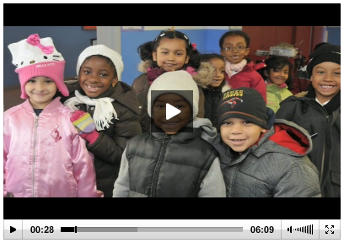

Slide 27
BREAK-IN
Key attributes
Functional drivers
Emotional drivers
Key message
Message
Emotional Benefits

Slide 28
MESSAGE
Emotional Driver:
Attributes:
Functional Driver:
Emotional Drivers Trigger More than 85% of Decisions
Your
School
Connect Your Messages!

Slide 29
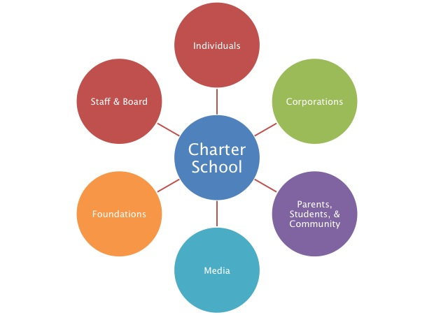
What Are Your Goals & WHY?
Raise awareness – why?
Raise money – why?
Increase recruitment – why?
Solve a problem – why?
Solve a crisis – what?
Determine strategy
Who do you need to help?
How will you communicate with them?
Audiences - Ambassadors

Slide 30
Charter School
Elected Officials & Community
Corporations
Parents & Students
Staff & Board
Foundations
Media
WHO is Your “World”?
Audiences - Ambassadors
Notes:
Background image?

Slide 31
Goals
80/20 rule
Prioritize audiences!
Know where the value is from (and where it isn’t)
Identify your ambassadors
Online and offline influencers
Those who have the power to influence at least 10 others
Determine strategy
Audiences - Ambassadors

Slide 32
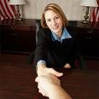
 | Foundation (25%) | Individuals (25%) | Media (5%) | Parents & Staff (25%) | Company (5%) | Elected Official & Community (15%)
Triggers & Values
Vehicles
Poster “Person”
Audience Analysis
Audience Analysis

Slide 33
Insights Example: Values of the Affluent
 | Unmistakable Affluent (14%) | Understated Affluent (20%) | Tasteful Affluent (8%) | Dependable Affluent (14%) | Economical Affluent (21%) | Practical Affluent (19%)
Key Personal Driver | Suit my personality | Avoid unnecessary attention | Won’t cause me discomfort | Perform as intended | Value | Practical
Values | Bragging rights to everything except value | No one notices I have really good stuff | I feel best when I have the best | I feel best when I am doing the “right” thing | Bragging rights to the best value | I feel best when things work
Poster Person |  |  |  |  |  | Millionaires next door.

Slide 34
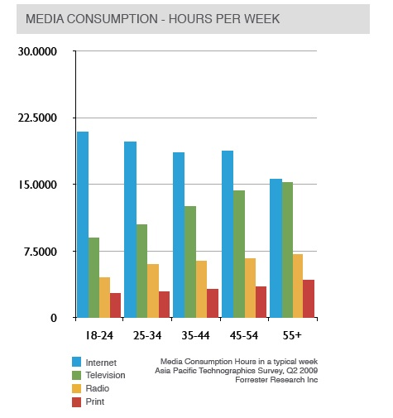
Consumption Patterns
Notes:
Delete?

Slide 35
 | Media Consumption % of Executives
Online media | 75%
Industry trade journal | 43%
National & local newspaper | 61%
General-business publication | 25%
 | Digital Media Consumption % of Executives
Use cellphones | 91%
Use wireless internet connection | 59%
Use digital cable | 29%
Listen to webcasts | 77%
Read blogs | 58%
Watch streaming video | 56%
Listen to podcasts | 41%
Contribute to blogs | 25%
Belong to social networking sites | 20%
Participate in virtual worlds | 12%
Own a blog | 9%
Example: C-level Executives
Heavy consumers of Print and Online Business and Lifestyle Media
Example: C-level executives

Slide 36
Executing Success
Goals & Budget
Three Audiences
What triggers them to act?
Where do the readily (and credibly!) consume information?
Theme & Messages
3 to 5 tactical executions
Bring the audience to the school & school to the audience

Slide 37
BREAK-IN
Message
Strategic priority (ies)
Two key audiences
Triggers & values
Two key vehicles (how will you reach them?)
Message
Emotional Benefits

Slide 38
 | Foundation (25%) | Individuals (25%) | Media (5%) | Parents & Staff (25%) | Company (5%) | Elected Official & Community (15%)
Triggers & Values
Vehicles
Poster “Person”
Audience Analysis
Audience Analysis

Slide 39
The Big “Bang”
Start with a Big “Bang” Idea
Generate momentum around your campaign
Excite audiences; ready audiences for information
Video, school event, website, viral video
Follow-up is critical!

Slide 40
Executing Success
Physical environment is often most important!
Communicate message visually
Does it feel ALIVE?
Student tours, performances
Does the school represent your message?
“I want to see for myself the feel of the school; its success.”
- Tiger Foundation representative

Slide 43
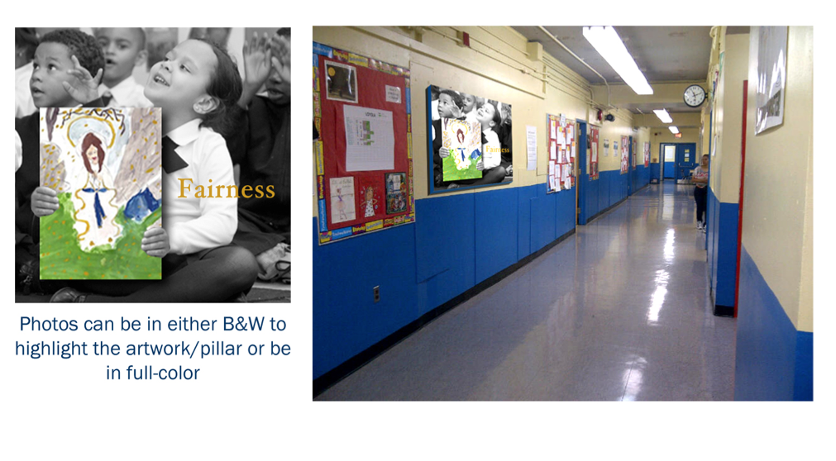

Slide 45
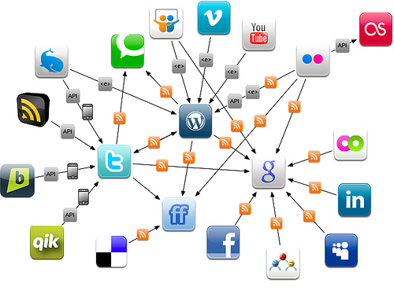
Ambassadors
Board, staff, parents & community are your most effective ambassadors
Create value & community for them to help ensure they help market the school
“Six degrees campaign”
Develop “tool kits” that highlight information & key messages
Cross-functional parent/teacher/staff communities
Public speaking – formal and informal
Social networking

Slide 46
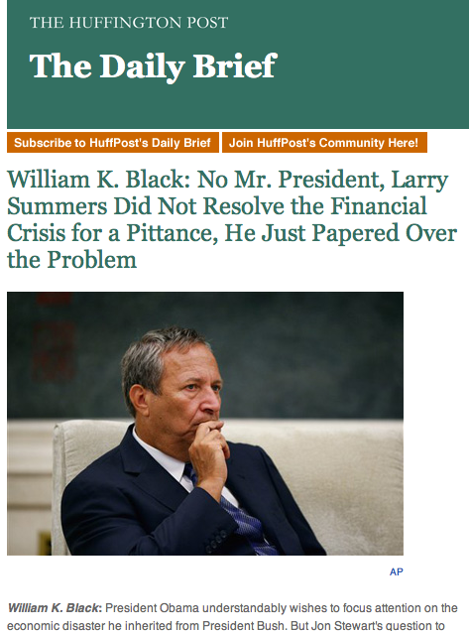
Media Ambassadors
Simple, engaging press kits; video
Create “news”
Ensure events include news & media-worthy partners
Elected & education officials
Artists
Celebrated individuals
Strong parent and community contingent
Consistent

Slide 47
Social Media Strategy

Slide 48
Social Media Strategy
Consider your approach
WHY social media?
Tell one story
Contests work!
Engage, Engage, Engage!
Connecting to links and other sites will raise your “popularity”
Fansite vs. non-profit site
Student blog

Slide 49
Simple, Consistent Contact
Constant Contact is a great resource
Very simple, monthly updates
Look & feel must be consistent
A picture is worth a million words
Video clips are even stronger, but be careful of size requirements

Slide 50
Email Communication

Slide 51
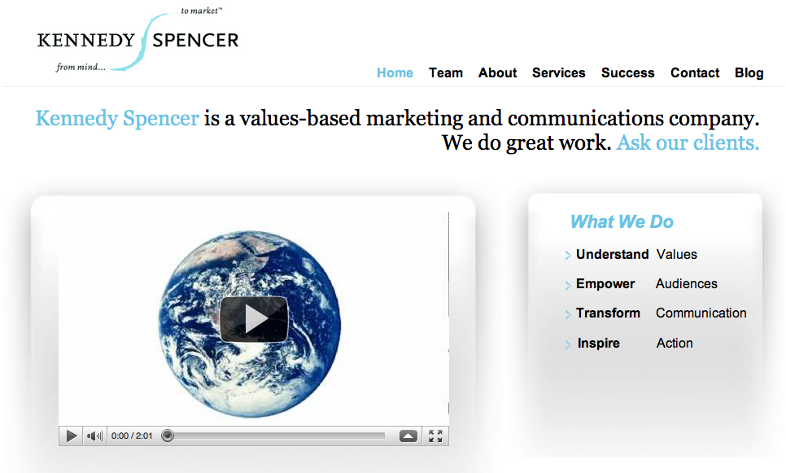
Website & Online
Home and team page most viewed
Clear, simple, “mobile-ready”
Very simple video on home page
Easy to navigate, support, give & engage
Rule of thumb: 2 clicks away
Where’s the WOW?!

Slide 52
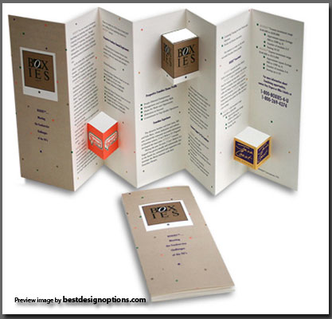
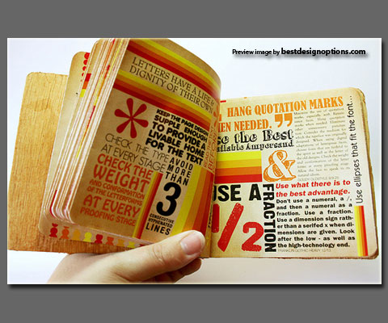

Slide 53
Executing Success
Ambassadors
Arm them with the messages & goals
Keep them informed; Solicit feedback
STRATEGICALLY Launch Campaign

Slide 54
REMEMBER
Message Matters Most
Determine Goals
Identify & Analyze Audiences
Start with The “Big Bang”
-Trigger the Emotion
Follow-up is Critical
-Build and Sustain the Value

Slide 55
THANK
YOU!
Kennedy Spencer

Slide 56
