Slide 1
National Charter Schools Conference
June 22, 2011
Charter Schools Leading the Special Education Revolution
Dr. Vicki Barber, Superintendent, El Dorado County Office of Education
Dr. Alice Parker, Former State Director of Special Education, CA
Gina Plate, Sr. Advisor, CA Charter Schools Association

Slide 2
Agenda

Slide 3
Charters Schools and Special Education:
Dispelling the Myths

Slide 4
The Myths
Myth: “Charter schools don’t serve students
with special needs”
Cherry Picking – “Charters accept only the best and brightest, refusing to serve students with unique needs”
Counseling Out – “Charters convince students with unique needs not to enroll or refer them to other schools”
Charters don’t serve a “fair share”
  “Charters only serve students with mild to moderate disabilities, but are unwilling or unprepared to serve students with the most severe needs”
  “Charters serve a smaller population of students with disabilities than traditional public schools”
Notes:
It is often stated that charter schools do not serve the same population of students with unique learning needs – such as students with disabilities – as their traditional public school counterparts. Since the inception of the charter school movement, this claim has taken a variety of forms. Some say that charter schools are unwilling to serve students with disabilities, often accusing charters of “counseling out” or referring students with disabilities to other schools. Others acknowledge that charter schools serve students with mild to moderate disabilities, but declare that charters are unwilling or unprepared to serve students with the most severe needs. Still, some simply allege that charter schools serve a smaller population of students with disabilities than traditional public schools.

Slide 5
The Truth
Non-discriminatory: charters cannot discriminate in enrollment or set admission requirements
Equal opportunity enrollment: if more students want to attend than there are seats available, charters must use a lottery for enrollment
Research shows that charter school students are just as diverse (racially and economically) as non-charter students
Truth: “As schools of choice, all charter schools are open to any student who wants to apply
Notes:
Does Aisha’s ppt address this

Slide 6
The Data
Research shows:
Charter school students are just as diverse as non-charter students
Charters are serving unique student populations, including students with disabilities
Charter schools are outperforming traditional schools with many key subgroups

Slide 7
Charter schools are outperforming traditional schools with many key subgroups
Charter School Growth in California
2009-10 Median API Scores by Subgroup
Charters
Non-Charters
N=
98 950
398 6,110
251 5,400
464 6,470
15 1,358
African-
American
Latino/ Hispanic
English Learner
Socioeconomically Disadvantaged
Students with Disabilities
2009-10 Student Ethnicity in California
2009-10 Median API Scores by Level
African- American
Latino
White
Asian
Other**
Non-Charters
N= 5,765,489
Charters
N= 301,558
N=
368 5,306
99 1,243
264 1,158
731 7,707
Charter School Growth Data, Source: CDE data, California Charter Schools Association analysis. Ethnicity Data, Source: California Department of Education. **Other includes Indian, Pacific Islander, Filipino and Multi-Racial groups Note: 22 non-charters & 2 charters are missing demographic data. Median API Data, Source: 2010 API Growth Scores, Association analysis; alternative and special education schools excluded.

Slide 8
California Charters do particularly well with African American students

Slide 9
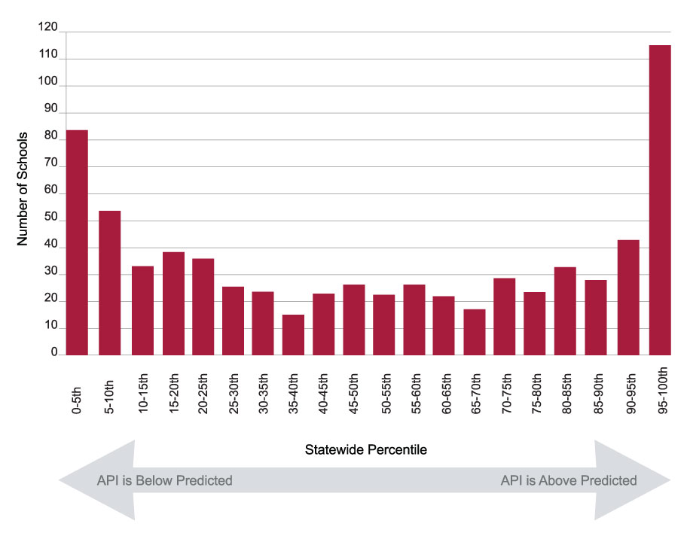
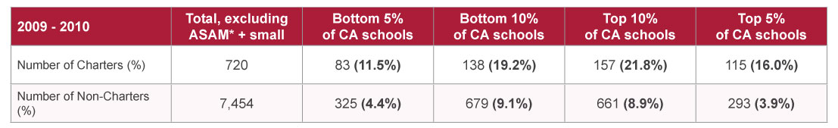
Concentration of Charters at Top and Bottom of Statewide Distribution
* The model excludes schools that are part of the Alternative Schools Accountability Model, as well as those testing fewer than 20 students.
Notes:
Charters are more likely to far over-perform their prediction than traditional public schools. To a somewhat lesser extent, charters are also more likely to far under-perform their prediction.
Charters are over four times as likely as non-charters to be among the top 5% of schools statewide in terms of performance relative to a prediction, yet are also over two times as likely to be among the bottom 5% of schools statewide.

Slide 10
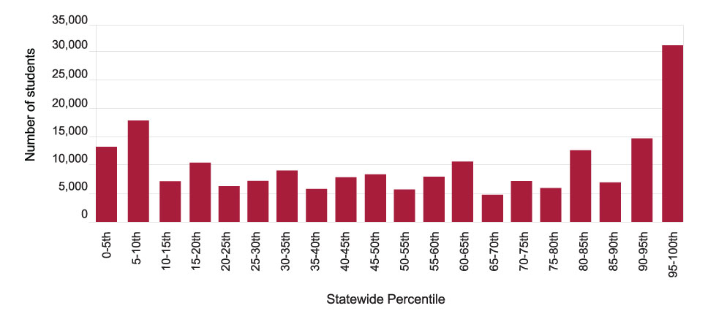
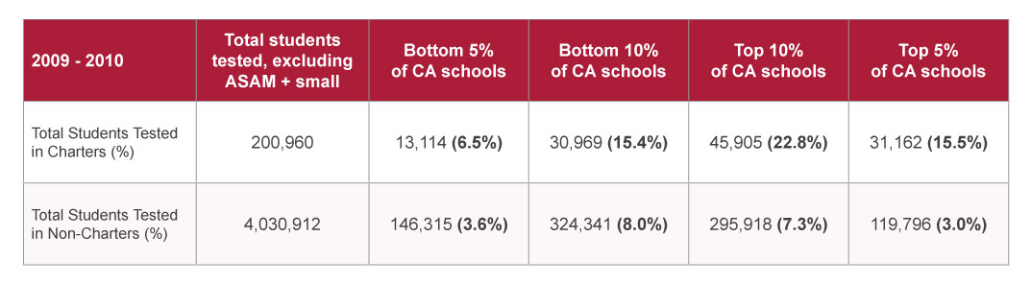
Many more students are served by high performing charters.
Notes:
More than twice as many students are served by charter schools performing far above their prediction than by under-performing ones.

Slide 11
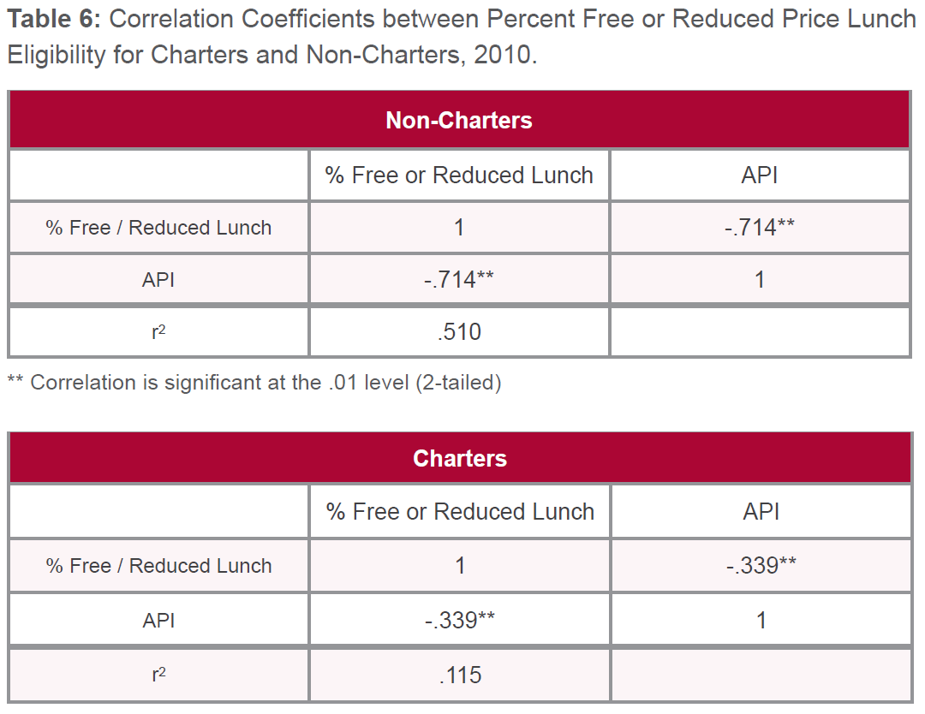
The impact of family income on charter schools’ API performance is four times less than the impact of family income on non-charters’ performance.
Notes:
Income level has four times less of an impact on the school’s API performance for charters as
it has on non-charters API performance. The r2 coefficient in Table 6 shows that for
non-charters, 51.0% of the variance in their API scores is explained by variation in
the percent of students eligible for the Free or Reduced Price Lunch program at the
non-charter school. For charter schools, it is only 11.5% of the variance. This suggests
that charter schools are finding ways to surpass the traditional limitations of poverty
more effectively than are non-charter schools.

Slide 12
Portrait of the Movement 2011:
Highlights from Findings
Charters are over four times as likely as non-charters to be among the top 5% of schools statewide in terms of performance relative to a prediction, yet are also over two times as likely to be among the bottom 5% of schools statewide.
We see some evidence that the concentration of far under-performing charters is decreasing over time.
More than twice as many students are served by charter schools performing far above their prediction than by under-performing ones.
Charters serving low-income populations are over-performing at high rates relative to the traditional system.
Notes:
42.2% of charter school students in L-I schools are top 10%. Only 10.6% of students in low-income non-charters.

Slide 13
Highlights from Findings cont’d.
(Charters 4+ years)
Charters are more likely than non-charters to:
  have high academic status and high growth.
  have low academic status and low growth, but those charters serve proportionally fewer students than low-performing non-charters.
Charters serving low-income populations are
  more likely to have high academic status and high growth, and
  less likely to have low academic status and low growth than non-charters serving low-income populations.
The impact of family income on charter schools’ performance is four times less than the impact of family income on non-charters’ performance.
Notes:
2 min
Additional data:
Status/Growth Framework: Schools and Students Served
Total charter schools in high status: 237 (48.9% of schools)
Total non-charter schools in high status: 3,834 (51.4% of schools)
Total charter schools in high growth: 257 (53.0% of schools)
Total non-charter schools in high growth: 3,675 (49.3% of schools)
Total charter students in high status: 79,087 (50.9% of students)
Total non-charter students in high status: 1,894,136 (47.3% of students)
Total charter students in high growth: 91,451 (58.9% of students)
Total non-charter students in high growth: 2,049,332 (51.1% of students)

Slide 14
CCSA is now beginning to collect data on the vast range of high risk populations served by charters
A recent study of a subset of charters found they served the following high risk population groups:
Highly mobile/transient
Dysfunctional homes
Credit deficient
Dropouts
Emotional or behavioral issues
Foster youth
Migrant families
Gang-affiliated
Adjudicated youth
Pregnant/parenting
Medical needs
Recent immigrant backgrounds
Homeless

Slide 15
The barriers:
Why the numbers look different
While Charter schools do serve students with special needs, the actual special education demographic in charter schools differs from that of traditional public schools for a number of reasons.

Slide 16
Overcoming Barriers
Underlying Barriers:
Statewide special education structures that result in inadequate funding and lack of control over services
Lack of access to the full continuum of special education services
Lack of data to show how and to what extent charters are serving students with special needs
Efforts to Overcome Barriers:
    Reform to improve special education arrangements
    Infrastructure building to make sure charters have access to services and funding
    Data collection to data to demonstrate how and to what extent charters are serving students with special needs

Slide 17
Special Education Structures in California

Slide 18
Language of Special Education
Each district (and charter school) must belong to a SELPA.
Special Education Local Plan Area
A Special Education Local Plan Area (SELPA) is the service area covered by the local plan for providing special education services to individuals with disabilities in that area under the state and federal law (EC 56195.1).
District may be a single SELPA or a member of a multi district SELPA. Each SELPA looks different, but what they have in common is:
  LOCAL PLAN that determines how they provide services and establishes the governance structure
  ALLOCATION PLAN that determines how they distribute funds.

Slide 19
Language of Special Education (cont.)
SELPAs in California are similar to:
  Educational Service Associations
  Parrishes
  Boroughs
  Boces
Other Terms:
  ADA – Average Daily Attendance
  LEA – Local Education Agency
  Out of Geographic Charter

Slide 20
The Foundation:
Two Options for Charter Schools in California
TWO OPTIONS EXIST for special education service delivery and responsibility:
Currently, most charter schools are SCHOOLS OF THE DISTRICT for
special education purposes. 130 charters are LEAs for special education. This number is growing.

Slide 21
Statewide Special Education Structures

Slide 22
Understanding the Options
SELPA
School District
Charter
School
LEA for Special Education
School of
The District

Slide 23
“School of the District” Model
Notes:
Default option:
If the school does not specifically elect to operate as an LEA by applying to and being accepted into a SELPA as an LEA for special ed
Charters have historically faced challenges in gaining SELPA membership – while options are increasing, access is still a challenge for two reasons: 1) insufficient options; 2) inability to demonstrate capacity to serve all kids, primarily stemming from district control over special ed as a school of the district
This means the District carries responsibility:
The chartering entity is ultimately responsible if charter school fails to provide appropriate special education.
…and retains all funding and decision making authority

Slide 24
LEA for Special Education
Notes:
The only way to avoid the challenges that created by school of the district status is for charters to operated independently for special education by becoming their own LEA for special education
With this, comes full responsibility and full control over both funding and service delivery
So, this is a great option. What’s holding us back? There are a number of barriers that historically existed for charters:
Before a charter school can become an LEA for special education, it must apply for membership and be accepted into a SELPA.
Not all SELPAs accept charter schools as LEA members
Some SELPAs, like San Diego Unified and LA Unified, are single district SELPAs and therefore don’t accept any other LEAs
Other SELPAs might accept school districts as LEAs, but their local plan doesn’t not provide for charter schools as LEAs
Traditionally, SELPAs were required to be regional, which limited charters to the SELPAs in their geographic region. If the SELPAs where the charter was located did not accept them, they were required to operate as a school of the district.
Even where they are prepared to accept the charter, they may not because they perceive the charter as lacking the expertise and infrastructure to succeed independantly
→ Once a charter is accepted into a SELPA and becomes an LEA, the responsibility shifts to the school.

Slide 25
Why would charter schools want to be an LEA?
GOVERNANCE
Selection of Staff
Assignment of Programs
Consistency with Philosophy of Program
Authorizer Makes all Decisions
FINANCE
Funding Determined by Authorizer
May be Faced with Excessive Costs
May Pay Greater than “Fair Share”
May have Insufficient Services

Slide 26
Criteria to Consider in Becoming an LEA for a Charter School
Compliance
Capacity
Program Expertise
Staff Expertise
Success of General Education Program
Financial Health of the Charter
Communication Technology Availability

Slide 27
Special Education Funding

Slide 28
STATE SPECIAL EDUCATION FUNDING FORMULAS
Formula Type | Description | States
Multiple student weights | Funding (either a series of multiples of the general education amount or tiered dollar amounts) allocated per special education student that varies by disability, type of placement, or student need | Arizona, Colorado, Florida, Georgia, Indiana, Iowa, Kentucky, New Mexico, Ohio, Oklahoma, South Carolina, Texas (n=12)
Census-based | A fixed dollar amount per total enrollment or Average Daily Membership (ADM) | Alabama, California, Idaho, Massachusetts, Montana, New Jersey, Pennsylvania (n=7)
Single student weights | Funding (either a single multiple of the general education amount or a fixed dollar amount) allocated per special education student | Louisiana, Maine, New Hampshire, New York, North Carolina, Oregon, Washington (n=7)
No separate special education funding | Funding to support special education is rolled into the overall funding levels | Arkansas, Connecticut, Hawaii, Missouri, North Dakota, Rhode Island, West Virginia (n=7)
Resource-based | Funding based on payment for a certain number of specific education resources (e.g., teachers or classroom units), usually determined by prescribed staff/student ratios that may vary by disability, type of placement or student need | Delaware, Kansas, Mississippi, Nevada, Tennessee, Virginia (n=6)
Combination | Funding based on a combination of formula types | Alaska, Illinois, Maryland, South Dakota, Vermont (n = 5)
Percentage reimbursement | Funding based on a percentage of allowable, actual expenditures | Michigan, Minnesota, Nebraska, Wisconsin, Wyoming (n = 5)
Block grant | Funding based on base-year or prior year allocations, revenues, and/or Enrollment | Utah (n = 1)
Source: Developed on the basis of descriptions provided on the Survey on State Special Education Funding Systems, 2008-2009, conducted by Project Forum.

Slide 29
Special Education Income
Funding for each LEA varies throughout the state based on the unique local allocation plan
  Each SELPA has unique characteristics of funding
  Each SELPA allocation plan distributes funds to LEAs in a unique manner.
  What is highly likely is that special education funding will NOT be sufficient to cover costs and LEAs have a significant local contribution.
Short version of SELPA funding (for SELPAs other than Charter SELPA)
SELPA K-12 ADA (current or prior year ADA) x unique SELPA rate (on average @ $617) + Cost of Living increase + Growth/Decline (growth at $465) = Entitlement. Subtract from the Entitlement the amounts received by the SELPA from Federal IDEA/Pl94142 funds and specific taxes allocated to special education and you will arrive at the level of State Aid.
Charter SELPA funding looks different.
  Current Year K-12 ADA x state portion of statewide target rate ($465)
  PLUS Federal IDEA/Pl 94142 funds (based on charters in the SELPA in the prior year)

Slide 30
Simplified Funding Example
Comparison of SELPA funding to Charter SELPA funding (Core formula)

Slide 31
Changing the
Landscape:
Innovation in California

Slide 32
California Pilots Charter SELPA and Out of Geographic Charters
4 Pilots from 2006-07 through 2009-10
  SELPAs Admitting Out of Geographic Charters
El Dorado County Charter SELPA
State Board Approved Charter SELPA and Regional Model – January, 2010

Slide 33
EDCOE Charter SELPA History

Slide 34
El Dorado County Charter SELPA Special Education pupil Count

Slide 35
Charter SELPA Pupil Counts
2010-11
 | Special Education Pupil Count | General Education Count | Special Education Percent
Prior Year Charters | 1,405 | 15,869 | 8.85%
2010-11 Charters | 1,620 | 22,731 | 7.13%
Totals | 3,025 | 38,600 | 7.84%

Slide 36
Comparison to Statewide Data

Slide 37
Special Education Data by Disability

Slide 38
Statewide Charter SELPA by Disability Percentages
Charter SELPA serves similar percentages by disability. Note they are lower than statewide average in areas such as autism, but serve a higher % of students identified as SLD (specific learning disability).

Slide 39
Successes and Lessons Learned
Charter SELPA has worked
Changed Landscape of Special Education Services for Children in Charter Schools
Improved Dialogue in Charters that have Stayed as a School within the Authorizer
Expansion of Other Charter SELPAs Now Happening
Allows Freedom/Choice – Improvement of Services and Quality Programs – Enhanced Funding

Slide 40
Case Study:
Los Angeles Unified
Service Delivery Models

Slide 41
The Great Divide
LAUSD previously operated under “hybrid” model
  Charters pay LAUSD 27-40% of their special education funding
  Charters received varying levels of support/services from the district
This arrangement present challenges for both sides
  Disparity created confusion amongst charters and district personnel
  Charters believed they did not receive sufficient funds/services
  LAUSD believed that contribution amount was not a “fair share” under the law
93 charters submitted notice of intent to leave the SELPA effective July 2011

Slide 42
The Goal of Reorganization
Create viable options for charter schools to remain in the LAUSD SELPA that:
  Establish clearly defined options for special education funding and service delivery
  Provide charters schools with the flexibility and autonomy to operate their own special education programs;
  Provide charters schools with the opportunity to participate in SELPA-level decisions affecting their school;
  Allow charter schools to access the significantly higher SELPA funding rate generated by the LAUSD SELPA
  Allow LAUSD to retain a portion of funding generated by the average daily attendance at these charter schools
  Allow LAUSD to retain a “fair share” contribution from schools that in an amount that is aligned with the intent of state law – reflecting the level of services provided to each school

Slide 43
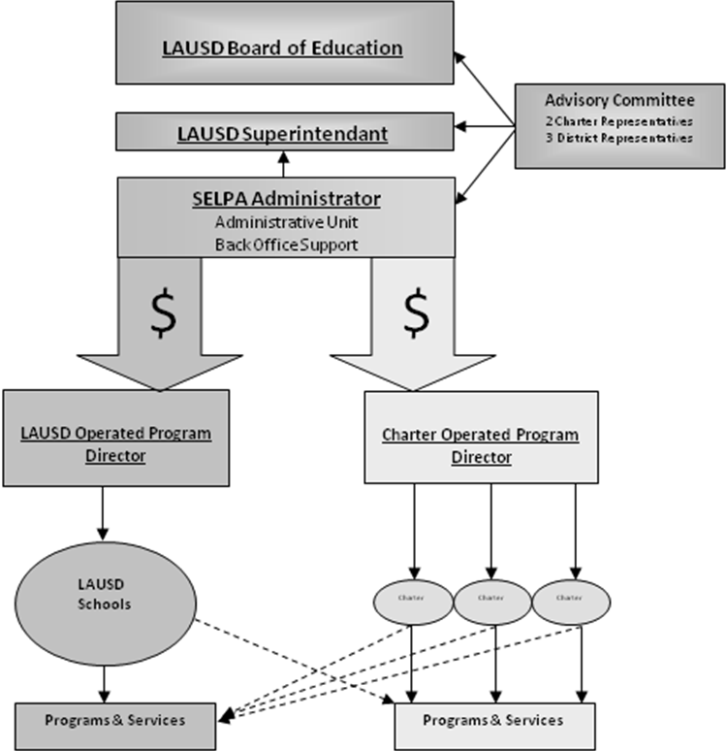
The Reorganization
One Single-District SELPA
Two Departments
  District Operated Programs (DOP)
  Charter Operated Programs (COP)
Three Options for Charters:
  Operate as a “school of the district” in the District Operated Programs department
  Operate independently as part of the Charter Operated Programs department
  Apply for LEA status in a SELPA outside of LAUSD

Slide 44
Looking towards 2011-2012

Slide 45
LAUSD charter school needs assessment: a case study of options and needs in serving students with disabilities
Review of 168 Charter Schools in areas of compliance, leadership, mission/vision for SWD, models in use, types of students served, options for improvement.
Needs Assessment included:
  Classroom Observations,
  Focus Groups, Interviews,
  Document Reviews,
  Data Review,
  Stakeholder Group Guidance

Slide 46
LAUSD charter school needs assessment: a case study of options and needs in serving students with disabilities
Findings in following constellations or themes:
  Supports and Resources
  Leadership, Culture and Systems
  Teaching and Learning
Special Education Services reflected:
  Tendency toward service delivery models from 80’s
  Some pockets of excellence
  Data evidencing range of students with disability types, but more frequently SLD, SLI, OHI
  Need for common vision and reflection of IDEA 2004 focus on services and sets of services to support access to the general curriculum

Slide 47
Eighty-five Percent of Students in the Charter School Project Pool are in the Regular Classroom 80% or More of the Time
Least Restrictive Environment | All California |  | LAUSD |  | Charter Project
Time in Regular Class | N | % | N | % | N | %
80% or more | 338,555 | 54.2% | 42,125 | 60.9% | 3,967 | 84.7%
40 to 79% | 122,997 | 19.7% | 17,860 | 25.8% | 485 | 10.3%
Less than 40% | 155,716 | 25.0% | 9,008 | 13.0% | 216 | 4.6%
Other | 6,828 | 1.1% | 213 | 0.3% | 18 | 0.4%
Total | 624,096 | 100.0% | 69,206 | 100.0% | 4,686 | 100.0%
Findings
Data shows students in general education setting for larger portion of day than traditional schools, but interviews, observations, and focus groups indicated services were traditional.

Slide 48
Eighty-five Percent of Students in the Charter School Project Pool are in the Regular Classroom 80% or More of the Time
Question: With Charter’s General Education programs being so innovative, why are their special education ones so antiquated?

Slide 49
Students aged 15 or older in the Charter Project Schools are more likely to have Transition related Language in their IEPs
What are the post secondary outcomes for these students?

Slide 50
Six of every ten exiting seniors with IEPs earned regular high school diplomas.
Three of every 10 seniors with IEPs exiting from Charter Pool schools dropped out without completing a diploma.
Data source: CASEMIS June 2010 submission
What questions or concerns do these data raise for you?

Slide 51
Summary of Needs for Teaching and Learning
Strengthen skills of general educators and special educators in differentiated instruction and teaching to different learning modalities.
Strengthen skills of general educators and special educators in how to create rigorous lessons.
Seek ways to include Speech and Language services in-house or if contracted out to more closely align those services to best practices for school personnel as defined by ASHA/CSHA, such as classroom-based assessment, curriculum-relevant intervention strategies, social-pragmatic language support, and single-sound intervention models.
Strengthen skills of general educators, special educators, and administrators in how to deal with severe emotional/behavior issues.
Implement more intentional, strategic, full-inclusion models

Slide 52
Summary of Needs for Support and Resources For Learning Communities
Break down isolation between special educators and general educators and between the charters themselves and the charters and the district.
Strengthen skills and systems for consistent, deep-level, data-driven practice.
Strengthen skills and systems to provide high-quality Co-Teaching and Collaboration between special education and general education staff.
Provide access and training in use of assistive and other technologies

Slide 53
Stakeholder Agreement on service delivery options

Slide 54
Stakeholder Agreement on service delivery options

Slide 55
Overarching Components for all service delivery options:
Universal Design for Learning
Instructional Technology
Assistive Technology
Access to General Curriculum
Mutual Responsibility across all educators thru joint planning and delivery of instruction
Project Based Learning/Thematic Instructional Practices whenever possible
Language and background knowledge explicitly taught

Slide 56
Questions?????

