Slide 1
Navigating
Charter School
Finance
with Josh Moreau and Charles Graham
@WeBoostED

Slide 2
What will we talk about
@WeBoostED
Who We Are
Charter School Finance
Case Study
3 Things to Remember
Q&A

Slide 3
Who We Are
@WeBoostED
Leading charter school accounting, finance and bridge financing organizations
Incubated and managed by Victory Education Partners, a company founded in 1999
We work with more than 20 charter schools in PA, NY, IL and FL
Manage over $500M in charter school funds annually

Slide 4
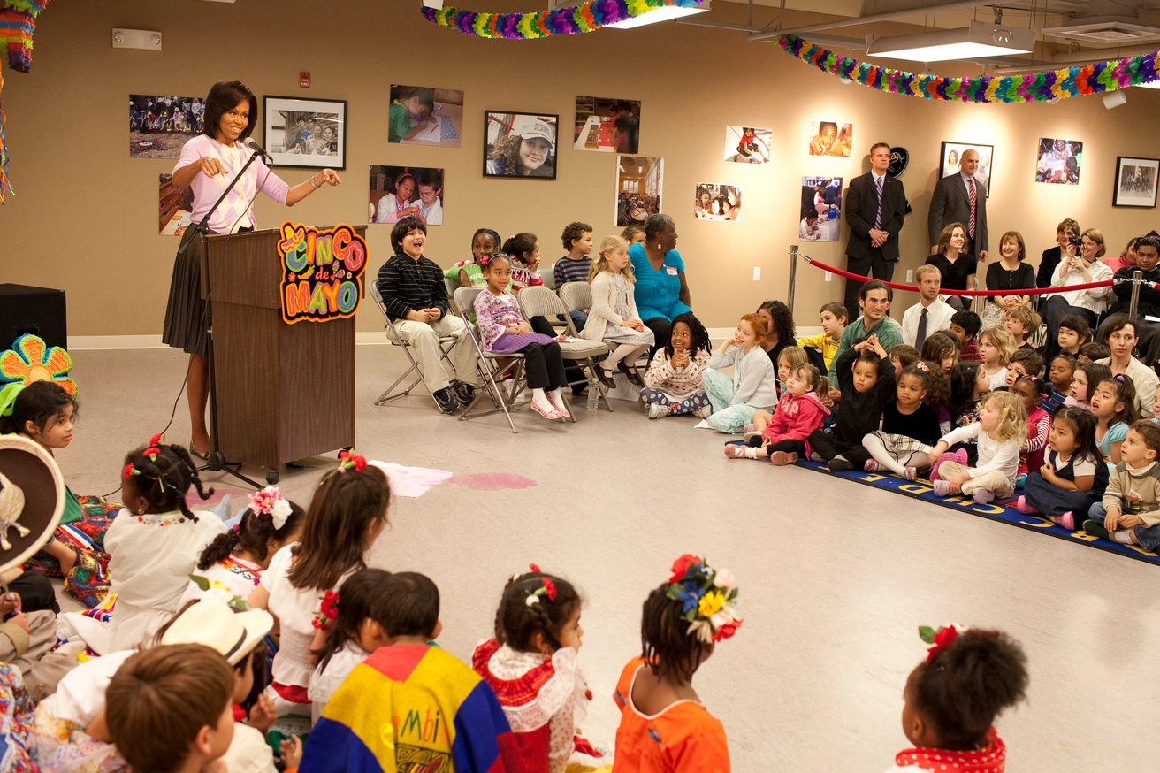
Charter School Difference
@WeBoostED
Notes:
Speaking Notes:
Charter Schools have specific needs and face difference challenges
Some of these challenges are <JOSH TO INSERT>
Recognizing this difference, we operate to deliver CFO level experience that features tailored services specific to charter schools.

Slide 5
What makes up charter school finance?
@WeBoostED
BUDGET
ACCOUNTS PAYABLE / PAYROLL / EXPENSES
REPORTING
AUDITS

Slide 6
Budget
@WeBoostED
Prelim Per Pupil allocation for following year
Federal Funding - Anticipated Free/Reduced lunch population from school
Staffing Plan - Principal/AP develop staffing plan, salaries are at board discretion
General Expenses – Inflationary increase/trends/needs of the school

Slide 7
Accounts Payable & Expenses
@WeBoostED
Attain goods and services at the lowest possible cost
Three bids minimum
Instructional/Furniture databases, built-in bids
Goods:
Purchase Order
Goods Received - Packing Slip/Bill of Lading
Invoice
Services:
Contract
Invoice
Check Request

Slide 8
Reporting
@WeBoostED
Profit & Loss
Balance Sheet
Cash Flow
Capital Expenditures
Metrics
Notes:
Profit and Loss Revenue
Per Pupil Revenue Allocation per Pupil; Money follows the child
State Specific Revenue
Federal Funding NCLB (Allocation determined by free/reduced lunch count), IDEA
SPED Funding Supplement Per Pupil for students receiving specialized services
Grants/Contributions – CSP
Other Income
Interest Income Money Market/Interest-Bearing Accounts
School-Based Activities Fund raising, bake sales, etc.
Food Service
Profit & Loss Expenses
Employee Salaries - Charter averages account for 65% of total costs
Employee Benefits
General/Administrative - Costs necessary to run the Admin office
Professional Services - Legal, Audit, Temp Staff
Direct Educational - Texts, Classroom Supplies
Operating/Maintenance - Costs to maintain building
School Admin Services - Management/Service Fee

Slide 9
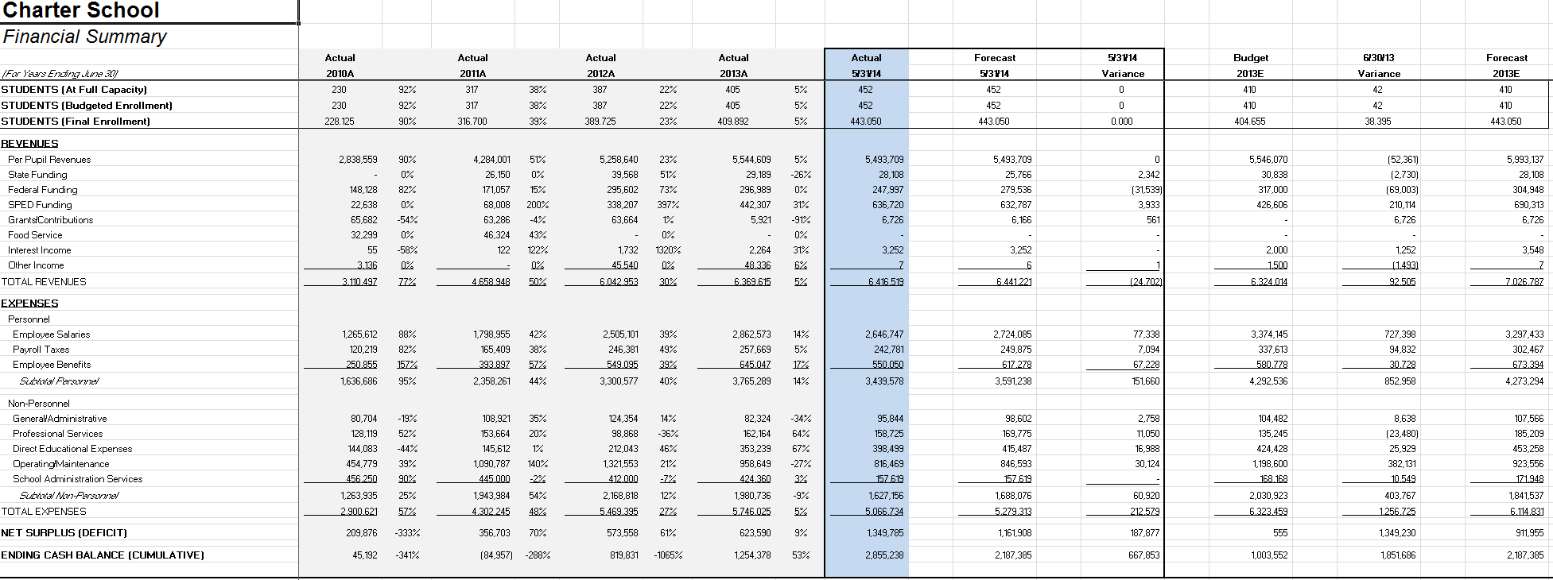
Reporting Example
@WeBoostED
Notes:
Profit and Loss Revenue
Per Pupil Revenue Allocation per Pupil; Money follows the child
State Specific Revenue
Federal Funding NCLB (Allocation determined by free/reduced lunch count), IDEA
SPED Funding Supplement Per Pupil for students receiving specialized services
Grants/Contributions – CSP
Other Income
Interest Income Money Market/Interest-Bearing Accounts
School-Based Activities Fund raising, bake sales, etc.
Food Service
Profit & Loss Expenses
Employee Salaries - Charter averages account for 65% of total costs
Employee Benefits
General/Administrative - Costs necessary to run the Admin office
Professional Services - Legal, Audit, Temp Staff
Direct Educational - Texts, Classroom Supplies
Operating/Maintenance - Costs to maintain building
School Admin Services - Management/Service Fee

Slide 10
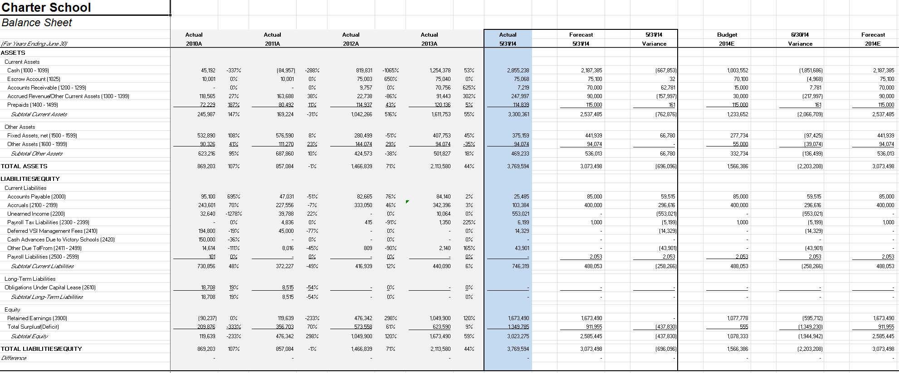
Reporting Example
@WeBoostED
Notes:
Profit and Loss Revenue
Per Pupil Revenue Allocation per Pupil; Money follows the child
State Specific Revenue
Federal Funding NCLB (Allocation determined by free/reduced lunch count), IDEA
SPED Funding Supplement Per Pupil for students receiving specialized services
Grants/Contributions – CSP
Other Income
Interest Income Money Market/Interest-Bearing Accounts
School-Based Activities Fund raising, bake sales, etc.
Food Service
Profit & Loss Expenses
Employee Salaries - Charter averages account for 65% of total costs
Employee Benefits
General/Administrative - Costs necessary to run the Admin office
Professional Services - Legal, Audit, Temp Staff
Direct Educational - Texts, Classroom Supplies
Operating/Maintenance - Costs to maintain building
School Admin Services - Management/Service Fee

Slide 11
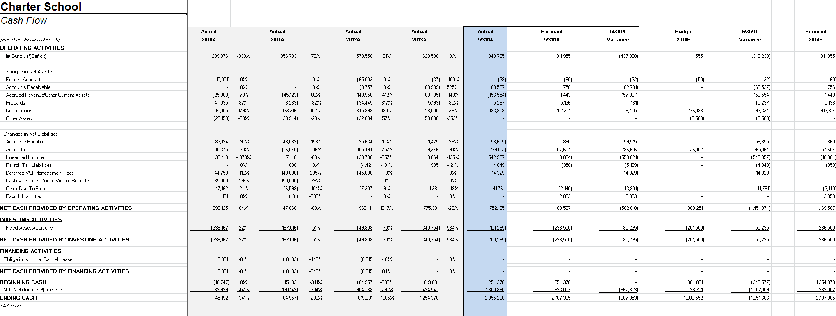
Reporting Example
@WeBoostED
Notes:
Profit and Loss Revenue
Per Pupil Revenue Allocation per Pupil; Money follows the child
State Specific Revenue
Federal Funding NCLB (Allocation determined by free/reduced lunch count), IDEA
SPED Funding Supplement Per Pupil for students receiving specialized services
Grants/Contributions – CSP
Other Income
Interest Income Money Market/Interest-Bearing Accounts
School-Based Activities Fund raising, bake sales, etc.
Food Service
Profit & Loss Expenses
Employee Salaries - Charter averages account for 65% of total costs
Employee Benefits
General/Administrative - Costs necessary to run the Admin office
Professional Services - Legal, Audit, Temp Staff
Direct Educational - Texts, Classroom Supplies
Operating/Maintenance - Costs to maintain building
School Admin Services - Management/Service Fee

Slide 12
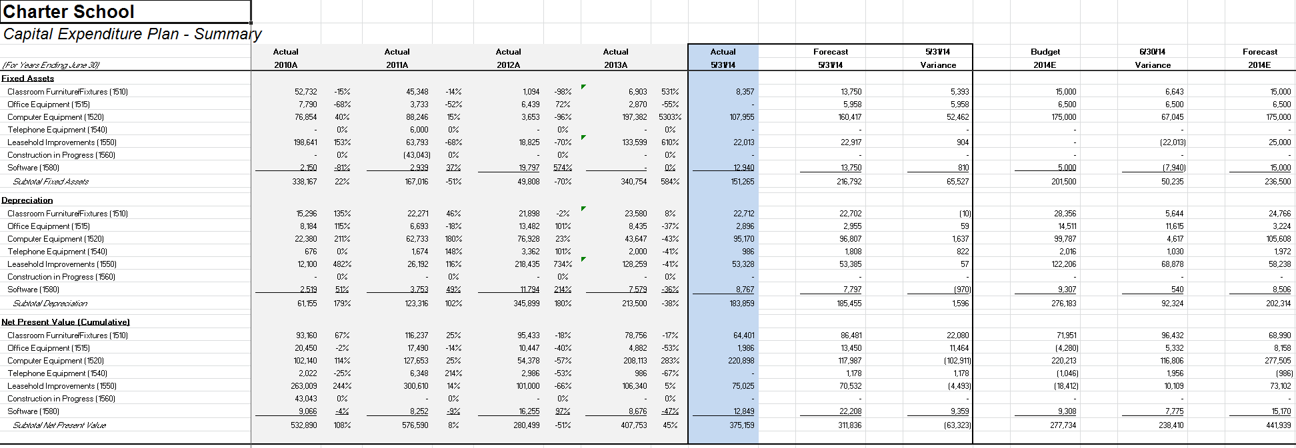
Reporting Example
@WeBoostED
Notes:
Profit and Loss Revenue
Per Pupil Revenue Allocation per Pupil; Money follows the child
State Specific Revenue
Federal Funding NCLB (Allocation determined by free/reduced lunch count), IDEA
SPED Funding Supplement Per Pupil for students receiving specialized services
Grants/Contributions – CSP
Other Income
Interest Income Money Market/Interest-Bearing Accounts
School-Based Activities Fund raising, bake sales, etc.
Food Service
Profit & Loss Expenses
Employee Salaries - Charter averages account for 65% of total costs
Employee Benefits
General/Administrative - Costs necessary to run the Admin office
Professional Services - Legal, Audit, Temp Staff
Direct Educational - Texts, Classroom Supplies
Operating/Maintenance - Costs to maintain building
School Admin Services - Management/Service Fee

Slide 13
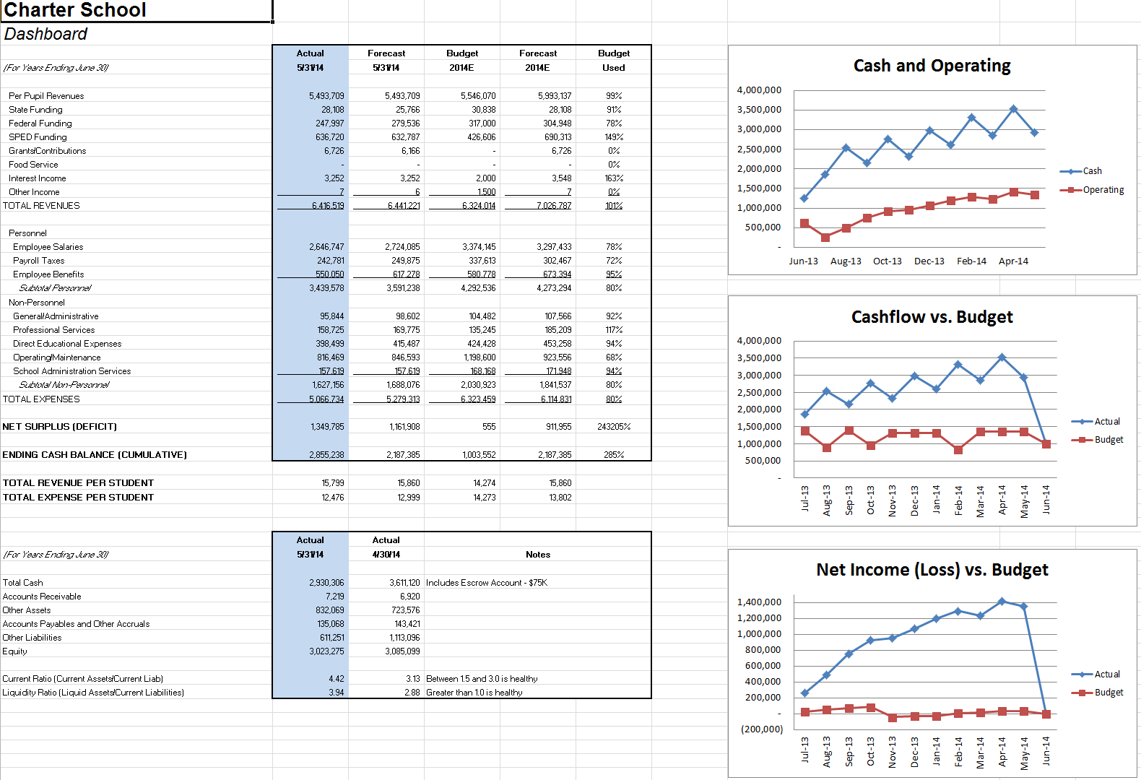
Reporting Example
@WeBoostED
Notes:
Profit and Loss Revenue
Per Pupil Revenue Allocation per Pupil; Money follows the child
State Specific Revenue
Federal Funding NCLB (Allocation determined by free/reduced lunch count), IDEA
SPED Funding Supplement Per Pupil for students receiving specialized services
Grants/Contributions – CSP
Other Income
Interest Income Money Market/Interest-Bearing Accounts
School-Based Activities Fund raising, bake sales, etc.
Food Service
Profit & Loss Expenses
Employee Salaries - Charter averages account for 65% of total costs
Employee Benefits
General/Administrative - Costs necessary to run the Admin office
Professional Services - Legal, Audit, Temp Staff
Direct Educational - Texts, Classroom Supplies
Operating/Maintenance - Costs to maintain building
School Admin Services - Management/Service Fee

Slide 14
Audit
@WeBoostED
After the June closing, the audit is scheduled (“field work”), typically for August/September
Auditors perform tests on the financial functions of the school as determined by the auditing and accounting standards
The auditors offer an opinion on the financial statements, unqualified or qualified

Slide 15
Case Study - RMA
@WeBoostED
Who was the school?
Why did they need a finance/accounting solution/team?
What were the key problems they faced?
How did BoostEd solve these problems?

Slide 16
Key Takeaways
@WeBoostED
Understand major functional areas of charter school finance
Understand why the audit takes place and its importance
Reporting! Reporting! Reporting!
Look at every financial situation/obstacle/hurdle as an opportunity to be more efficient

Slide 17
Thank you!
Contact Us:
JMoreau@WeBoostEd.com
212.786.7912
CGraham@WeBoostEd.com
212.786.7401
Follow Us:
@WeBoostEd
WeBoostEd.com

