Slide 1

Title Slide
California Charter Schools Association
2013 Annual Conference
Charter Working Capital
El Dorado County Superintendent of Schools
Research on the Landscape
Presented by Dr. Vicki Barber, El Dorado County Office of Education
Francie Heim, El Dorado COE
Lori Raineri, Government Financial Strategies
March 13, 2013

Slide 2

Agenda
Working Capital Need (Deferrals)
Working Capital Borrowing Options (Districts/Charters)
Legislative Solutions
El Dorado County Superintendent of Schools’ Research
Cost of Borrowing
Development of Credit Market for Charters
Closing

Slide 3
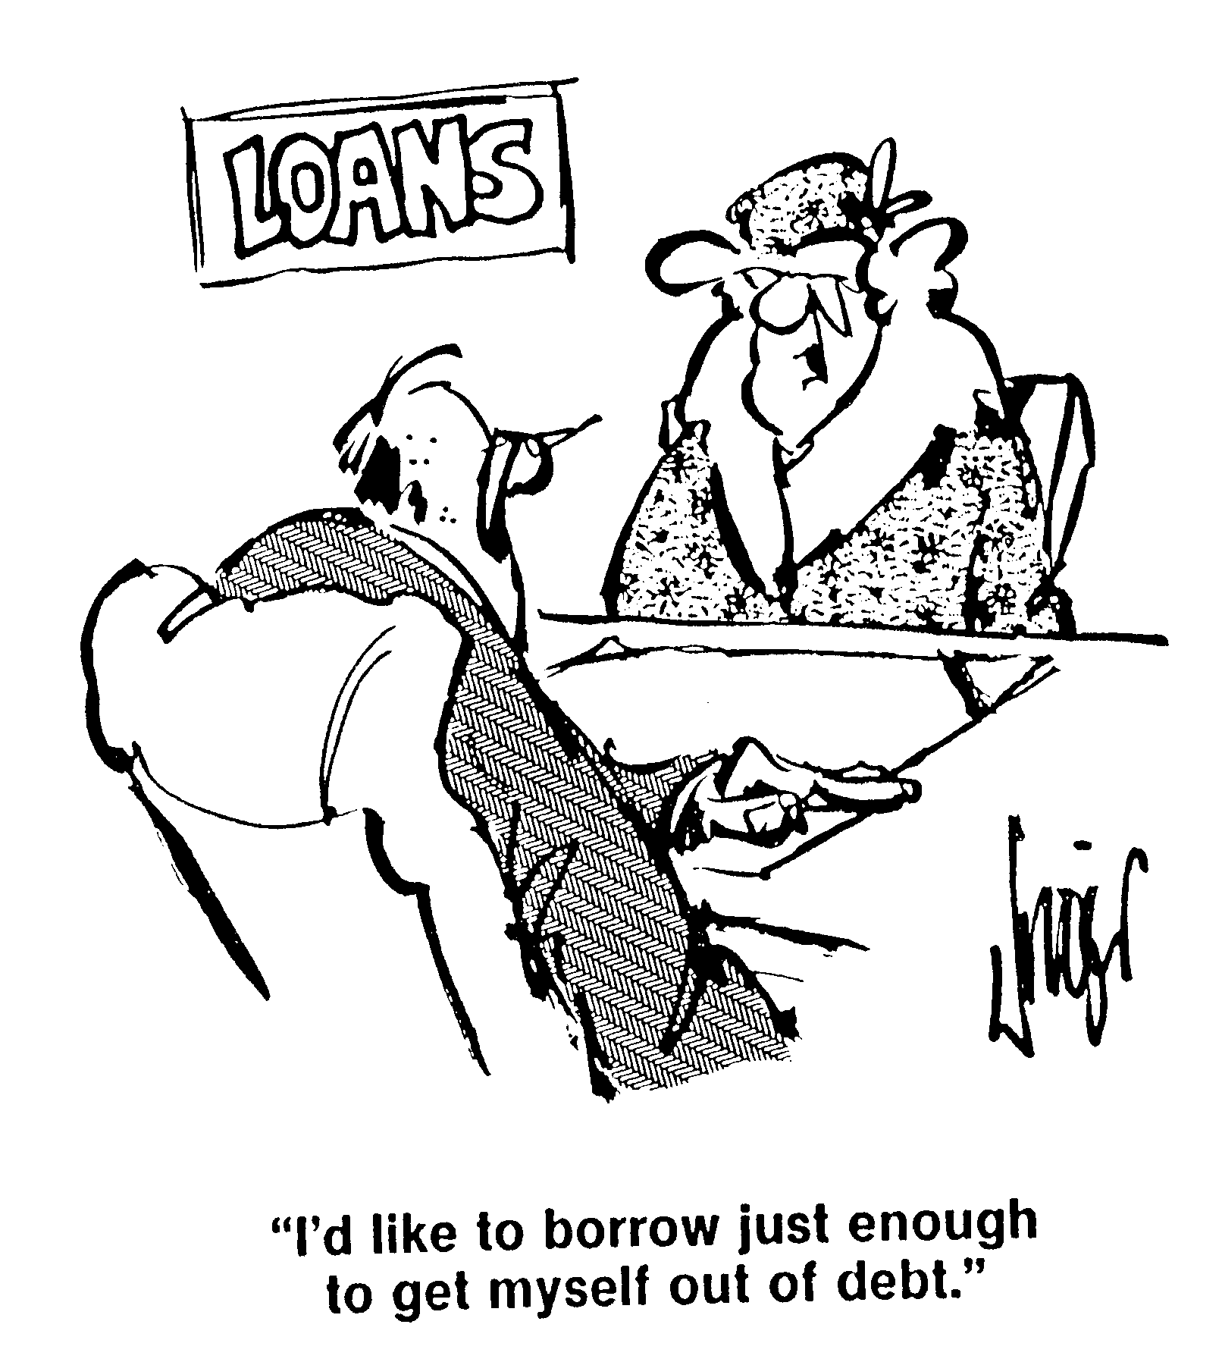
Working Capital Need

Slide 4
Working Capital Need
Deferrals

Slide 5
Deferrals –It’s getting better all the time…
Deferral Defined:
  Intrayear. State pays you late but within the fiscal year.
  Interyear. State pays you really late – next fiscal year.
  Some waivers possible – but doesn’t solve the problem
K-12 deferrals reduced by $2.2 billion in 2012-13
At the peak of deferrals, approximately 45% of state aid payments owed to school districts were deferred to the following year.

Slide 7
Deferrals Have An Unequal Impact
Charter A & B have equal ADA and funding rates.
Charter A is funded primarily on property taxes, as a result the impact of deferrals is minimal.
Charter B has limited property taxes and higher state aid, as a result the impact of deferrals is significant.

Slide 8
Cash Flow - Other
Deferrals are the primary reason for the current cash flow crisis
But each charter cash flow varies based on the ratio of property taxes to state aid
Operational expense outgo may not align with cash inflows
  e.g. A growing charter will incur more expenses but state aid doesn’t recognize the growth in ADA until February

Slide 9
Deferrals 2013-14
The Governor’s Budget (January proposal)
  $1.8 billion to eliminate some of the interyear deferrals
  End of 2013-14, $5.6 billion in deferrals still anticipated
  Conclusion:
  The Governor is committed to reducing deferrals.
  Will the legislature uphold that priority in a final budget?
  When will they disappear entirely?
  Bottom line – we still have cash flow needs.
  Stay tuned……………

Slide 10
Cash Borrowing Options
Districts versus Charters

Slide 11
District Options for Cash Borrowing
Inter fund borrowing (Education Code Section 42603)
Rate = County Treasury Rate (typically <1%)
Tax and Revenue Anticipation Notes (TRANS)
Rate = Varies but 1% to 2%
County Office of Education (EC 42621,42622)
Rate = Usually County Treasury Rate (typically <1%)
Borrowing from County Treasurer (EC42620)
Rate = Usually County Treasury Rate (typically <1%)

Slide 12
Charter Traditional Borrowing Options
Payment Terms with Vendors
Loans from
  Bank or Credit Union
  Authorizer
  Private party
  Community Development Finance Institutions
Issuance of Revenue Anticipation Notes
Sale of Receivables
Range of costs from 5% to 20%

Slide 13
New Legislation
opens the door for more options for charters

Slide 14
Charter Cash – New EC Language (2012-13)
SEC. 54. Section 47603 of the Education Code is amended to read:
47603. (a) This part shall not be construed to prohibit any private person or organization from providing funding or other assistance to the establishment or operation of a charter school.
(b) (1) A charter school may contract with a county superintendent of schools or a county board of education for purposes of borrowing moneys pursuant to subdivision (f) of Section 1042.
(2) Moneys borrowed pursuant to subdivision (f) of Section 1042 shall be expended by a charter school solely for purposes of meeting the cash management needs of the charter school due to the deferral of apportionment payments pursuant to Sections 14041.5, 14041.6, 14041.65, and 14041.7 and pursuant to Sections 16325, 16325.5, and 16326 of the Government Code and shall not be used for purposes of making capital acquisitions.
(c) This section shall become inoperative on July 1, 2017, and, as of January 1, 2018, is repealed, unless a later enacted statute, that becomes operative on or before January 1, 2018, deletes or extends the dates on which it becomes inoperative and is repealed.

Slide 15
Charter Cash – New EC Language (2012-13)
SEC. 51. Section 42621 of the Education Code is amended to read:
42621. The county superintendent of schools of each county, with the approval of the county board of education, may make temporary transfers to a school district or charter school that does not have sufficient money to its credit to meet current operating expenses from the county school service fund, in amounts and at times that the county superintendent of schools deems necessary. These transfers shall not exceed 85 percent of the amount of money accruing to the school district or charter school at the time of transfer. The amounts so transferred shall be repaid to the county school service fund before June 30 of the current year from any funds subsequently received by the school district or charter school.
SEC. 52. Section 42622 of the Education Code is amended to read:
42622. The county superintendent of schools, with the approval of the county board of education, may make an apportionment to a school district or charter school from the county school service fund conditional upon the repayment to the fund during the next succeeding fiscal year of the amount apportioned to the school district or charter school and, during the next succeeding fiscal year, shall transfer the amount of the apportionment from the general fund of the school district or charter school to the county school service fund.

Slide 16
Summary
  County offices of Education (COE) may make cash loans to charter schools
    COE (not an authorizer) may enter into a contractual agreement
    For cash flow due to deferrals, not for capital acquisition
    Authorization through July 2017
    Current County Superintendent of Schools authority to make transfers/advance apportionments to school districts is extended to charter schools as well.

Slide 17
El Dorado County Office of Ed
Testing the marketplace

Slide 18
Testing the Market Place
Assumption
  Start with a core group of charters
  History of strong leadership
  Track record of student achievement
  Solid financial expertise
  Balance sheet with strong net asset position
  Test the market place for competitive interest rates

Slide 19
El Dorado Charter Cash Options Corp.
“ECCO”
  Established by El Dorado County Office of Education
  Intended to provide a vehicle to bring charters together to the marketplace and influence borrowing options for charters
  Ability to coordinate intercept agreements
Explore Partnerships with other agencies
  E.g CA School Finance Authority
Coordinate an RFP (Request for Proposal)

Slide 20
CA School Finance Authority
The California School Finance Authority (CSFA) was created in 1985 to finance educational facilities and provide school districts and community college districts access to working capital. Since its inception, the Authority has developed a number of school facilities financing programs and most recently is focused on assisting charter schools to meet their facility needs.
The Charter School Facilities Program is a $900 million program that provides low-cost financing for charter school facilities. Projects will receive 50 percent of their costs in the form of a state grant, while the school is responsible for the balance of the project costs through either a lump sum matching payment or a long-term loan from the state.
The Charter School Facilities Credit Enhancement Grant Program is an $8.3 million program that serves to fund debt service reserves for the financing of acquisition, renovation, or construction of charter school facilities, or the refinancing of existing charter school facility debt.

Slide 21
Results of our RFP
Encouraging
  More vendors recognizing charters as a lending opportunity
  More competition means lower rates
Discouraging
  Rates still higher than those currently experienced by school districts
  School districts generally have higher reserves than charters (20%+)
  Charters can (and do) close operations and go out of business

Slide 22
Results of research

Slide 23
Research
Request for Proposal sent to 30 financial institutions and finance companies
Proposals received from 5 Teams
    Interviews and follow up discussions were held
What we learned
  Lenders with the most knowledge of charter credit had limited access to capital to lend.
    Couldn’t satisfy a large need or pricing was high.
  Lenders with best access to capital had least knowledge of charter credit.
    Pricing was high.
Notes:
Potential Providers who received RFP included:
Citi
First Southwest
JP Morgan
Ed Capital
LISC
NCB Capital Impact
Clearinghouse CDFI
Northern California Community Loan Fund
Low Income Investment Fund
Nonprofit Finance Fund
Charter School Capital
Green Campus Partners
Community Business Bank
Westhoff, Cone and Holmstedt
Bank of America Merrill Lynch
Capital One Bank
Transocean Funding
Sovereign Bank
Municipal Finance Corporation
Brandis Tallman
Municipal Services Group
Wulff Hansen & Co.
Merrimak Capital
GE Capital
KeyBank
Public Capital Corporation
Dexia Bank
CG Commercial Finance
Baystone Capital
Holman Capital

Slide 24
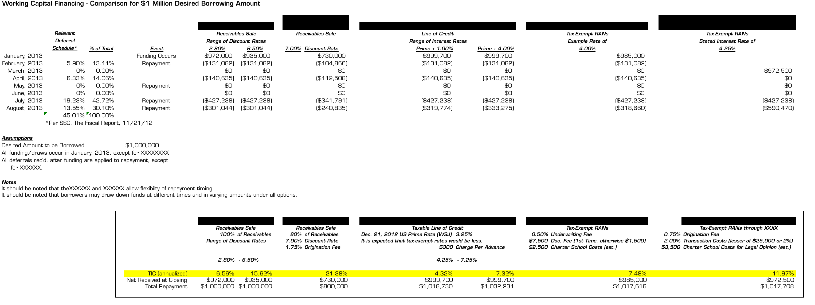
Cost for $1 M Borrowed: 4.32% - 21.38%
Timing of cash flow (in and out) is important
TIC or True Interest Cost is the real cost of borrowing

Slide 25
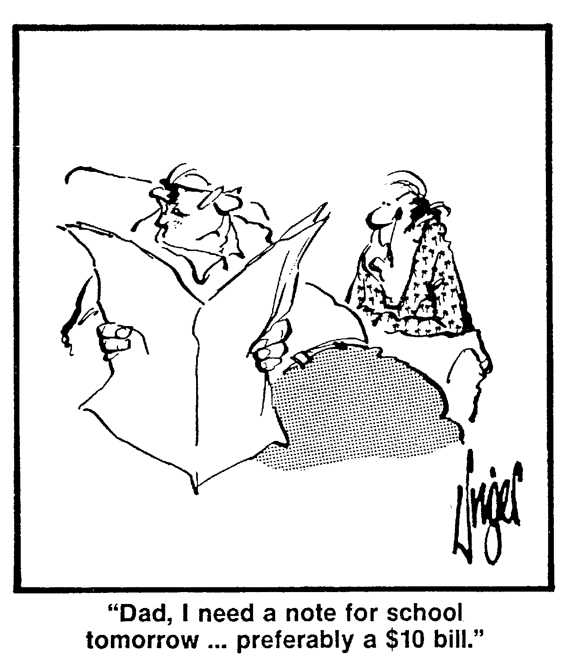
Charter Credit Is Hard to Understand

Slide 26
Bank Credit Analysis
Charter Credit
  Credit strengths often include:
    Growth in Accounts Receivable
    Increasing Days Cash on Hand
  Credit weaknesses often include:
    Operating losses
    Minimal Assets and Lack of Growth Trend in Assets
    Lack of Secondary Repayment Source
    Lack of Cash
    Current Ratio (Current Assets/Current Liabilities)
    Quick Ratio (Cash + Marketable Securities + Receivables)/Current Liabilities

Slide 27

Important Rating Agency Credit Factors
All three rating agencies, Standard & Poor’s, Moody’s and Fitch, have published credit rating criteria for charter schools and for short term ratings.
  Charter criteria are focused primarily on long term credit quality.
  Short-term credit is dependent on operating performance, revenue quality, cash flow projection reliability, and long term credit evaluation.
  The vast majority of rated short-term notes issued by State and local governments in the United States carry the highest short-term credit rating.

Slide 28
“Good” Commercial Credit Characteristics
Credit characteristics which are considered “good” fall into three categories:
  Short Term Liquidity (Cash Flow Statement)
  Capital Structure and Solvency (Balance Sheet)
  Operating Performance (Income Statement)

Slide 29
“Good” Credit Characteristics ≠ Charters
Short Term Liquidity
  Measured from Balance Sheet ratios; a public school dependent on State revenues or local property taxes usually monitors with a cash flow projection.
Capital Structure and Solvency
  Measured from the Balance Sheet by looking at the severity of debt claims on the cash flow; debt can pose the same threat for a charter school, though many are low debt. No equity, but Fund Balance.
Operating Performance
  Measured by margins and profit over a month, quarter or year. Public school operating performance may be better reflected over multiple years.

Slide 30
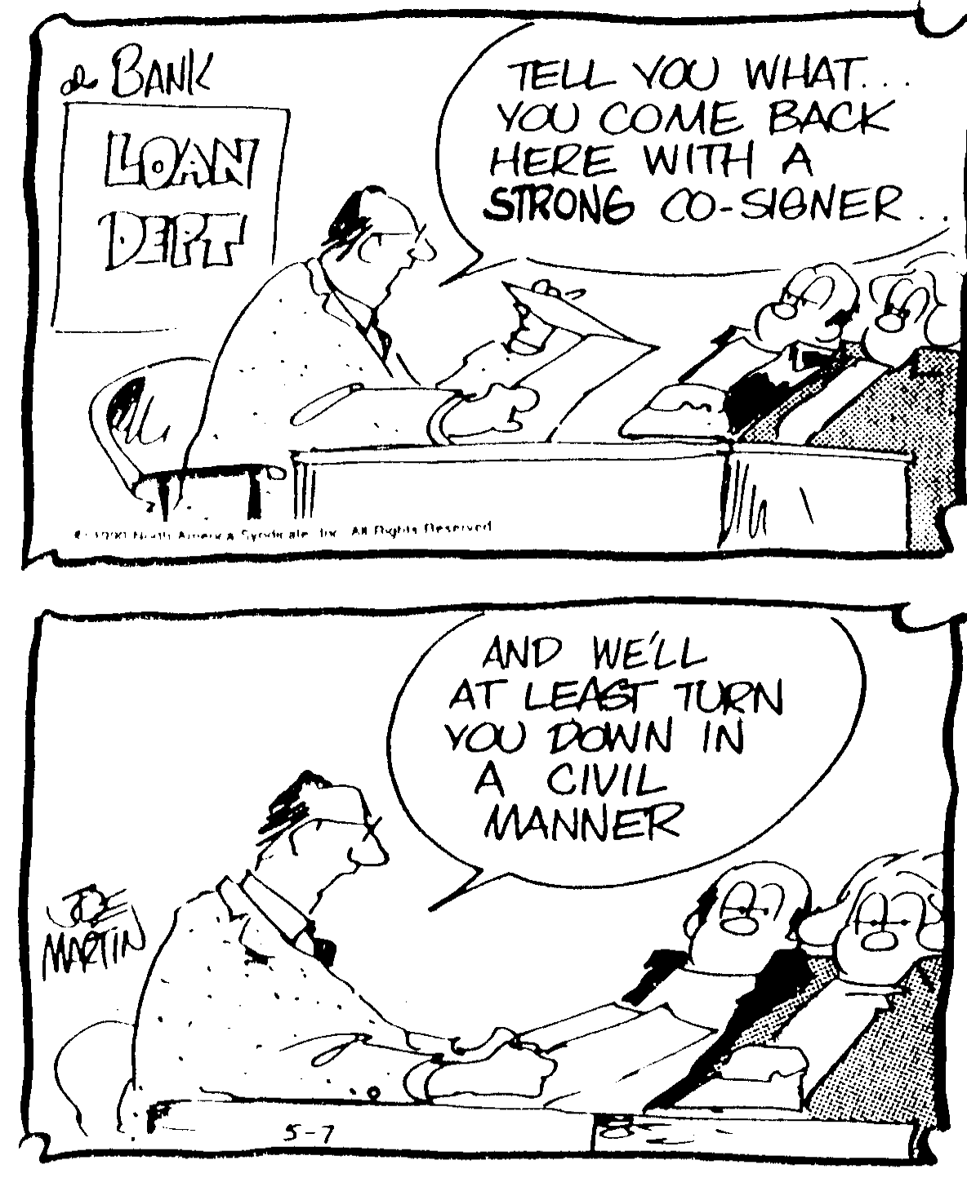
Credit Enhancement May or May Not Help
Information needs to be packaged for the user.

Slide 31
Revenue Quality
      “Revenues derived from other governmental entities, such as state aid funding, could exhibit historical volatility, especially in the face of an adverse budget climate, that could make timing and amount of future receipts uncertain.”
    Standard and Poor’s Criteria for Short-Term Debt
Sample charter schools rely on State revenue and suffer cash flow shortfalls from deferrals in similar proportions to school districts, but have important credit limitations related to potential failure and a lack of uniformity on other credit characteristics.
Still, CSFA State revenue intercept is an important credit feature.

Slide 32
How Can Charters Affect Their Credit?
  If charter schools don’t fit conventional credit standards (for business or for public agencies), what can be done to improve the fit and at what cost?
  Charter school lending market has information asymmetries.
  Is there revenue quality which can be measured differently?
  If so, will this result in improved access to capital?

Slide 33
Academic Evidence Supports Charters’ Exp.
“First . . . banks charge higher interest rates and finance relatively less creditworthy borrowers in market segments with greater information asymmetries.
Second, when faced with greater competition from outside lenders, banks reallocate credit toward more captured borrowers (flight to captivity).
Third, if borrower quality and captivity are sufficiently correlated, an increase in the competitiveness of uninformed lenders can worsen the informed lender’s overall loan portfolio.”
  Dell’Ariccia, Giovanni, and Robert Marquez, 2004, “Information and bank credit allocation,” Journal of Financial Economics, 72, pp. 185–214.

Slide 34
Price System is Not Working
Price system of capital allocation not working for charters
  Comparison to school districts, the most frequent issuer of Tax and Revenue Anticipation Notes, may be harmful
  Hospitals may be a better metaphor
Information asymmetries in the municipal market have historically been addressed by third party independent opinions of creditworthiness, i.e. rating agencies.
  Charter schools can work collectively to standardize cash flow projections and obtain short term credit ratings.

Slide 35
Development of Credit Market for Charters
Information is the traditional answer to an information problem.
  Investing in charters occurs through private placements, public offerings, and commercial lending.
  An education effort about short term charter credit could be directed to each of these markets.
  Certification of credit via credit rating has value.

Slide 36
Education and Certification
Collective Effort to Focus on Short-Term Credit
  Education effort
    Demonstrate the value of charter credit through agreed improvements in timely and complete financial reporting including presentation of financial ratios and trends, use of a web site to provide downloadable information (perhaps even comparisons), road shows, and investor calls.
  Certification of credit via credit rating
    Address the 3 rating agencies to make short term credit criteria more specific and the highest short term credit ratings attainable
Both of these have been pursued by individual charter schools for individual benefit.

Slide 37
Next Steps
Charters need to get better at managing cash, cash flow reporting, and analyzing true cost of borrowing
Marketplace needs to become better educated about charters

Slide 38
Quality Cash Projections Are Key
The projections need to be:
  Accurate
  Flexible
  Well-documented
Not as easy as it sounds, especially given…
  Limited need / experience preparing accurate cash projections.
  Timing concerns (e.g., May revision, adopted charter budget, adopted State budget).

Slide 39
Common Problems
Apportionment deferrals not included / up to date.
Use of prior year receipts / disbursements as template can be inaccurate.
Cash vs. Revenue
  Individual monthly entries should reflect changes in cash, not accounting revenue and expense.
How to handle prior year receipts / disbursements?

Slide 40
Cash Flow Projection Checklist
Tie beginning cash figures to Audit
  Document discrepancies (e.g., revolving cash).
Design spreadsheets to be flexible
  Separate table with apportionment deferral % which can be adjusted to reflect new deferrals from the State.
Document assumptions on spreadsheet (use comments)
  Budget version used as starting point.
  Apportionment deferrals included.
  Impact of potential carryovers.
Update cash flow projections monthly

Slide 41

Banking Relationship Checklist
How Well Do You Know Your Banker?
  Does Your Local Banker Have Lending Authority?
  Does Your Bank Issue Credit Cards?
  What Services Can Your Bank Offer?
  How are Services Priced?
How Well Does Your Banker Know You?
  Obtain Input from Your Banker on Credit Information They Review
  Match Audit Engagement Requirements to What Your Banker Wants to See
  Review Charter Financials with Banker at Least Once a Year
Basic Services • Checking account • Business savings account • Credit card • Deposit-only card • Discounted employee checking accounts • Online banking
Lending Services • Lines of credit • Term-loans • Commercial real estate • Equipment leasing • SBA loans
Cash Management • Wire transfers • Wholesale lockbox • Merchant services
Other • Payroll • Retirement accounts • Insurance • Discounts with other vendors

Slide 42

Conclusions
Strong cash flow management and borrowing skills are growing among charter schools – but there is room for improvement.
We need to do a better job of educating the financial lending institutions about charter schools.
Charter schools will benefit from cooperative efforts to approach the marketplace in a “united front”.
  This would result in a change on the “demand-side”.

