Slide 1
October 2012
How Do We Know if a Charter School is Really Succeeding? – Various Approaches to Investigating School Effectiveness
Missouri Charter Public Schools Association 2012 Conference
Presented By:
Otoniel Lopez
Jing Zhu

Slide 2
Presentation Outline
Introduction
Why data and evaluation?
Evaluation components
Impact/outcome studies
Implementation studies
Choosing the right design

Slide 3
Metis Associates
National applied research and consulting firm (New York City, Philadelphia, Atlanta)
Over 35 years of expertise in research/evaluation, grants development, and information technology
Focus areas: K-12 Education, higher education, children and family services, youth development, juvenile justice, etc.
Conducted six evaluations of two charter school programs spanning six years

Slide 4
Why data and evaluation?
Demonstrate program impact
Identify successful practices and challenges
Assess overall program fidelity
Engage key stakeholders
Facilitate the daily management of the grant
Inform programmatic decisions
Fulfill federal and state reporting requirements

Slide 5
Evaluation Components
 | Purpose | Data sources and methods
Impact/ Outcome Study | Assess program impact on: Academic performance Customer impact and satisfaction | Statistical analyses Review of school characteristics and their association with outcomes Stakeholder surveys Analysis of demographic, program participation, academic achievement and attendance data
Implementation Study | Assess implementation regarding: Program fidelity Promising practices, challenges and lessons learned | Review of project documentation Interviews with project staff and partners Observations of cross-school activities

Slide 6
Impact Study Designs (I)
Randomized controlled trial (RCT)
The gold standard
Random assignment of students, classes or schools
A number of long-standing concerns (e.g., ethical, logistical, and financial)
Attrition and other issues

Slide 7
Impact Study Designs (II)
Quasi-experimental design (QED)
Need for a comparison group
Naturally occurring
Statistically well-matched
Common matching characteristics (baseline achievement, gender, race/ethnicity, ELL status, poverty status, etc.)
Assess baseline equivalence of two groups
Cannot control for potential unobserved differences between groups

Slide 8
WWC Study Ratings
The What Works Clearinghouse (WWC)
Initiative of the U.S. DOE’s IES
Started in 2002, reports since 2005
Three possible study ratings
Meets WWC Evidence Standards without Reservations (RCT with low attrition)
Meets WWC Evidence Standards with Reservations (RCT with high attrition OR QED; must establish baseline equivalence)
Does Not Meet WWC Evidence Standards

Slide 9
Rigorous Charter School Evaluations
RCT studies
Random lottery (oversubscription to enrollment)
Gleason, P., Clark, M., Tuttle, C. C., & Dwoyer, E. (2010). The Evaluation of Charter School Impacts: Final Report.
Dobbie, W., & Fryer, R. G., Jr., (2009). Are High-Quality Schools Enough to Close the Achievement Gap? Evidence from a Social Experiment in Harlem.
QED studies
Statistical matching of students
Center for Research on Education Outcomes. (2011). Charter School Performance in Indiana.
Center for Research on Education Outcomes. (2010). Charter School Performance in New York City.

Slide 10
Two Popular Qualitative Methods in Impact Studies for Charter Schools
Survey Research
Capture experience of participants
Provide quantifiable data that can be used in associating that experience with other hard data (e.g., student achievement)
MEASURE changes in perceptions overtime
Observations
ASSESS instruction using quantitative tools developed from a set of standards or known best practices
QUANTIFY a set of items or behaviors within a school or classroom

Slide 11
Implementation Studies
Assessment of program fidelity
Question of resources and capacity
Are intended populations being reached?
Are services appropriate?
Alignment of outcomes and implementation
Logic model

Slide 12
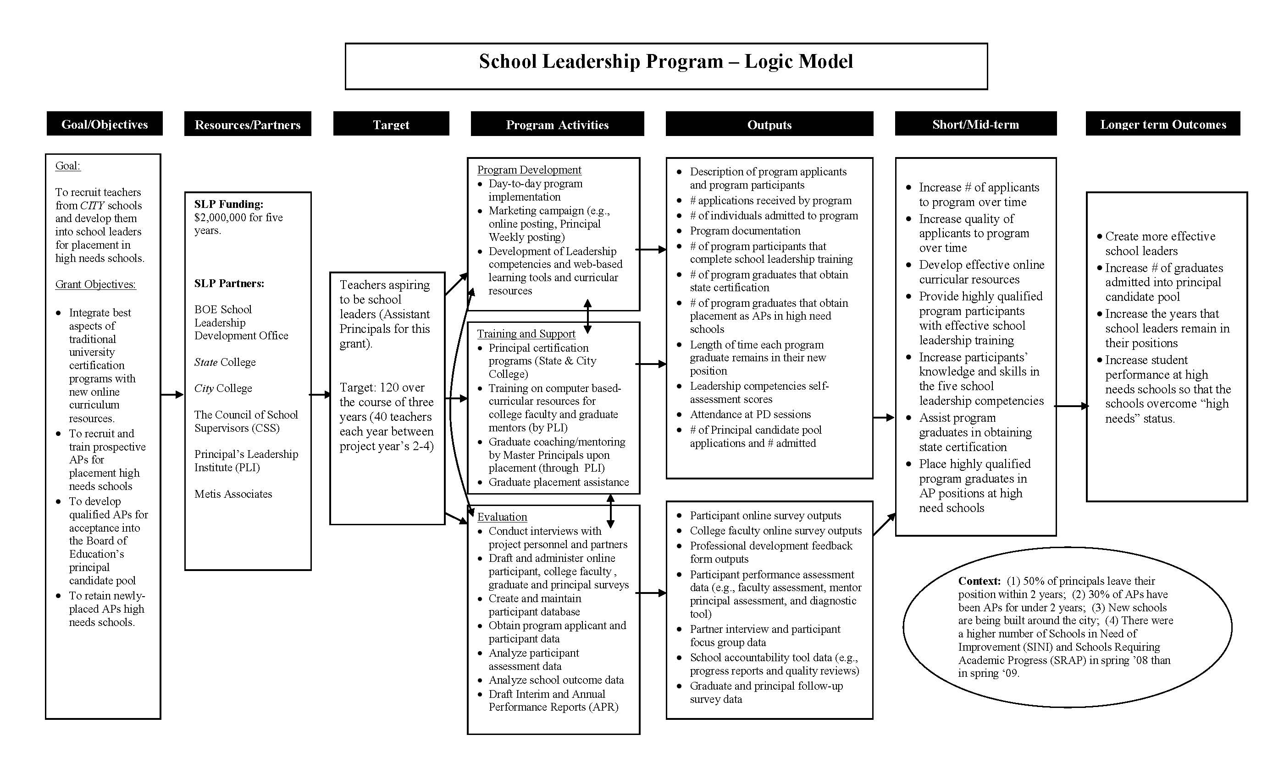
Logic Model

Slide 13
Methods for Collecting Implementation Data
Interviews with key personnel
Focus Groups with a set of individuals closely tied to the particular program (e.g., teachers)
Observations of instruction, faculty meetings, or school walkthroughs
Some survey research
Collection of program documentation

Slide 14
Advantages of Implementation and Outcome Components
Implementation:
Provides ongoing data (i.e., formative)
Provides a real-world look at what is actually going on at a school
Does not require long periods to gather useful information
Doesn’t require a comparison group
Outcome:
Measures program impact
Can provide an evidence base
Provides useful information to policy makers

Slide 15
One Size Doesn’t Fit All
Complex designs vs. point-in-time descriptive studies
Balancing design approaches in current economic climate
Before identifying right fit:
Use of theories of change, logic models, information systems and self-evaluation to inform research.

Slide 16
Evaluation Resources
What Works Clearinghouse (WWC) Official Website (http://ies.ed.gov/ncee/wwc/)
American Evaluation Association Online Resources (www.eval.org/resources.asp)
American Education Evaluation Association (www.aera.net)
Kellogg Foundation (http://www.wkkf.org/knowledge-center/publications-and-resources.aspx)
W.K. Kellogg Foundation Logic Model Development Guide
W.K. Kellogg Foundation Evaluation Handbook
The Evaluator’s Institute (http://tei.gwu.edu/faculty.htm)
Rossi, P. H., Lipsey, M. W., & Freeman, H. E. (2004).Evaluation: A Systematic Approach. (7 ed.). Thousand Oaks: Sage Publications, Inc.

Slide 17
Otoniel Lopez
olopez@metisassociates.com
Jing Zhu
jzhu@metisassociates.com

