Slide 1
I’m in the Principal’s Seat, Now What? Allan R. Bonilla, Ed.D coaching4educators.com

Slide 2
Strategies to Get Us to Exemplary Schools
STRUCTURED VISIBILITY
DELEGATION to COLLABORATION to CHANGE
SCHOOL BASED MANAGEMENT/SHARED DECISION MAKING
CELEBRATION
CULTURE & CLIMATE

Slide 3
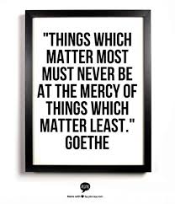
Johann Wolfgang von Goethe 1749-1832

Slide 4
STRUCTURED VISIBILITY
What’s my plan?
AM & PM
Walkthroughs
Hallways
Lunch
Activities

Slide 5
Thoughts on Visibility..

Slide 6
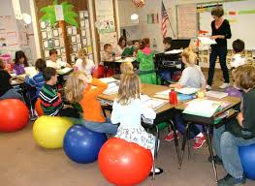
Letter to a principal Justin Tarte, St.Louis, Missouri www.justintarte.com
“Will you please come to our classrooms more often? We are really doing some awesome, innovative and creative things with our students, and we would love to share our experiences and successes with you and your staff.”

Slide 7
SMART DELEGATION
Strengths
Talents
Likes
What do I like to do?
What am I good at?

Slide 8
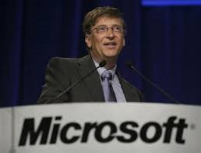
Bill Gates
“As we look ahead into the next century, leaders will be those who empower others”.

Slide 9
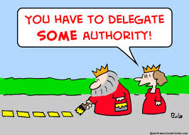
Thoughts on Delegation..

Slide 10
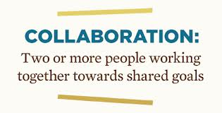
COLLABORATION
Smart Delegation Leads to Cohesive Collaboration….

Slide 11
School Based Management/Shared Decision Making
Sign-up/area of interest
Budget
Curriculum
Personnel
Discipline
Social
General monthly meeting/reports

Slide 12
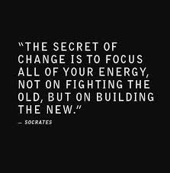
CHANGE
Attendance
Block Schedule
Middle School Conversion
SARP
Uniforms
Report Cards

Slide 13
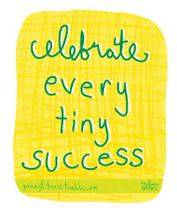
CELEBRATION
“CELEBRATE WHAT YOU WANT TO SEE MORE OF”
Tom Peters, author of In Search of Excellence
What do you want to see more of?

Slide 14
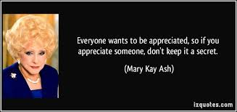
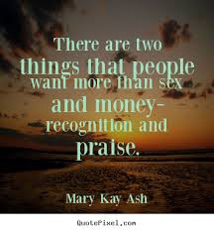
Mary Kay Ashe Inspirational Business Leader/Founder of Mary Kay Cosmetics

Slide 15
Teachers, Students, Parents
Attendance
Honor Roll
TV
Birthdays
Holidays
Student of the Month
Milestones

Slide 16
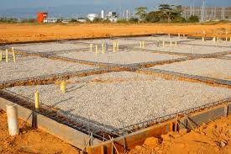
CULTURE & CLIMATE
The foundation upon which everything is built.

Slide 17
Diane Ravitch, Reign of Error
“Genuine school reform must be built on hope, not fear; on encouragement, not threats; on inspiration, not compulsion; on trust, not carrots and sticks; on belief in the dignity of the human person; not a slavish devotion to data; on support and mutual respect, not a regime of punishment and blame. To be lasting, school reform must rely on collaboration and teamwork among students, parents, teachers, principals, administrators and local communities.”

Slide 18
How Important is it?
Rethinking Principal Evaluation (NAESP/NASSP) https://www.naesp.org/rethinking-principal-evaluation
Culture…one of six domains
George W. Bush Institute
“Forty-Three states include developing a positive school culture in their standards for principals”. http://www.bushcenter.org/george-w-bush-institute

Slide 19
New Positions..Interested?
Dean of School Culture/Achievement First
http://www.achievementfirst.org/
Connecticut, New York, Rhode Island
25 schools in five cities.
Director of School Climate/ Baltimore Public Schools
http://www.baltimorecityschools.org

Slide 20
Job Description
The Dean of School Culture models how to build strong, mutually respectful relationships with students and families and supports teachers to do the same.
The Director of School Climate provides oversight in the development of school climate improvement strategies.

Slide 21
Take a moment to Reflect
What do I do to focus on teachers?
What do I do to show I care about students?
How am I showing my interest in parents?
In what areas am I a role model for faculty and students?
In what ways are we receiving feedback from parents, students, and faculty?
How are we making our school a happy place?
How do we set the tone and walk the talk?
( from “I’m in the Principal’s Seat, Now What?” p.10-11)

Slide 22
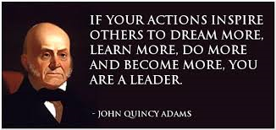
John Quincy Adams 6th US President

Slide 23
I’m in the Principal’s Seat, Now What? The Story of a Turnaround Principal

Slide 24
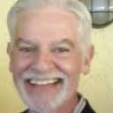
Contact information Allan R. Bonilla
http://www.linkedin.com/pub/allan-r-bonilla-ed-d/4/198/42/
www.mentoringeducators.com
abonilla1@yahoo.com

