Slide 1
key components for successful schools
Critical success factors
Lorna.bonner@region10.org

Slide 2
OBJECTIVES
IDENTIFY CRITICAL SUCCESS FACTORS AND THEIR IMPORTANCE FOR SCHOOL SUCCESS
REVIEW RESEARCH ON CRITICAL SUCCESS FACTORS AND THE FRAMEWORK FOR THE TAIS PROCESS
PLAN STRATEGIES FOR IMPLEMENTATION OF CRITICAL SUCCESS FACTORS

Slide 3
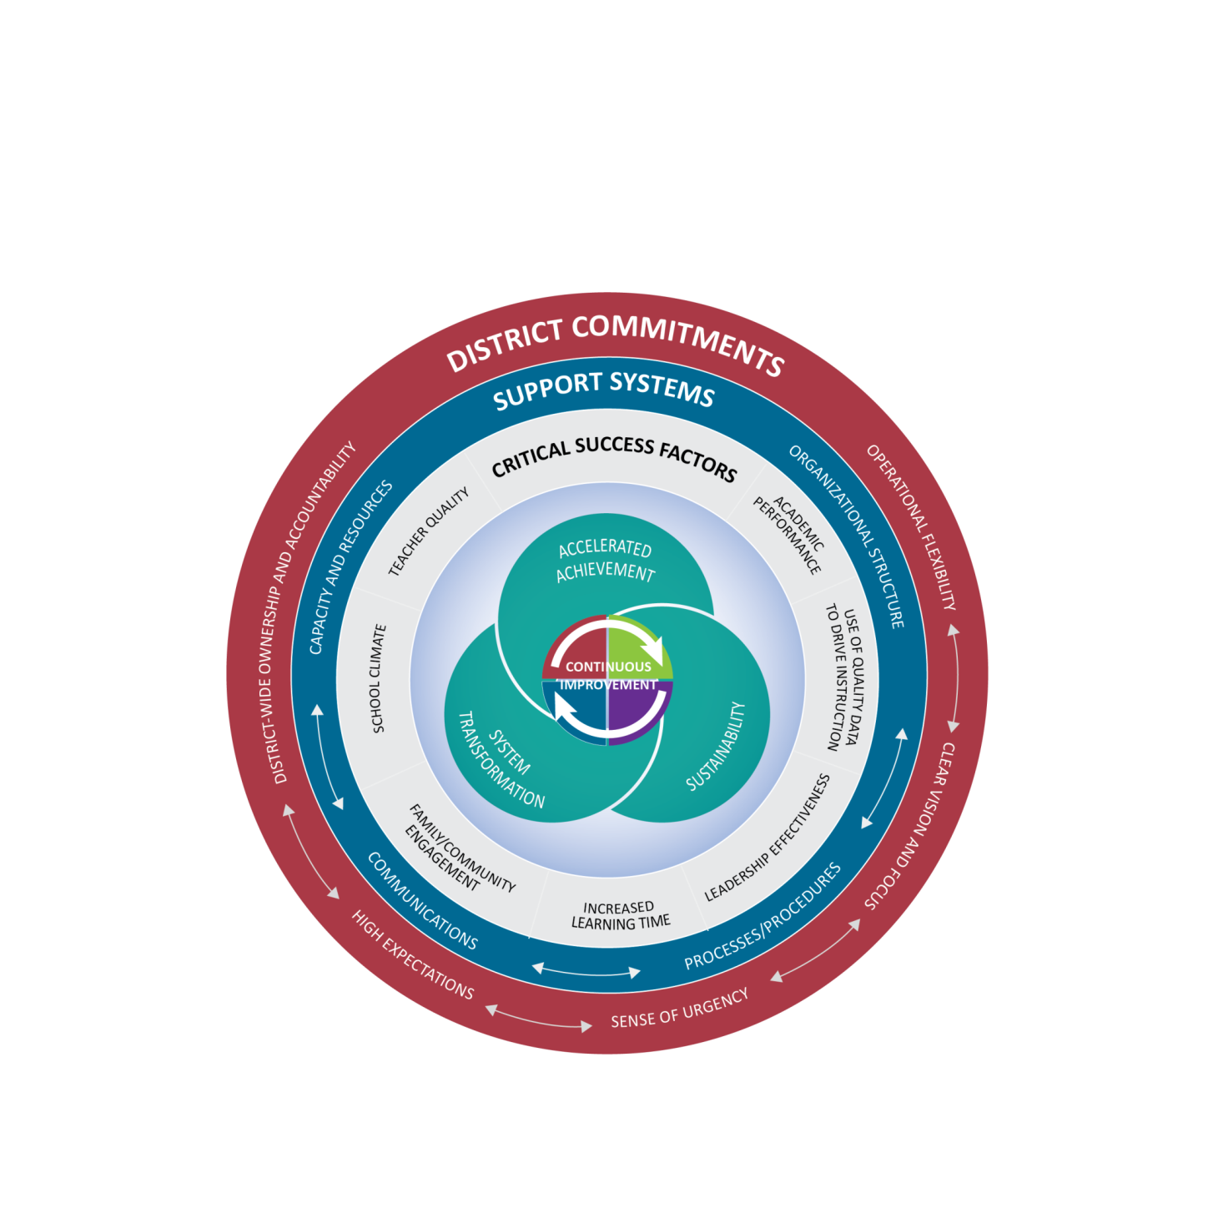
Framework for District and School Improvement
What are the essential foundations for success?
Notes:
TAIS PROCESS-
The State Framework
The Framework for District and School Support along with Texas Accountability Intervention System are a research based approached to school improvement that engages the district and school in the improvement process. The framework outlines five systemic components regarding district-level commitments, four support system components to be implemented at both the district and campus levels, and seven factors know to be critical to campus success. Planning for continuous improvement through the lens of these District Commitments, Support Systems and Critical Success Factors will result in the outcomes of accelerated achievement, sustainability, and system transformation.
The Framework for district and school support was developed collaboratively between the TEA and TCDSS. Local ESCs continue to develop tools and support for districts and campuses that align with framework that drives continuous improvement.

Slide 4
Key Components of a Successful school
Review the following on your campus:
Interventions
Resources
How are they customized for the campus?

Slide 5
CRITICAL SUCCESS FACTORS
Leadership
Effectiveness
Increase Learning
Time Teacher Quality
Quality Data to Drive School Climate
Instruction
Academic Family & Community
Performance Engagement
Notes:
GROUP DISCUSSION ON HOW THESE FACTORS IMPACT SCHOOLS/DISTRICT
Fill in the blank worksheet-Mach Critical Success Factor to Milestones
Share Milestones ask participants to hold up name of Critical Success Factor- Match Activity

Slide 6
Critical Success Factors | CSF 1: Academic Performanc | CSF 2: Use of Quality Data to Drive Instruction | CSF 3: Leadership Effectiveness | CSF 4: Increase Learning Time | CSF 5: Family and Community Engagement | CSF 6: School Climate | CSF 7: Teacher Quality
List all data sources used for each CSF
NOTES
Notes:
Facilitator: Set up activity with groups. The purpose of this activity is to collaboratively identify the data sources campuses/districts are already collecting around each CSF.
Share handout on Critical Success Factors

Slide 7
Add critical success factors to improve your district/campus?
How can….
Notes:
Group discussion

Slide 8
Critical success factors
Review possible questions to consider
Action to be taken
What are the steps you will need to take

Slide 9
Food for thought:
“Strive for continuous improvement, instead of perfection.” Kim Collins
“ Without continual growth and progress, such words as improvement, achievement, and success have no meaning.” Benjamin Franklin

Slide 10
RESOURCES
www.tcdss.net
www.taisresources.net/
www.region10.org/capacity-building-initiative

