Slide 1
Florida Charter School Conference
Understanding the Requirements of Title I, Part A
November 15, 2012
Caribe Royale
LaTrell Edwards, Florida Department of Education
Anna Moore, Florida Department of Education
Ernesto Lontoc, Palm Beach County Public Schools
Jessica Swere, Hillsborough County Public Schools
Dr. Ruth Jacoby, Somerset Academy, Inc.

Slide 2
AGENDA
Welcome and Introductions
Title I History
Program Models
Allocations and Set-Asides
Parental Involvement

Slide 3
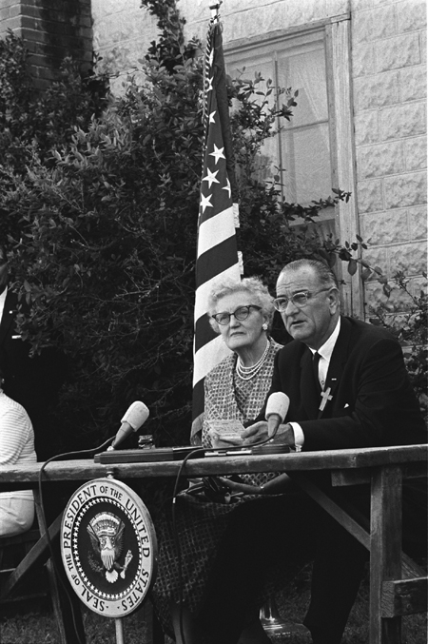
1965 – The First Title I
Sitting next to his first teacher, President Johnson signs the Elementary and Secondary Education Act of 1965 on April 11, 1965.

Slide 4
Title I - A Brief History
1965 – ESEA originally passed
Reauthorized with different “nicknames”
1994 – Improving America’s School Act (Title I)
2001 – No Child Left Behind
Modified through regulations and new funding
2008 – New Regulations – CFR 200
2009 – Title I ARRA funding
2011 – ESEA Flexibility Waivers
Reauthorization???

Slide 5
Purpose of Title I
Increase the achievement of all students, particularly those who are disadvantaged.
Ensure all children have fair, equal, and significant opportunity to obtain high quality education
Reach, at minimum, proficiency on challenging state standards & assessments (reading, mathematics, and readiness)

Slide 6
Federal Funds Supplement State and Local Support
Title I, Part A provides federal dollars to help supplement educational opportunities.
Funds flow to SEAs then to LEAs and finally to Title I schools.

Slide 7
Title I Program Models

Slide 8
Title I Program Models
Targeted Assistance
Section 1115
Eligible Students
Targeted Resources
Schoolwide
Section 1114
Needs Assessment
Schoolwide Plan

Slide 9
Targeted Assistance Model
School poverty level must be below 40%
Eligibility
Criteria
Delivery Models

Slide 10
Targeted assistance programs must…
Supplement the core curriculum
Use HQ instructional staff
Provide professional development
Increase parent and family engagement
Coordinate with other programs and provide transition services from Pre-K to elementary grades

Slide 11
Schoolwide Model
Student poverty level must be at or above 40%
More flexible than a targeted assistance program

Slide 12
Schoolwide Planning Cycle
Conduct a CNA
Develop and implement the schoolwide plan
Annually evaluate and modify the plan based on the evaluation

Slide 13
Allocations and Set-Asides

Slide 14
Determining School Allocations
LEA Responsibility
How are schools selected?
How are funds distributed to schools?

Slide 15
Title I Set-Asides
Set-asides are amounts used at the LEA level before allocating funds to schools; some are required, others are optional.

Slide 16
Title I, Part A Set-Asides
Administration (optional, as needed)
Maintain Highly Qualified Status of Teachers and Paraprofessionals*
Parent Involvement*
Homeless Students

Slide 17
Title I, Part A Set-Asides
Neglected & Delinquent Students (required, amount optional)
LEA-Wide Activities*:
Instructional Activities and Professional Development (optional)
Professional Development for Priority and Focus Schools (optional)
SES*

Slide 18
Supplement Not Supplant
Federal funds must be used to “supplement, not supplant” services, staff, programs, or materials that would otherwise be paid with state or local funds (and, in some cases, other federal funds).
Always ask: “What would have happened in the absence of federal funds?”

Slide 19
Parental Involvement

Slide 20
How are Parents Involved in Decisions?
Parents must be involved in the Title I program by assisting the schools with decisions about:
How Title I funds will be used (SAC)
The development of plans

Slide 21
Parent Notification Requirements
School and LEA Parent Involvement Policies
[NCLB Section 1118(a)(2) and (b)(1), Parent Involvement Guidance, C-3 and C–4 (district), and D-1 (school)]
Compact
[NCLB Section 1118(d)], Parent Involvement Guidance D-8]
Annual Report Cards
[NCLB Section 1111(h)(1) and (2), Parent Involvement Guidance, B-5 (State) and C-7 (District)]
Individual Student Assessment
[NCLB Section 1111(h)(6)(B)(i), Parent Involvement Guidance, D-10]

Slide 22
Parental Involvement Requirements
Annual Meeting
Policies that require parent input
LEA level
School level
School Improvement Plan
Parent-School Compact
Specific parental notifications
SES
Choice-Related Transportation

Slide 23
Title I Parental Involvement Plan
School Parent Involvement Policy is:
Written
Agreed upon by parents
Describes the means for carrying out parent involvement activities at the school level
Distributed to parents, and the local community, in a format and language, to the extent practicable, that parents can understand

Slide 24
Parent-School Compact
Describe the school’s responsibility to provide high-quality curriculum and instruction in a supportive and effective learning environment
Identify ways in which parents will be responsible for supporting their children’s learning
Must be discussed at a parent-teacher conference for elementary aged students

Slide 25
Parent’s Rights
Curriculum being used
State’s standards and expectations
Child’s level of achievement
Request and receive notice regarding the qualifications of child’s teacher
Be informed if their child is taught be a non-highly qualified teacher for four or more consecutive weeks

Slide 26
Questions?

Slide 27
Contact Information
LaTrell.Edwards@fldoe.org
Anna.Moore@fldoe.org
850-245-0479
bfep@fldoe.org

