Slide 1

“Working with your Authorizer to get from Approved to Open!”
Presented by members of the
Florida Association of Charter School Authorizers (FASCA)

Slide 2
Agenda
COMMUNICATION
GOVERNANCE
FUNDING & FINANCE
DEVELOPMENT
OPERATIONS
SCHOOL OPERATOR TESTIMONIALS
PANEL DISCUSSION

Slide 3


Slide 4

Understand District rules and expectations
Create and maintain open lines of communication
Foster an environment of mutual cooperation

Slide 5


Slide 6

Non-profit corporation
Transition from a Founding Board to a Governing Board
Defined organizational structure
Background Clearance/Screening
New Applicant and Governance training
Roles and responsibilities:
  Governing Board
  Education Service Provider (ESP)
  Employees
Principal search and appointment

Slide 7


Slide 8

Revised financial projections
REAL Grants & other fundraising opportunities

Slide 9


Slide 10

Develop a “realistic” timeline and schedule for opening:
  Implement and/or revise student recruitment plan (marketing and advertising)
  Finalize student enrollment timeline
  Recruit and hire staff
  Formalize academic program
  Procure and finalize all goods and services

Slide 11
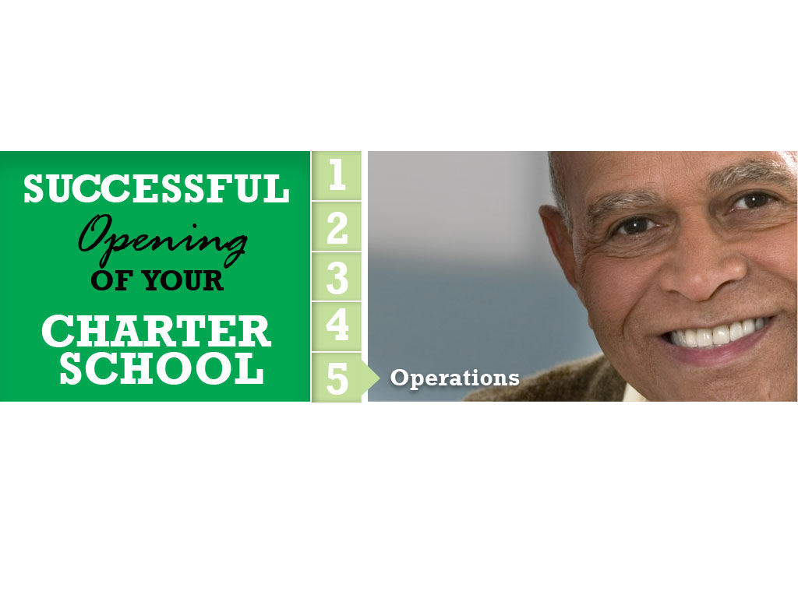

Slide 12

Charter Contract Negotiations (official approval to operate)
Business and contractual relationships
Facility identification, preparation and acquisition (Plan A & Plan B)
School Policies and Procedures Development (ongoing and continuous)

Slide 13
Testimonials
Ms. Sonia Lopez
Alpha Charter of Excellence (ACE)
1217 S.W. Fourth Street
Miami, FL 33135
Kindergarten through grade 5
Ms. Zenobia Cann
W.E. Phillips Learning Academy
2506 S. Parsons Avenue
Seffner, FL 33584
Kindergarten through grade 5

Slide 14
A Panel Discussion
Christopher Bernier
  Orange County Public Schools
Juanita Edwards
  Palm Beach County School District
Jenna Hodgens
  Hillsborough County Public Schools
Tiffanie Pauline
  Miami-Dade County Public Schools
Nancy C. Scowcroft
  Pasco County School District
Kia Sweeney Scott
  Orange County Public Schools

